Slide 1
DClinPsy
systematic
review workshop
Paul Cannon
College Librarian Medical, Veterinary & Life Sciences
paul.cannon@glasgow.ac.uk
@pcann_LIS
http://orcid.org/0000-0001-8721-1481
Photo by rawpixel on Unsplash

Slide 2
Refining a research and search question
Developing inclusion and exclusion criteria
Database selection
Scoping searches
Search terms, search syntax and subject headings
Practical database searches
Saving searches and exporting results to reference management software (i.e. EndNote)
PRISMA reporting guidelines
Critical appraisal tools
We will be covering…

Slide 3
PICO Used for: Evidence-based medicine http://dx.doi.org/10.7326/ACPJC-1995-123-3-A12 | SPICE Used for: Evaluating projects or interventions http://dx.doi.org/10.1108/07378830610692127 | SPIDER Used for: Qualitative or mixed methods http://dx.doi.org/10.1177/1049732312452938 | ECLIPSE Used for: Evaluating services http://dx.doi.org/10.1046/j.1471-1842.2002.00378.x
Population / patient | Setting | Sample | Expectation
Intervention / indicator | Perspective / population | Phenomenon of Interest | Client group
Comparator / control | Intervention | Design | Location
Outcome | Comparison | Evaluation | Impact
 | Evaluation | Research methodology / method | Professionals
 |  |  | SErvice
See Supplementary Material 1 of Booth A, Noyes J, Flemming K, et al. Formulating questions to explore complex interventions within qualitative evidence synthesis. BMJ Global Health 2019;4:e001107: http://dx.doi.org/10.1136/bmjgh-2018-001107 for an exhaustive list of question formulation frameworks.
If a template doesn’t fit your research question, don’t worry. The main aim is to identify the key components of your search and the various synonyms and acronyms used to describe them.
Search strategies and search questions

Slide 4
The Cochrane Library
www.cochranelibrary.com
Shows the methods of previous reviews
Databases used
Search strategies for each database
Starting out

Slide 5
PubReMiner
https://hgserver2.amc.nl/cgi-bin/miner/miner2.cgi
Quickly identifying textwords and subject headings
Developing a first search

Slide 6
Medline
www.gla.ac.uk/library
On the Library search box, click ‘Databases’ > ‘Databases by name’. Type in Medline. Connect to ‘Medline (Ovid)’. Login with your GUID and password. Select ‘Embase 1947-Present, Updated daily’.
Developing a first search

Slide 7
PsycINFO
www.gla.ac.uk/library
On the Library search box, click ‘Databases’ > ‘Databases by name’. Type in PsycINFO. Connect to ‘PsycINFO (EBSCOhost)’. Login with your GUID and password.
Additional databases

Slide 8
Conference proceedings and abstracts
Covered in Scopus and Web of Science, PapersFirst and ProceedingsFirst
Official publications
Government, NGOs, charities, professional bodies, etc.
Sources
Open Grey (EU)
National Technical Information Service (US)
NICE Evidence Search
Grey literature
Notes:
Don’t underestimate grey literature. It is important to look beyond academic publications and to the professional use of information and knowledge.

Slide 9
http://systematicreviewtools.com/
Select an underlying approach: Whole process > Search
Micah D. J. Peters (2017) Managing and Coding References for Systematic Reviews and Scoping Reviews in EndNote, Medical Reference Services Quarterly, 36:1, 19-31, DOI: 10.1080/02763869.2017.1259891
Systematic review toolbox and EndNote
Notes:
Don’t underestimate grey literature. It is important to look beyond academic publications and to the professional use of information and knowledge.

Slide 10
Source: Ovid MEDLINE(R) In-Process & Other Non-Indexed Citations and Ovid MEDLINE
Interface: OvidSP
Database coverage dates: 1946 to Present
Search date: 23 May 2018
Retrieved records: 2565
Search strategy:
[Line by line, copy and paste of your search strategy]
See Appendix B of https://www.nice.org.uk/guidance/ph56/evidence/evidence-review-1-431762365
Reporting of search strategies
Notes:
Don’t underestimate grey literature. It is important to look beyond academic publications and to the professional use of information and knowledge.

Slide 11
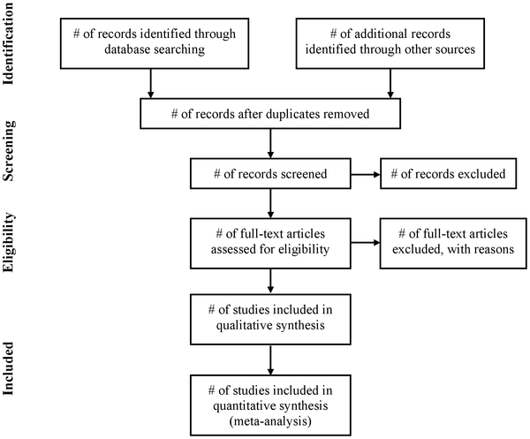
Reporting of systematic reviews
Use in conjunction with the PRISMA Checklist!
See http://prisma-statement.org/
Moher D, Liberati A, Tetzlaff J, Altman DG, The PRISMA Group (2009) Preferred Reporting Items for Systematic Reviews and Meta-Analyses: The PRISMA Statement. PLOS Medicine 6(7): e1000097. https://doi.org/10.1371/journal.pmed.1000097
See also http://prisma-statement.org
PRISMA reporting guidelines
Notes:
Don’t underestimate grey literature. It is important to look beyond academic publications and to the professional use of information and knowledge.

Slide 12
Cochrane Handbook
https://training.cochrane.org/handbook
See Part 2: General methods for Cochrane reviews, chapters 8 & 9
Joanna Briggs Institute
http://joannabriggs.org/research/critical-appraisal-tools.html
CASP
https://casp-uk.net/casp-tools-checklists/
Appraisal tools
Notes:
Don’t underestimate grey literature. It is important to look beyond academic publications and to the professional use of information and knowledge.

Slide 13
ArticleReach: https://bit.ly/2yqI20Y
Literature search and review in MVLS: https://edshare.gla.ac.uk/78/
Formulating a research question and structuring a literature search: https://edshare.gla.ac.uk/38
Developing literature search strategies: https://edshare.gla.ac.uk/76
Searching library databases: https://edshare.gla.ac.uk/278
Book an appointment to see me at: http://bit.ly/2lIaTGI
only after reviewing the self-help material, please!
Contact me
paul.cannon@glasgow.ac.uk
0141 330 6532
Self-help resources
Notes:
Don’t underestimate grey literature. It is important to look beyond academic publications and to the professional use of information and knowledge.

Slide 14
https://www.gla.ac.uk/myglasgow/library
Paul Cannon
College Librarian Medical, Veterinary & Life Sciences
paul.cannon@glasgow.ac.uk
@pcann_LIS
http://orcid.org/0000-0001-8721-1481
Photo by rawpixel on Unsplash

