Slide 1
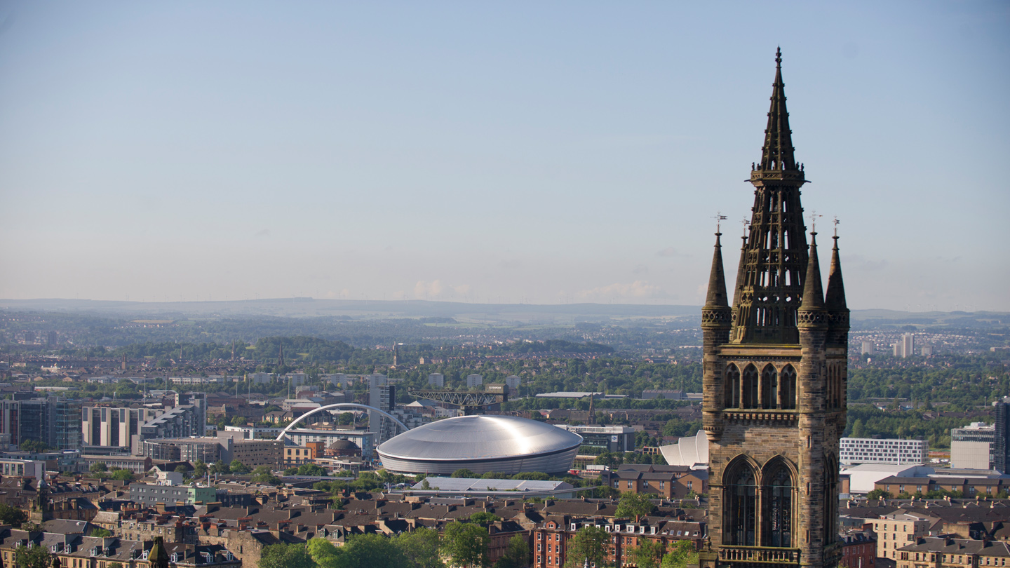


Capturing Esteem in (M)Eprints: Our Enlighten experience
EPrints User Group, London, 14th March 2019
@WilliamJNixon, University Library

Slide 2
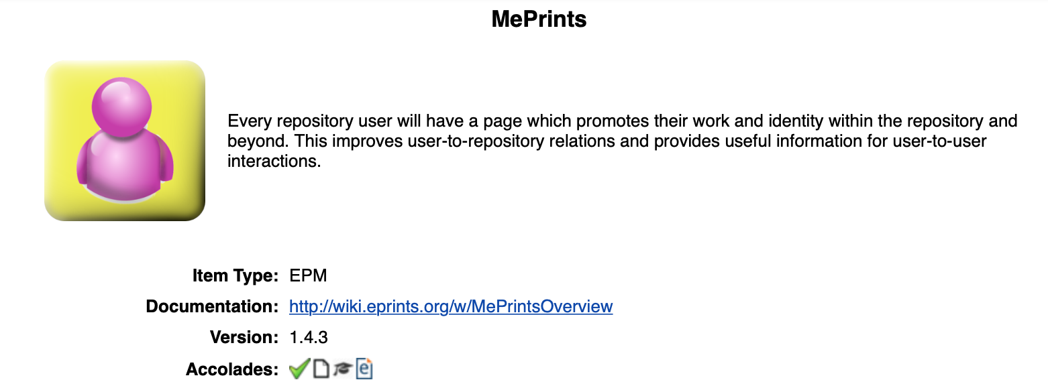
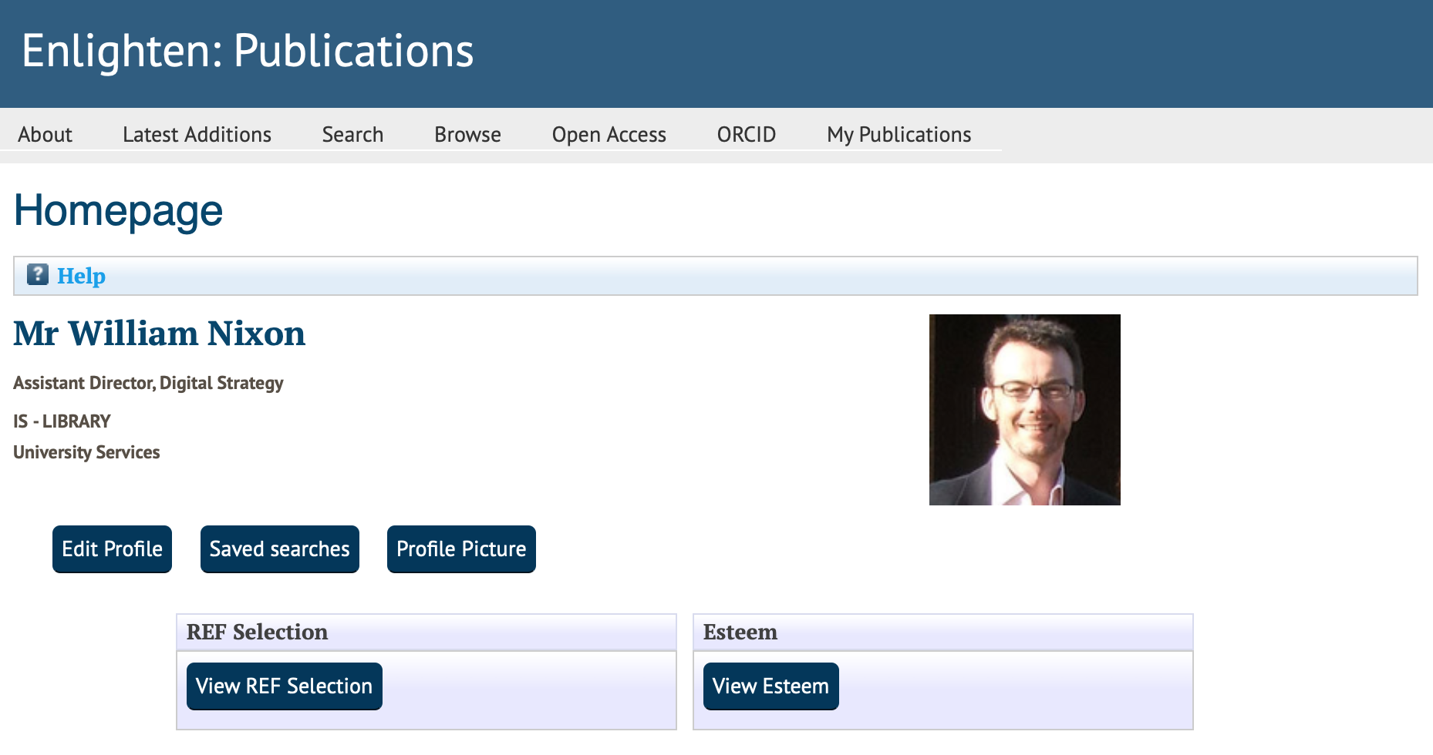
MePrints and Enlighten
MePrints in use at Glasgow over the last 6 years
Provides a Home Page for staff rather than just Manage Deposits
We don’t use the public profile
Staff have completed fields for Expertise, Qualifications and Bio
Provides browse view for Expertise
Felt like the natural home for ‘esteem’ data
Local Widgets for REF and Esteem

Slide 3
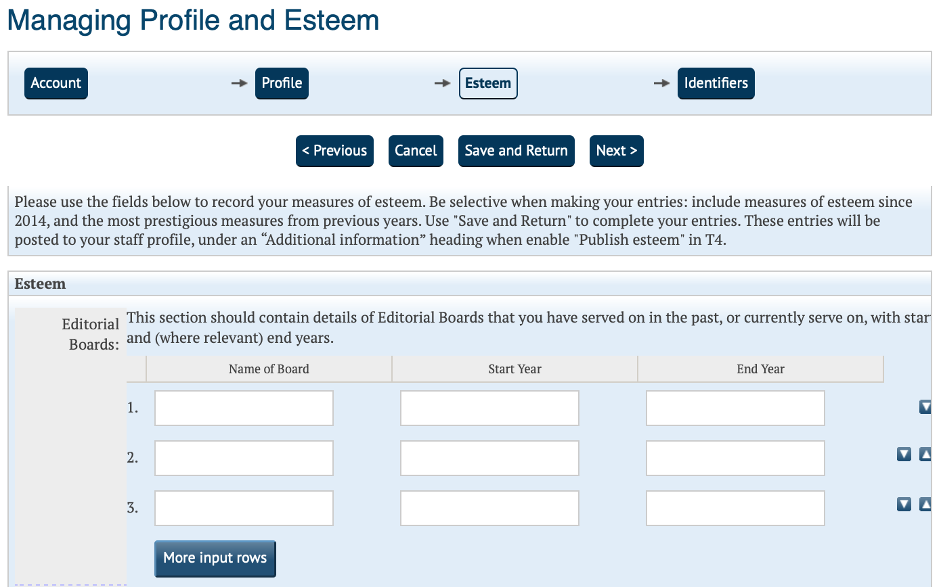
Measures of Esteem Pilot
New functionality in Enlighten
JSON export for our CMS
Includes
  Editorial Boards
  Grant Committees
  Professional & Learned Societies
  Research Fellowships
  Prizes, Awards, Distinctions
  Invited International presentations
Working in partnership with EPrints Services, our Web team and College Research Offices

Slide 4
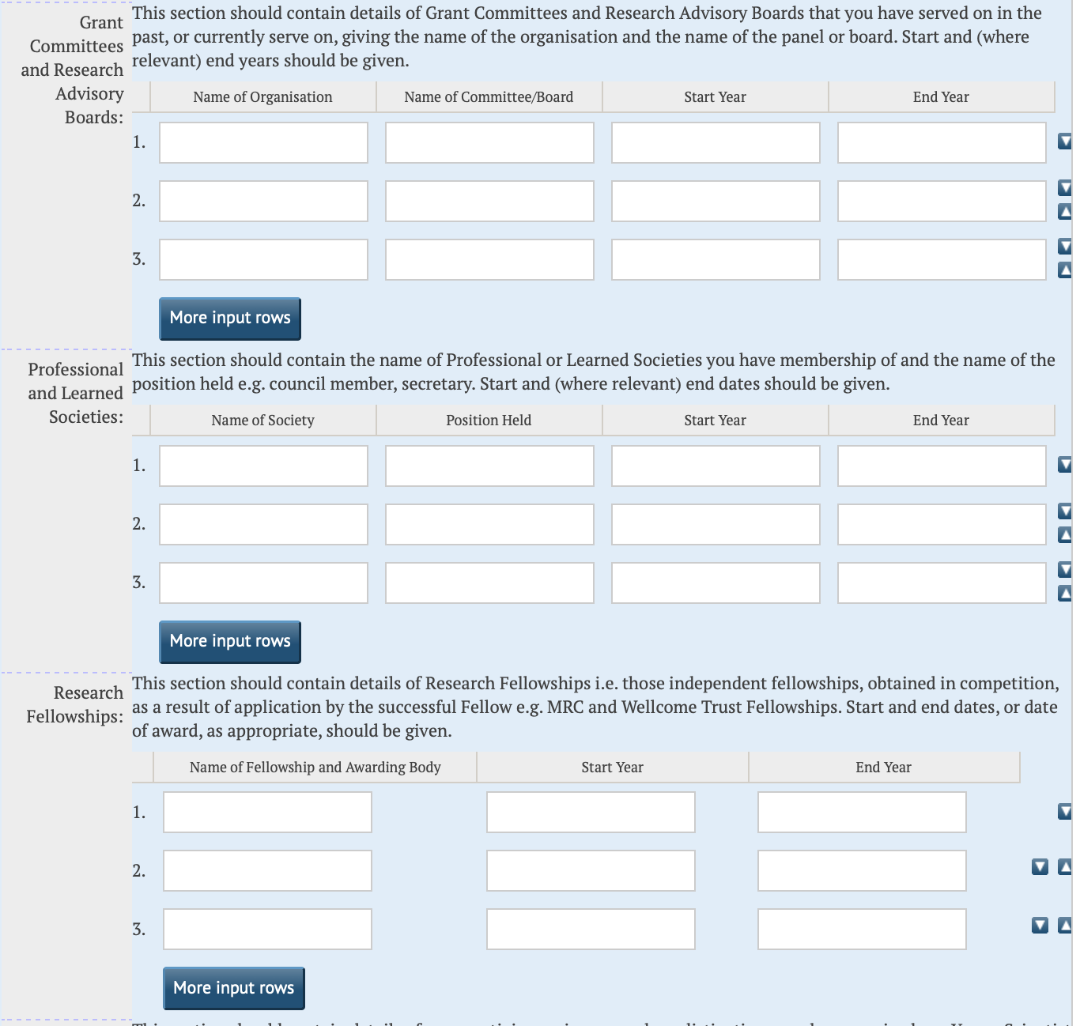
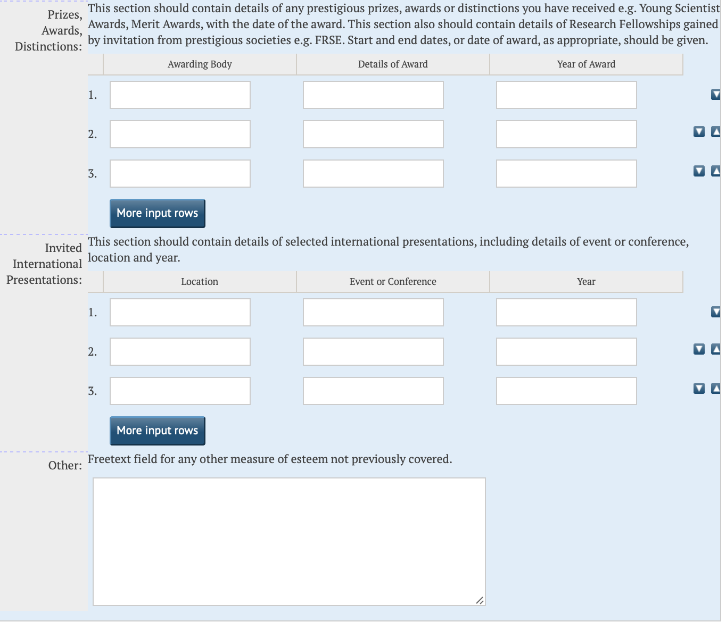
Esteem

Slide 5
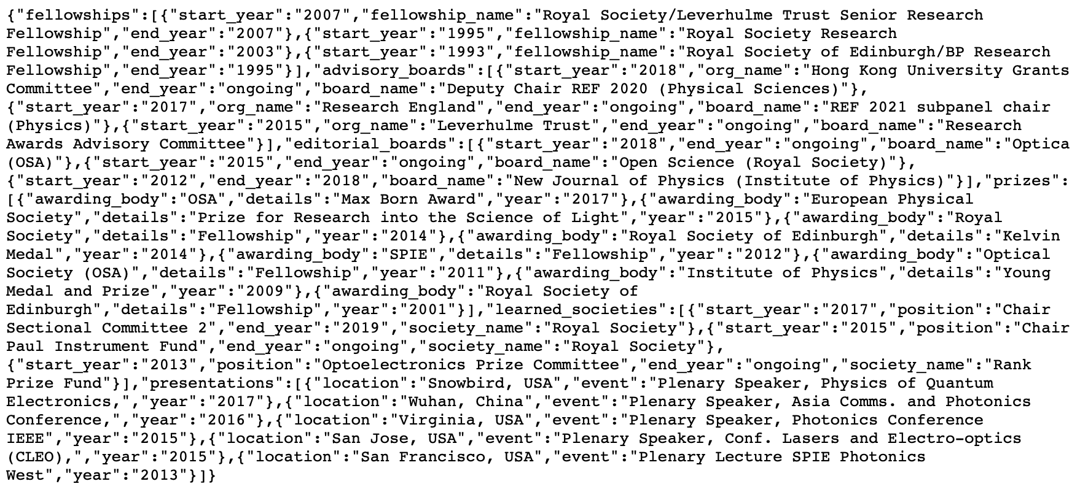
Integration with CMS (T4)
Esteem surfaced via University CMS not via Enlighten itself
Working with University Web Team
Public JSON export
New esteem section in profile
  Bulleted list of categories
  Concatenated data
All esteem data made public

Slide 6
Terminology Elsewhere
* Liverpool: External engagement
* Manchester: Activities
* Queen Mary: Performance
* Queen’s: Activities
* Sheffield: Professional activities
* UCL: Achievements
* York: Activities
* Strathclyde: Professional activities
* Birmingham: Other activities
* Bristol: Awards & activities
* Cardiff: <part of> Biography
* Durham: Indicators of Esteem
* Exeter: External Engagement & Impact
* Imperial: Recent measures of esteem and Other significant activities (these are separate tabs)

Slide 7
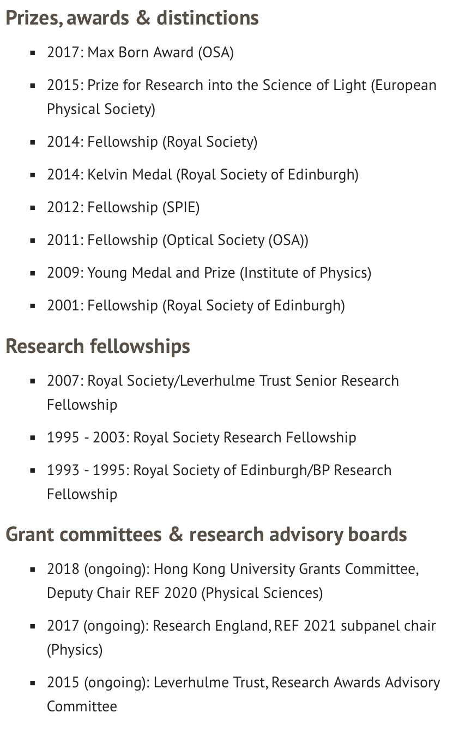
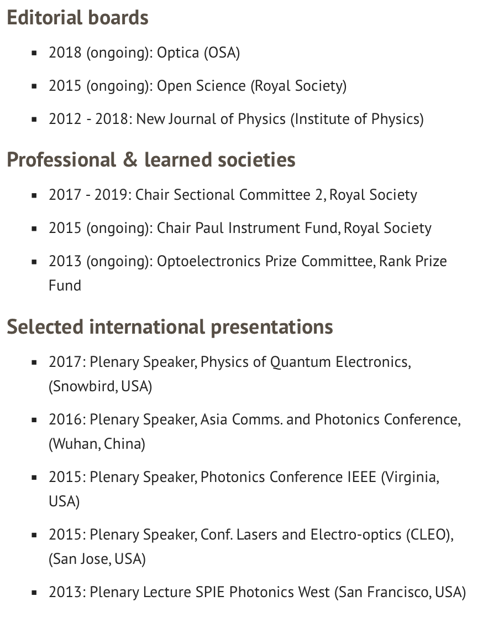
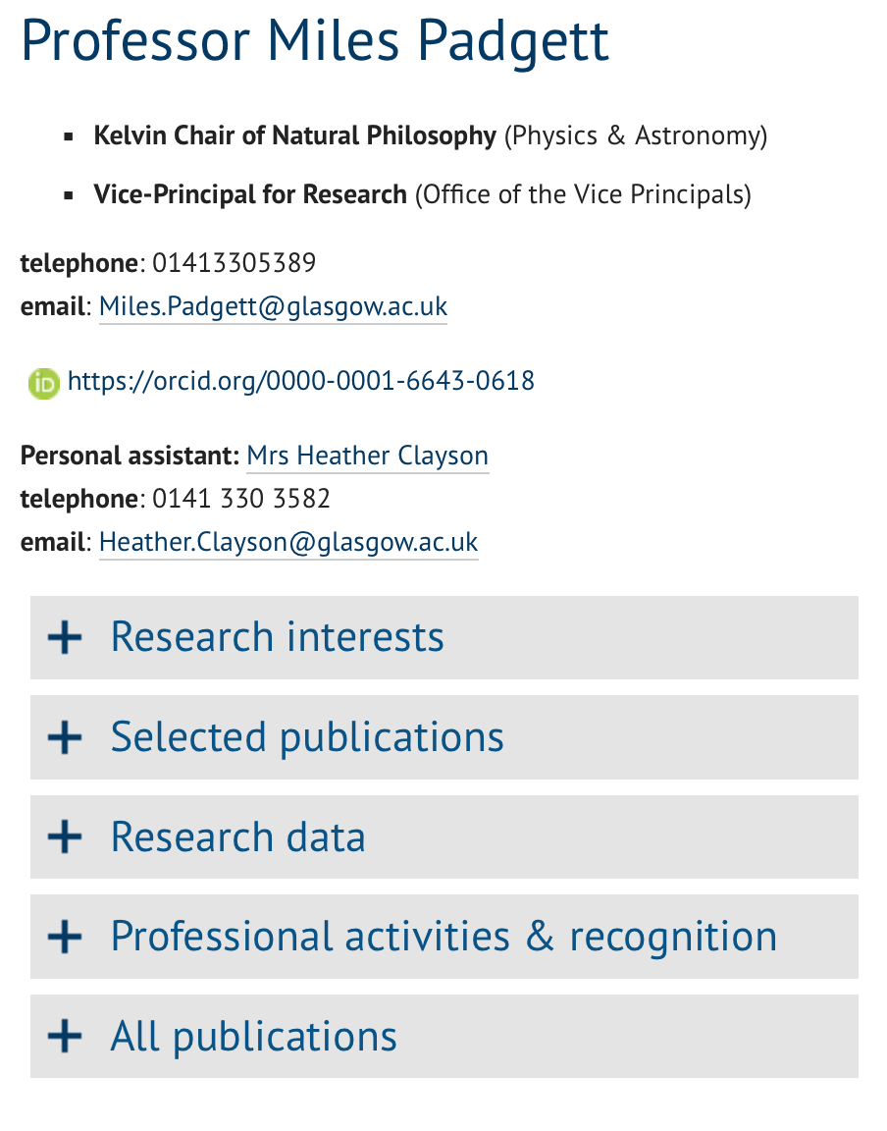
Esteem

Slide 8
Feedback and Next Steps
Data Entry
  Autocompletion
  Option to not display data
Reporting
  Generic Reporting Framework & QlikView
Search/Browse
  Search across public esteem data
  Browse by Fellowships, Editorial Boards
Integration
  Let staff enable this via our CMS (T4)
  Display options on staff pages
  Other University systems to populate this data e.g. for Perfomance & Development Reviews
Positive feedback from staff
“I think this is a good idea – the system is easy to use to input the data and the section headings seem appropriate.”
‘I’m really happy that you are adding this to our profile website as I would usually have to ask one of our administrators to add this for me as “additional information”.’
“works well”

Slide 9

Summer Plans?
Registration and Workshops open for Open Repositories 2019
“All the user needs”
10-13 June, Hamburg
#OpenRepo2019
https://or2019.blogs.uni-hamburg.de

Slide 10




Thank you and Questions
@williamjnixon
william.nixon@glasgow.ac.uk
www.glasgow.ac.uk/enlighten
#UofGWorldChangers
@UofGlasgow

