Slide 1
Discovering
Information and
Developing Rigour
and Validity in Literature Searches at Doctoral Level
Paul Cannon
College Librarian Medical, Veterinary & Life Sciences
paul.cannon@glasgow.ac.uk
@pcann_LIS
http://orcid.org/0000-0001-8721-1481
This work is licensed under a Creative Commons Attribution 4.0 International License

Slide 2
Workshop aims
By the end of the workshop you should…
Understand the various literature review styles available and strengths and weaknesses of each
Be able to structure a search strategy for effective literature searching
Utilise advanced search techniques to find relevant information in your research field
Use basic text mining techniques to improve the precision and sensitivity of searches
Use article data to identify prominent literature and authors within your field
Workshop aims

Slide 3
Getting started and familiarisation
Enlighten Publications: the University’s research repository
Enlighten Theses: research degree repository
Enlighten Research Data: research data repository
EthOS: UK doctoral theses
Proquest Dissertations and Theses: UK and Ireland
Proquest Dissertations and Theses: Global
University of Glasgow Library: your collections and archives
Copac: Search the collections of most UK and Irish libraries
Getting started

Slide 4
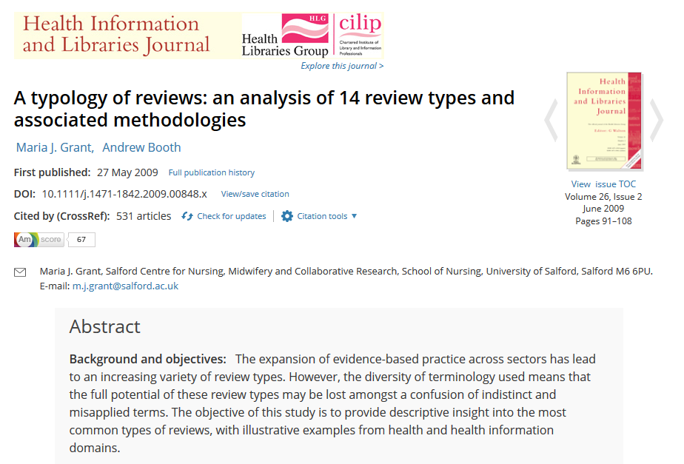
What type of literature review am I doing?
A typology of reviews

Slide 5
Type of review | Strengths | Weaknesses
Narrative/literature review | Consolidation of existing research | Significant bias in search methods and synthesis
Critical review | Critical Used to justify subsequent research | Open to bias in search methods and synthesis of results
Rapid review | Quick, but methodological | Open to bias, but in a transparent way
Systemised review | Provides insight into a topic without resource implications of full SR | High likelihood of bias with limited methodology
Systematic review | Systematic method of searching and appraisal | Application of study designs reduces insight into research topic Time and resource heavy
Meta-analysis | Assimilation of evidence base Useful for getting knowledge into practice | Needs to systematically identify all literature Quality of available studies
Adapted from Grant, M. J. and Booth, A. (2009), A typology of reviews: an analysis of 14 review types and associated methodologies. Health Information & Libraries Journal, 26: 91-108. doi:10.1111/j.1471-1842.2009.00848.x
A typology of reviews

Slide 6
Creating a search strategy
PICO Used for: Evidence-based medicine http://dx.doi.org/10.7326/ACPJC-1995-123-3-A12 | SPICE Used for: Evaluating projects or interventions http://dx.doi.org/10.1108/07378830610692127 | SPIDER Used for: Qualitative or mixed methods http://dx.doi.org/10.1177/1049732312452938 | ECLIPSE Used for: Evaluating services http://dx.doi.org/10.1046/j.1471-1842.2002.00378.x
Population / patient | Setting | Sample | Expectation
Intervention / indicator | Perspective / population | Phenomenon of Interest | Client group
Comparator / control | Intervention | Design | Location
Outcome | Comparison | Evaluation | Impact
 | Evaluation | Research methodology / method | Professionals
 |  |  | SErvice
See Supplementary Material 1 of Booth A, Noyes J, Flemming K, et al. Formulating questions to explore complex interventions within qualitative evidence synthesis. BMJ Global Health 2019;4:e001107: http://dx.doi.org/10.1136/bmjgh-2018-001107 for an exhaustive list of question formulation frameworks.
If a template doesn’t fit your research question, don’t worry. The main aim is to identify the key components of your search and the various synonyms and acronyms used to describe them.
Search strategies

Slide 7
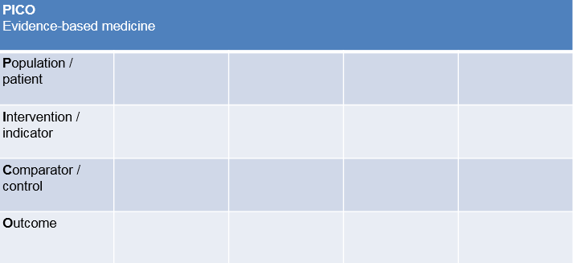
Creating a search strategy
Should GPs be checking carcinoembryonic antigen levels in patients with non-specific abdominal pain?
PICO Evidence-based medicine
Population / patient | GP | general practitioner | general practice physician | family physician
Population / patient | abdominal pain
Intervention / indicator | carcinoembryonic antigen | CEA
Comparator / control
Outcome
Search strategies

Slide 8
Illustrating a PICO search strategy
INTERVENTION
CONDITION
OUTCOME
POPULATION
INTERVENTION
Retrieved literature
Intervention
A
B
F
OR
C
POPULATION
A
CONDITION
Population
A
E
D
Condition
C
OR
B
AND
C
OR
B
Outcome
A
Outcome
C
OR
B
Search strategies
Notes:
In a systematic review, it is common to only search on two elements of a PICO, such as the population and condition. Often the outcome of a study is not discussed within a title and abstract, so if you search for those elements, you will not retrieve a true picture of the literature – you will obtain a false positive result.

Slide 9
Adapted from: McLeonard, C. 2017. Are adult cats fed on wet maintenance diets less at risk of developing chronic kidney disease compared to adult cats fed on dry maintenance diets? Veterinary Evidence, 2(4). https://dx.doi.org/10.18849/ve.v2i4.130
Exercise one: PICO
Use print outs or download e-version at https://edshare.gla.ac.uk/351/
Population / patient | adult cat
Population / patient | chronic kidney disease
Intervention / indicator | Wet maintenance diet
Comparator / control | dry maintenance diet
Outcome | lower disease risk
Search question
Are adult cats fed on wet maintenance diets less at risk of developing chronic kidney disease (CKD) compared to adult cats fed on dry maintenance diets?
Search strategy
(cat OR cats OR feline*)
AND
(chronic renal failure OR chronic renal disease OR chronic renal insufficiency OR chronic kidney insufficiency OR chronic kidney failure OR chronic kidney disease OR CKD)
AND
(diet* OR food* OR feed)
PICO exercise

Slide 10
Advanced search techniques
Boolean searching
OR: increases sensitivity
use for different synonyms, spelling variants and acronyms, i.e. diet or eat or feed…
AND: increases specificity
use to group different concepts that must be mentioned with the search results, i.e. GP AND CEA AND abdominal pain
NOT: exclude unwanted terms
in most circumstances, never use NOT; you may lose important references
Advanced search techniques

Slide 11
Advanced search techniques
Search syntax
Proximity: more sensitive than phrase searching
use to find words near each other, i.e. “mental health” adj3 (personnel or professional or staff…)
NOTE: the proximity syntax varies in each database, and is not supported in others
Truncation: different word endings (or sometime beginnings)
use for singular, plural and adjectives, i.e. toxic* will retrieve toxic, toxicity, toxicology…
Wildcards: spelling variations
use for British and American spelling amongst other uses, i.e. colo?r will retrieve color and colour
NOTE: the proximity syntax varies in each database, and is not supported in others
Advanced search techniques

Slide 12
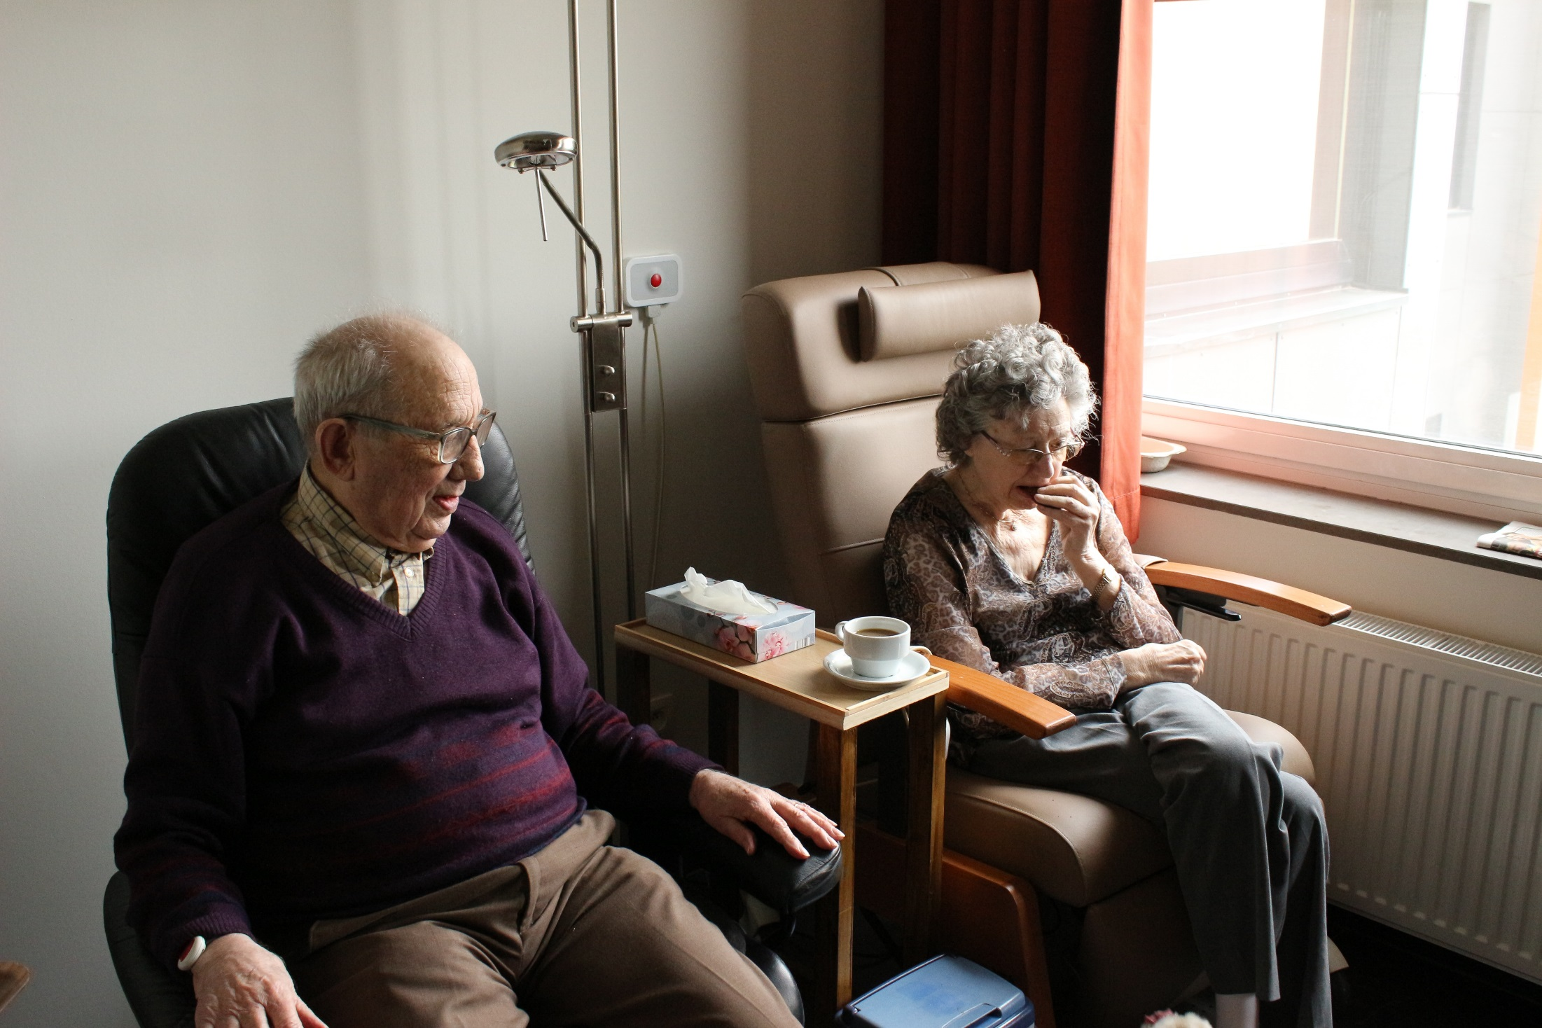
How would you describe the age of these people?
Photo by Elien Dumon on Unsplash

Slide 13
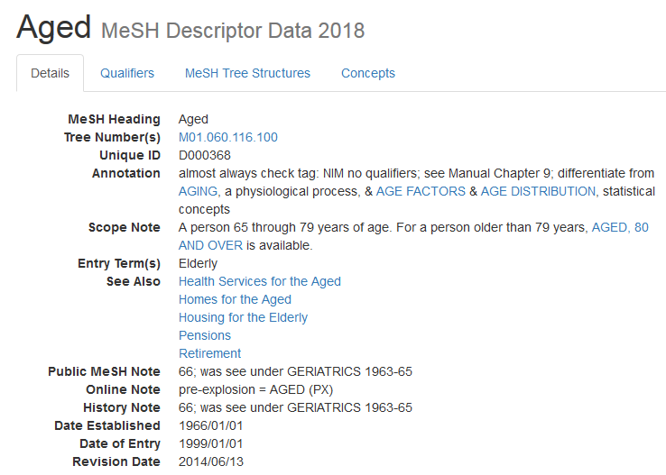
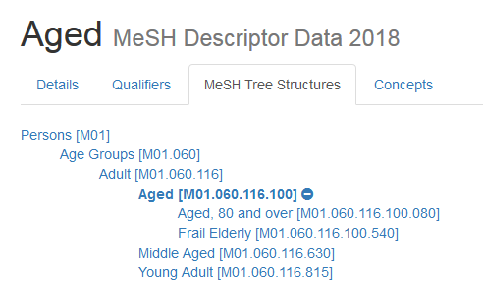
https://meshb.nlm.nih.gov/record/ui?ui=D000368
Subject headings
Notes:
Subject headings are not just for systematic reviews, they go some way to ensuring that relevant papers are not missed. Arguably, they may also reduce geographical bias by retrieving articles with different spelling variations or articles from non-English language publications.
Subject headings
Controlled vocabulary
Often hierarchical
Increase the sensitivity of a search
Are database-specific
Some databases include sub-headings of the subject headings

Slide 14
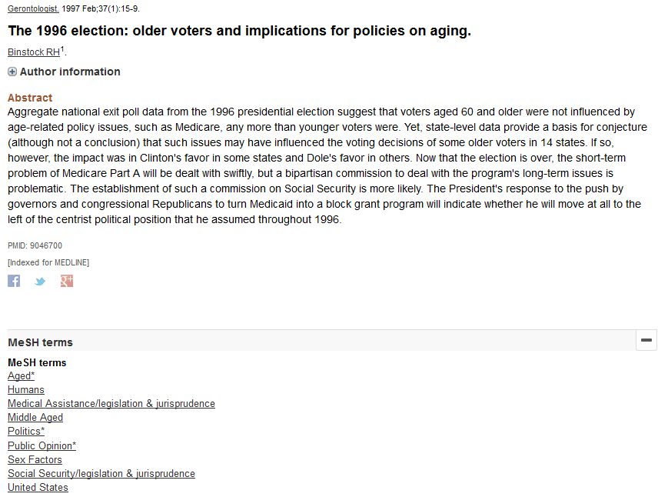
https://www.ncbi.nlm.nih.gov/pubmed/9046700
Subject headings
Notes:
Subject headings are not just for systematic reviews, they go some way to ensuring that relevant papers are not missed. Arguably, they may also reduce geographical bias by retrieving articles with different spelling variations or articles from non-English language publications.

Slide 15
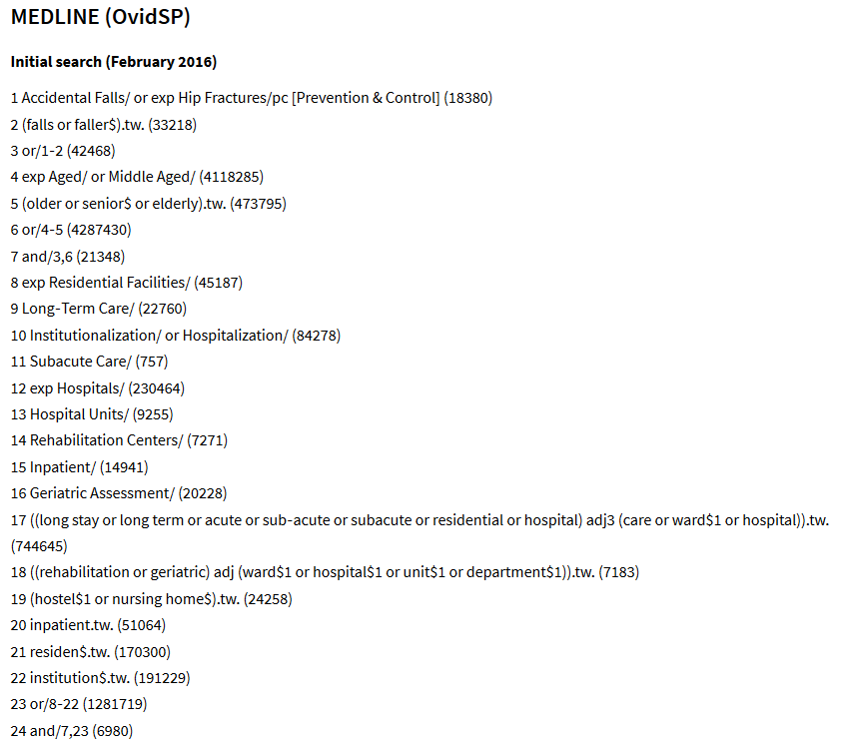
Cameron, ID, Dyer, SM, Panagoda, CE, et al. (2018) Interventions for preventing falls in older people in care facilities and hospitals. Cochrane Database of Systematic Reviews: https://www.cochranelibrary.com/cdsr/doi/10.1002/14651858.CD005465.pub4
Advanced search techniques

Slide 16
Text mining
PubMed PubReMiner: text mines PubMed
MeSH on Demand: identifies MeSH headings and articles from PubMed
The National Centre for Text Mining
Previously identified literature
Text mining
Notes:
Previously identified literature not only helps identify relevant keywords, phrases and subject headings, but can also act as a red flag if they are not part of your literature search results – you may be searching in the wrong database, or not using the right keywords and subject headings.

Slide 17
Exercise two: text mining to develop a search strategy
Return to print out or download e-version at https://edshare.gla.ac.uk/351/
What insights can we learn from the number of articles published per year?
Frequency of articles published per year is falling. Perhaps there is a new treatment available or this is no longer a hot topic
Where might you chose to read, or publish in, on this topic?
Antimicrobial Agents and Chemotherapy
What authors might you follow or seek out their work?
Be careful with author names – these may not be unique persons and may simply share a surname and initial(s)
Are there any particular keywords or MeSH headings you would incorporate into a search strategy as a result of this search?
Look out for F0XDI6ZL63; this is the Unique Ingredient Identifier. Always search for the drug name, trade name, registry number and UNII
Text mining

Slide 18
Grey literature
Conference proceedings and abstracts
Covered in Scopus and Web of Science, PapersFirst and ProceedingsFirst
Official publications
Government, NGOs, charities, professional bodies, etc.
Sources
Open Grey (EU)
National Technical Information Service (US)
NICE Evidence Search
Grey literature
Notes:
Don’t underestimate grey literature. It is important to look beyond academic publications and to the professional use of information and knowledge.

Slide 19
Exercise three and four: hands-on searching
Return to print out or download e-version at https://edshare.gla.ac.uk/351/
Embase: key database for all MVLS subjects
BIOSIS Previous: useful for biomedical life sciences
Exercise five: citation searching
The BIOSIS platform, Web of Science, is useful for citation searching and analysis (although Scopus is probably a better database for citation searching)
Hands-on searching

Slide 20
Feeling a bit like this?
Photo by Mishal Ibrahim on Unsplash

Slide 21
Self-help resources
ArticleReach: https://bit.ly/2yqI20Y
Literature search and review in MVLS: https://edshare.gla.ac.uk/78/
Formulating a research question and structuring a literature search: https://edshare.gla.ac.uk/38
Developing literature search strategies: https://edshare.gla.ac.uk/76
Searching library databases: https://edshare.gla.ac.uk/278
Book an appointment to see me at: http://bit.ly/2lIaTGI
only after reviewing the self-help material, please!
Previous class recording available at: https://edshare.gla.ac.uk/352/
Contact me
paul.cannon@glasgow.ac.uk
0141 330 6532
Self-help resources

Slide 22
The Library and your research journey
ORCID and researcher profile
Research data management
EndNote
Open Access
Scoping the literature
Publication
Thesis and data deposit

Slide 23
http://www.gla.ac.uk/myglasgow/library/
Paul Cannon
College Librarian Medical, Veterinary & Life Sciences
paul.cannon@glasgow.ac.uk
@pcann_LIS
http://orcid.org/0000-0001-8721-1481
This work is licensed under a Creative Commons Attribution 4.0 International License

