Slide 1


EdShare: Glasgow’s new teaching and learning repository
https://edshare.gla.ac.uk
Notes:
Intro slide - If your presentation does not relate solely to student recruitment, please use this version

Slide 2
What is it? Who is it for?
EdShare is a resource for collaboration and sharing of materials used in teaching and learning at the University of Glasgow. The resource has been created for teachers and other staff, who are involved in supporting students in their learning, to organise, manage, share and collaborate on the everyday resources that they use in their teaching.
EdShare enables the entire University community to make resources visible to colleagues and students across the University and the World. These resources may be very simple in format – Powerpoint presentations, Word documents and PDF files – or they may be more complex learning objects combining a range of file formats.
[Source: University of Southampton http://blog.soton.ac.uk/keepit/2009/09/29/edshare-repository-preservation-objectives/]

Slide 3

Why use it?
Easy upload of material
Embed links in Moodle or T4
Secure storage
Safe, secure and persistent URL
Sharing and collaboration
Accommodates multiple file types and large file sizes
Version control
Preview of content
Search and browse content

Slide 4
How does it link with T4 and Moodle?
Not intended as a replacement or a competitor
Complementary to existing systems
Moodle embed code

Slide 5
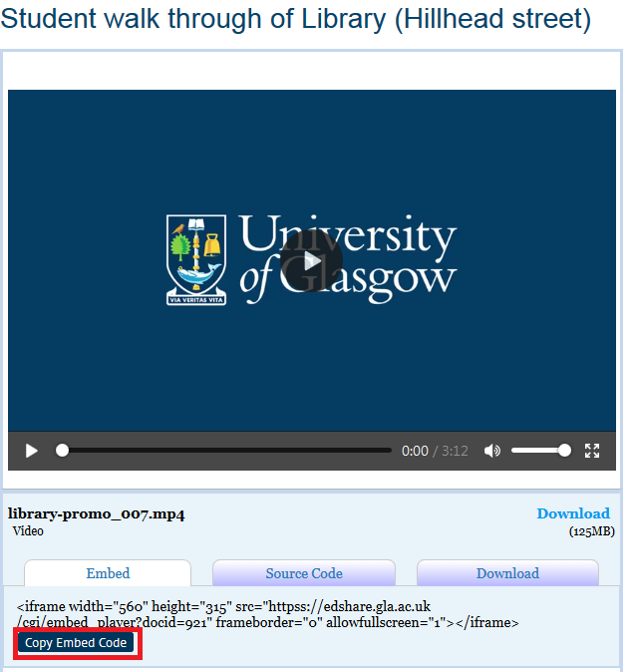
Embed code for videos

Slide 6
Access to objects
Initially default access will be for Glasgow users only.
When depositing you can choose to make your material available worldwide.

Slide 7
Finding material in EdShare
Direct search within EdShare
Most likely via links in Moodle or elsewhere on the University web site.
Via search engines
Notes:
Demo
Caveats
Log –in – GUID – account already set up
Self deposit – no team. Will present challenges.
Quick deposit
Minimal mandatory fields
World v local
Licenses
Usage statistics

Slide 8
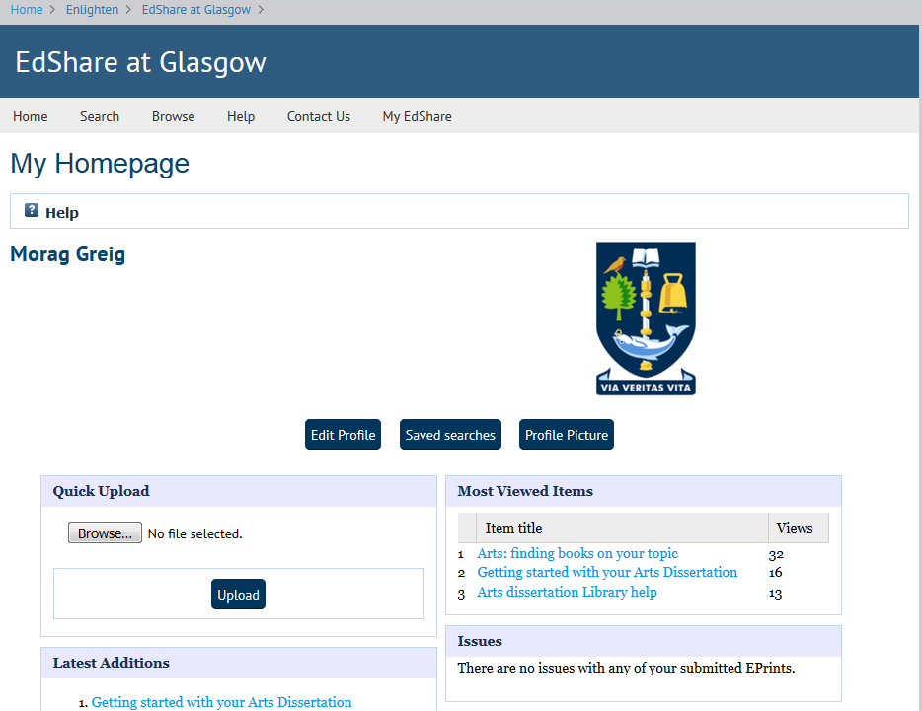

Slide 9

Other information
  Software developed at University of Southampton (ePrints stable – Enlighten/Theses etc).
  Already used at Southampton and Glasgow Caledonian.

Slide 10

What can you do?
Try out deposit
Send any feedback to teaching-edshare@glasgow.ac.uk
Let colleagues know about it

Slide 11









Thank you
Any questions?
/glasgowuniversity
@UofGlasgow
@UofGlasgow
UofGlasgow
Search: University of Glasgow

