Slide 1
DClinPsy
systematic
review workshop
Paul Cannon
College Librarian Medical, Veterinary & Life Sciences
paul.cannon@glasgow.ac.uk
@pcann_LIS
http://orcid.org/0000-0001-8721-1481
Photo by rawpixel on Unsplash

Slide 2
Database selection
Developing inclusion and exclusion criteria
Search terms, search syntax and subject headings
Exporting results to reference management software (i.e. EndNote)
PRISMA reporting guidelines
Critical appraisal tools
We will be covering…

Slide 3
PICO Used for: Evidence-based medicine http://dx.doi.org/10.7326/ACPJC-1995-123-3-A12 | SPICE Used for: Evaluating projects or interventions http://dx.doi.org/10.1108/07378830610692127 | SPIDER Used for: Qualitative or mixed methods http://dx.doi.org/10.1177/1049732312452938 | ECLIPSE Used for: Evaluating services http://dx.doi.org/10.1046/j.1471-1842.2002.00378.x
Population / patient | Setting | Sample | Expectation
Intervention / indicator | Perspective / population | Phenomenon of Interest | Client group
Comparator / control | Intervention | Design | Location
Outcome | Comparison | Evaluation | Impact
 | Evaluation | Research methodology / method | Professionals
 |  |  | SErvice
If a template doesn’t fit your research question, don’t worry. The main aim is to identify the key components of your search and the various synonyms and acronyms used to describe them.
An example systematic review title

Slide 4
Interventions for female drug-using offenders
PICOS
Population / patient | Female Offenders
Intervention / indicator | ?
Comparator / control
Outcome
Study design/ Setting/ Situation | Prison? Community treatment?
If a template doesn’t fit your research question, don’t worry. The main aim is to identify the key components of your search and the various synonyms and acronyms used to describe them.
PICOS for the research question

Slide 5
All the possible literature on interventions
All the possible literature on females
All the possible literature on prisons
Interventions for female drug-using offenders

Slide 6
The Cochrane Library
www.cochranelibrary.com
Shows the methods of previous reviews
Databases used
Search strategies for each database
Starting out

Slide 7
All the possible literature on females
All the possible literature on substance misuse programmes
All the possible literature on prisons
Substance treatment for female drug-using offenders

Slide 8
Female
Age ranges
Length of stay
Types of offenders
Prisons
Types of prison
Substance misuse programmes
Type of substance
Length of treatment
Inclusion and exclusion criteria

Slide 9
PubReMiner
https://hgserver2.amc.nl/cgi-bin/miner/miner2.cgi
Quickly identifying textwords and subject headings
Developing a first search

Slide 10
Boolean searching
OR: increases sensitivity
use for different synonyms, spelling variants and acronyms, i.e. prisoner OR offender OR incarcerated…
AND: increases specificity
use to group different concepts that must be mentioned with the search results, i.e. female AND prisoner
NOT: exclude unwanted terms
in most circumstances, never use NOT; you may lose important references
prisoner
offender
female
prisoner
humans
animals
Advanced search techniques

Slide 11
Search syntax
Proximity: more sensitive than phrase searching
use to find words near each other, i.e. “mental health” adj3 (personnel or professional or staff…)
NOTE: the proximity syntax varies in each database, and is not supported in others
Truncation: different word endings (or sometime beginnings)
use for singular, plural and adjectives, i.e. toxic* will retrieve toxic, toxicity, toxicology…
Wildcards: spelling variations
use for British and American spelling amongst other uses, i.e. colo?r will retrieve color and colour
NOTE: the proximity syntax varies in each database, and is not supported in others
Advanced search techniques

Slide 12
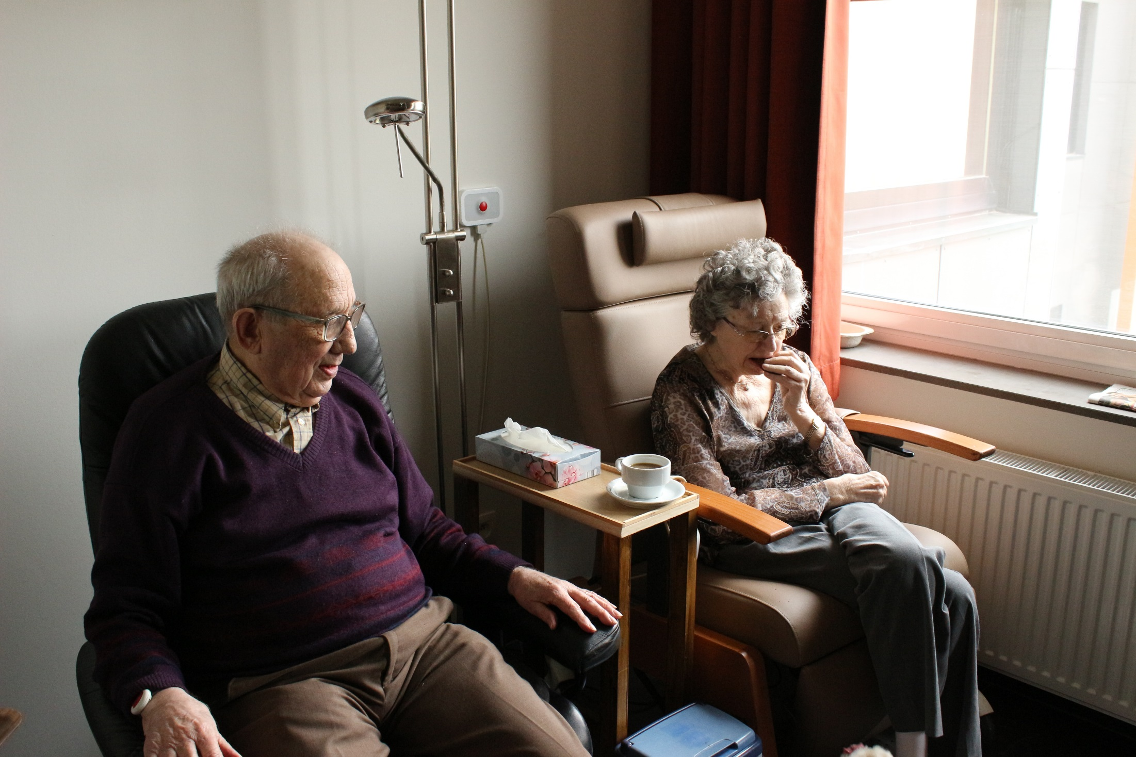
How would you describe the age of these people?
Photo by Elien Dumon on Unsplash

Slide 13
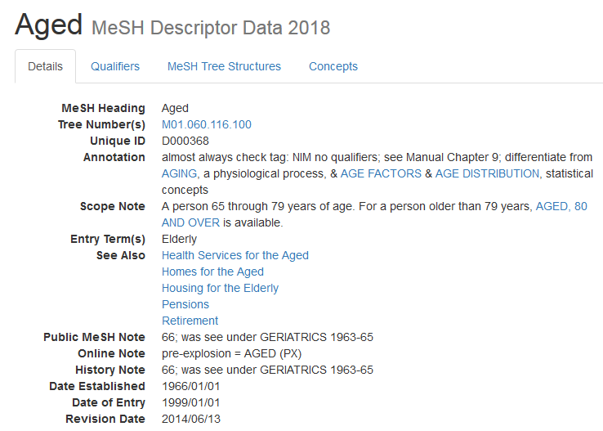
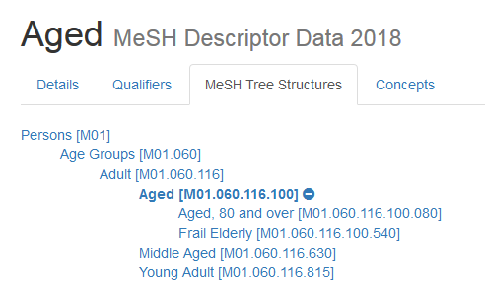
https://meshb.nlm.nih.gov/record/ui?ui=D000368
Subject headings
Notes:
Subject headings are not just for systematic reviews, they go some way to ensuring that relevant papers are not missed. Arguably, they may also reduce geographical bias by retrieving articles with different spelling variations or articles from non-English language publications.
Subject headings
Controlled vocabulary
Often hierarchical
Increase the sensitivity of a search
Are database-specific
Some databases include sub-headings of the subject headings

Slide 14
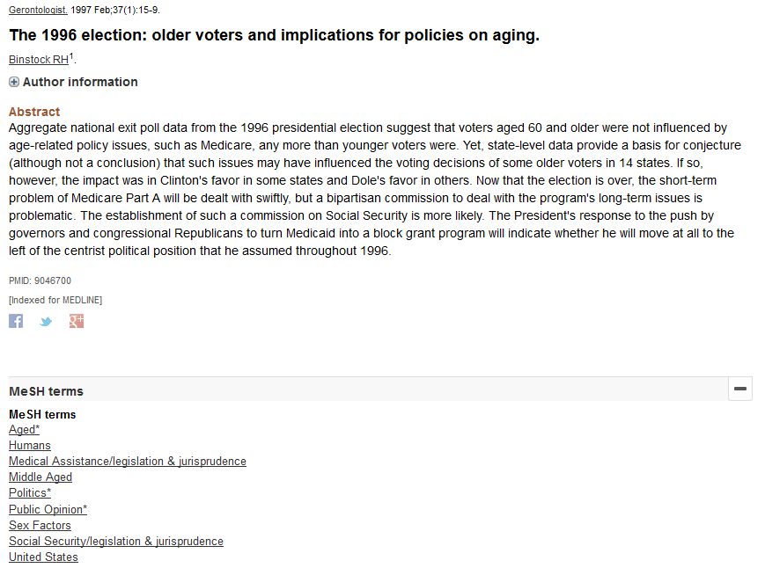
https://www.ncbi.nlm.nih.gov/pubmed/9046700
Subject headings
Notes:
Subject headings are not just for systematic reviews, they go some way to ensuring that relevant papers are not missed. Arguably, they may also reduce geographical bias by retrieving articles with different spelling variations or articles from non-English language publications.

Slide 15
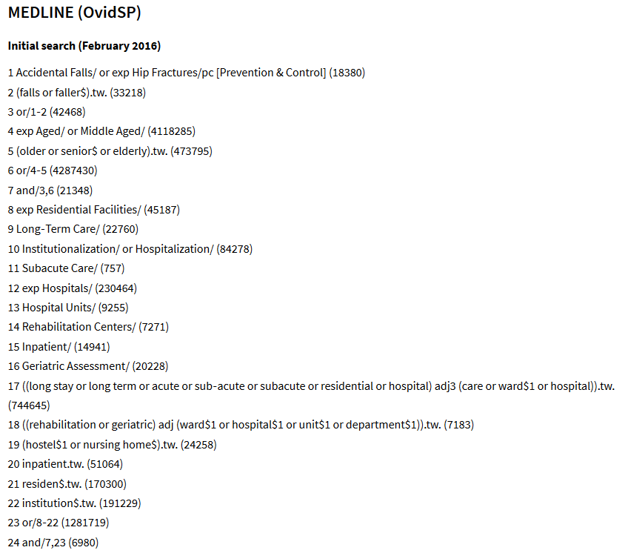
Cameron, ID, Dyer, SM, Panagoda, CE, et al. (2018) Interventions for preventing falls in older people in care facilities and hospitals. Cochrane Database of Systematic Reviews: https://www.cochranelibrary.com/cdsr/doi/10.1002/14651858.CD005465.pub4
Subject headings

Slide 16
Medline (Ovid SP)
www.gla.ac.uk/library > Databases > Databases by name
Large biomedical database
Useful database to test a draft search to assess review feasibility
Developing a first search

Slide 17
exp "Substance‐Related‐Disorders"/
((drug or substance) adj3 (abuse* or addict* or dependen* or misuse*)).tw
((drug* or substance*) adj3 (treat* or intervention* or program*)).tw
(detox* or methadone).tw
(narcotic* adj3 (treat* or intervention* or program*)).tw
or/1-5
exp "Prisons"/
exp "Prisoners"/
prison*.tw
(offender* or criminal* or inmate* or convict* or probation* or remand or felon*).tw
or/7-10
6 and 11
Adapted from: https://www.cochranelibrary.com/cdsr/doi/10.1002/14651858.CD010910.pub2/appendices#CD010910-sec1-0012
Developing a first search

Slide 18
Conference proceedings and abstracts
Covered in Scopus and Web of Science, PapersFirst and ProceedingsFirst
Official publications
Government, NGOs, charities, professional bodies, etc.
Sources
Open Grey (EU)
National Technical Information Service (US)
NICE Evidence Search
Grey literature
Notes:
Don’t underestimate grey literature. It is important to look beyond academic publications and to the professional use of information and knowledge.

Slide 19
http://systematicreviewtools.com/
Select an underlying approach: Whole process > Search
Micah D. J. Peters (2017) Managing and Coding References for Systematic Reviews and Scoping Reviews in EndNote, Medical Reference Services Quarterly, 36:1, 19-31, DOI: 10.1080/02763869.2017.1259891
Systematic review toolbox and EndNote
Notes:
Don’t underestimate grey literature. It is important to look beyond academic publications and to the professional use of information and knowledge.

Slide 20
Source: Ovid MEDLINE(R) In-Process & Other Non-Indexed Citations and Ovid MEDLINE
Interface: OvidSP
Database coverage dates: 1946 to Present
Search date: 23 May 2018
Retrieved records: 2565
Search strategy:
[Line by line copy and paste of your search strategy]
See Appendix B of https://www.nice.org.uk/guidance/ph56/evidence/evidence-review-1-431762365
Reporting of search strategies
Notes:
Don’t underestimate grey literature. It is important to look beyond academic publications and to the professional use of information and knowledge.

Slide 21
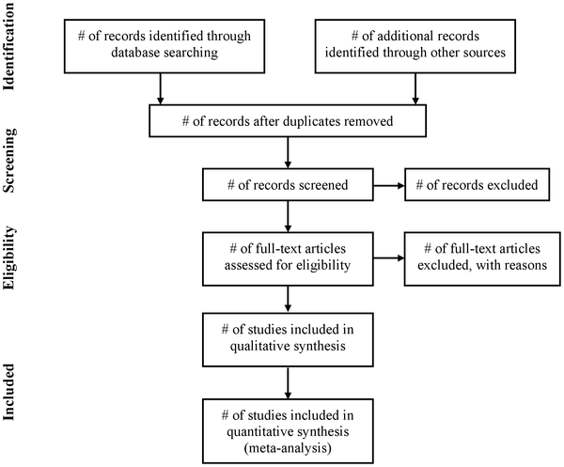
Reporting of systematic reviews
Use in conjunction with the PRISMA Checklist!
See http://prisma-statement.org/
Moher D, Liberati A, Tetzlaff J, Altman DG, The PRISMA Group (2009) Preferred Reporting Items for Systematic Reviews and Meta-Analyses: The PRISMA Statement. PLOS Medicine 6(7): e1000097. https://doi.org/10.1371/journal.pmed.1000097
See also http://prisma-statement.org
PRISMA reporting guidelines
Notes:
Don’t underestimate grey literature. It is important to look beyond academic publications and to the professional use of information and knowledge.

Slide 22
Cochrane Handbook
https://training.cochrane.org/handbook
See Part 2: General methods for Cochrane reviews, chapters 8 & 9
Joanna Briggs Institute
http://joannabriggs.org/research/critical-appraisal-tools.html
CASP
https://casp-uk.net/casp-tools-checklists/
Appraisal tools
Notes:
Don’t underestimate grey literature. It is important to look beyond academic publications and to the professional use of information and knowledge.

Slide 23
ArticleReach: https://bit.ly/2yqI20Y
Literature search and review in MVLS: https://edshare.gla.ac.uk/78/
Formulating a research question and structuring a literature search: https://edshare.gla.ac.uk/38
Developing literature search strategies: https://edshare.gla.ac.uk/76
Searching library databases: https://edshare.gla.ac.uk/278
Book an appointment to see me at: http://bit.ly/2lIaTGI
only after reviewing the self-help material, please!
Contact me
paul.cannon@glasgow.ac.uk
0141 330 6532
Self-help resources
Notes:
Don’t underestimate grey literature. It is important to look beyond academic publications and to the professional use of information and knowledge.

Slide 24
https://www.gla.ac.uk/myglasgow/library
Paul Cannon
College Librarian Medical, Veterinary & Life Sciences
paul.cannon@glasgow.ac.uk
@pcann_LIS
http://orcid.org/0000-0001-8721-1481
Photo by rawpixel on Unsplash

