Slide 1
Comparing your papers to the rest of the world
SciVal (i.e. the Scopus database)
October 2018
Notes:
Add in detail

Slide 2
SciVal
A database that allows users to visualise and benchmark citation-based research performance, and to identify existing and potential collaborative partnerships with academia or industry
Contains 46M publication records from >22,800 journals from 5,000 publishers worldwide
Also includes data on views of your profile, awarded grants, patent article citations and media mentions
The University of Glasgow subscribes to three Scival modules: Overview, Benchmarking, and Collaboration
Citation data from SciVal is used to calculate the Institutional KPI for Output Quality
This presentation is a step-by-step guide to a few basic but powerful features of SciVal

Slide 3
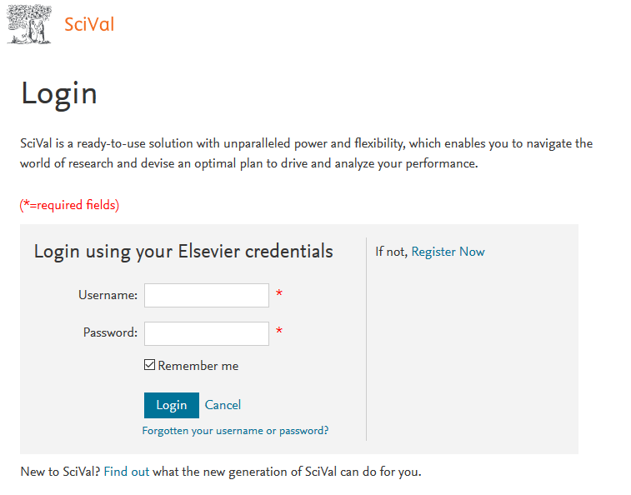
Log on to SciVal.com
Log-on to SciVal at: http://www.scival.com/home
Use an on-campus computer to log in for the first time
For subsequent off-campus use please log on via remote desktop. For more information on accessing remote desktop, click here.

Slide 4
Overview module: Create a new researcher record (1/4)
The ‘Define a new researcher’ function in the SciVal Overview module allows you to create a record for yourself. You can then use this record to compare your citation profile with that of other researchers.
Select the Overview module on the SciVal homepage
1.

Slide 5
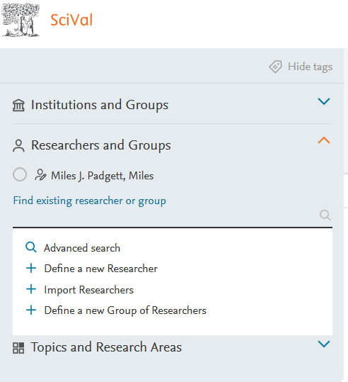
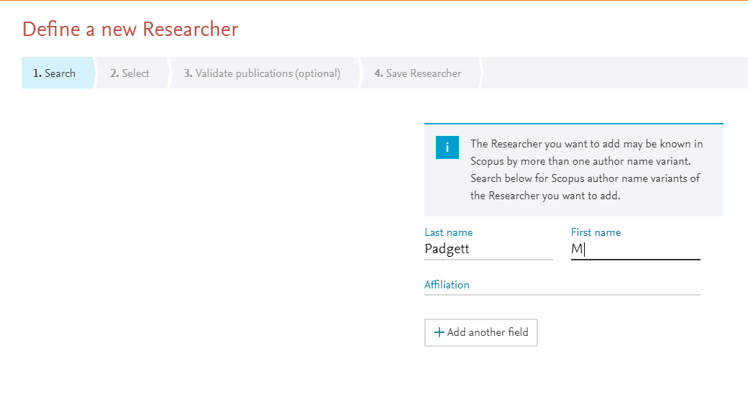
Overview module: Create a new researcher record (2/4)
Click on ‘Define a new Researcher’
Type in your name. You can optionally also add an affiliation; this will narrow the search, and so is useful if you have a common name
3.
2.

Slide 6
Overview module: Create a new researcher record (3/4)
Select yourself from the list of suggested authors
If you have more than one record, select the additional records too
Click ‘Directly go to Save Researcher’. This step will merge related records, where they exist
4.
5.
6.

Slide 7
Overview module: Create a new researcher record (4/4)
Choose how you want your researcher name to appear
There is an optional functionality to add one or more tags. Tags allow you to analyse a group of researchers that have the same tag(s)
Click ‘Save and finish’. You can now proceed to analyse your citation profile and compare it to others
7 & 8.
9.

Slide 8
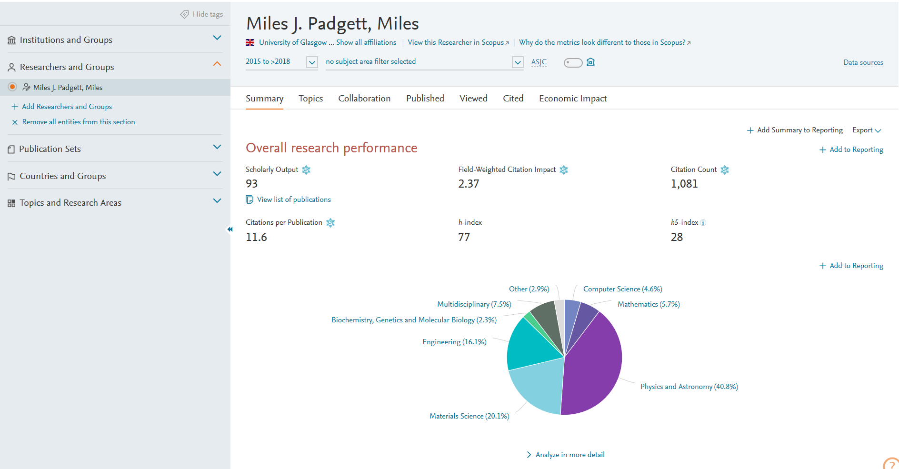
Overview module: Review your citation-based metrics (1/2)
The Overview module provides a high-level overview of the citation-based research performance of individual researchers but also of groups of researchers, institutions, or countries
Field-Weighted Citation Impact (FWCI): The ratio of citations received by an output relative to the expected world average for the subject field, publication type and publication year as indexed in the Scopus database
Select yourself in the ‘Researchers and Groups’ section
The ‘Summary’ tab gives you a list of bibliometric indicators under two sections: ‘Overall research performance’ (this slide) and ‘Performance Indicators’ (next slide). The blue boxes on this slide define each bibliometric indicator
Change the year range to the desired interval (records start in 2013)
Citation Count: Sums the citations received to date by institutional outputs
3.
1.
2.
Scholarly Output: The number of outputs of any type
Citations per Publication: The average number of citations received to date by each output that is part of a particular set
h-index: The number of articles by an author (h) that has received at least (h) citations. Note: this value is the lifetime h-index rather than the h-index in the selected time period
h5-index: The h-index based upon data from the last 5 years; e.g. when selecting 2017, the h5-index will reflect the date range 2013–2017 for both documents and citations
Notes:
Overview from 2013 benchmarking from 1996

Slide 9
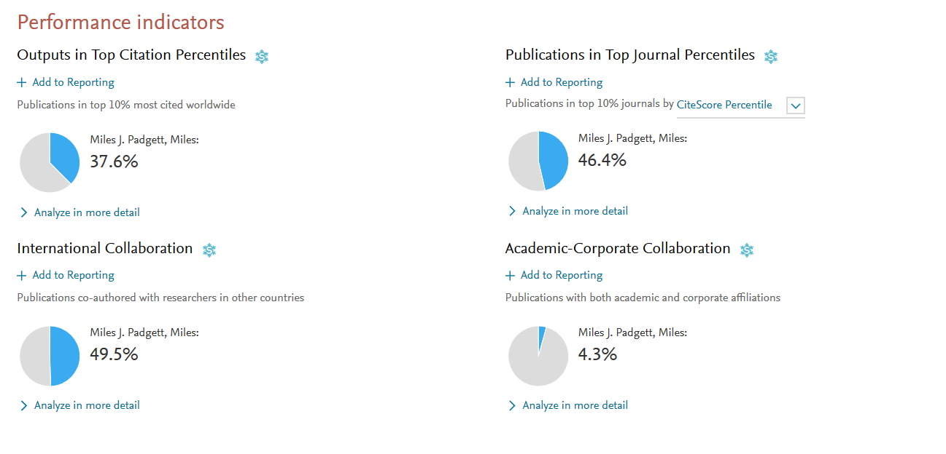
Overview module: Review your citation-based metrics (2/2)
Still on the ‘Summary’ tab, scroll down to see the ‘Performance Indicators’ heading
These indicators cannot be changed apart from the basis of the ‘Publications in top 10% journals’
Clicking on ‘Analyze in more detail’ will take you to other parts of the Overview module, where you can delve deeper into the selected metric
4.
5.
6.
6.
6.
6.

Slide 10
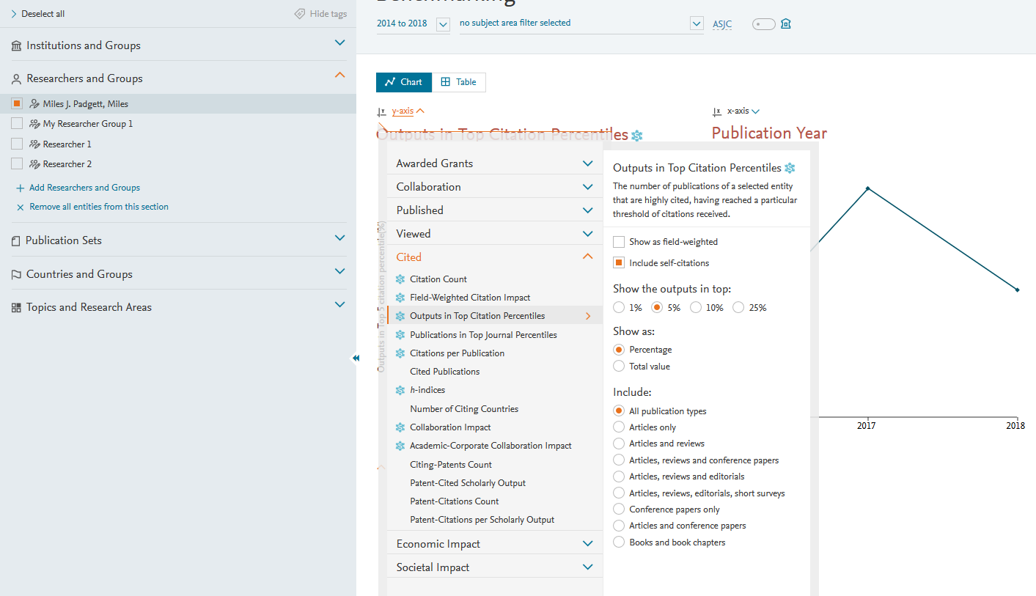
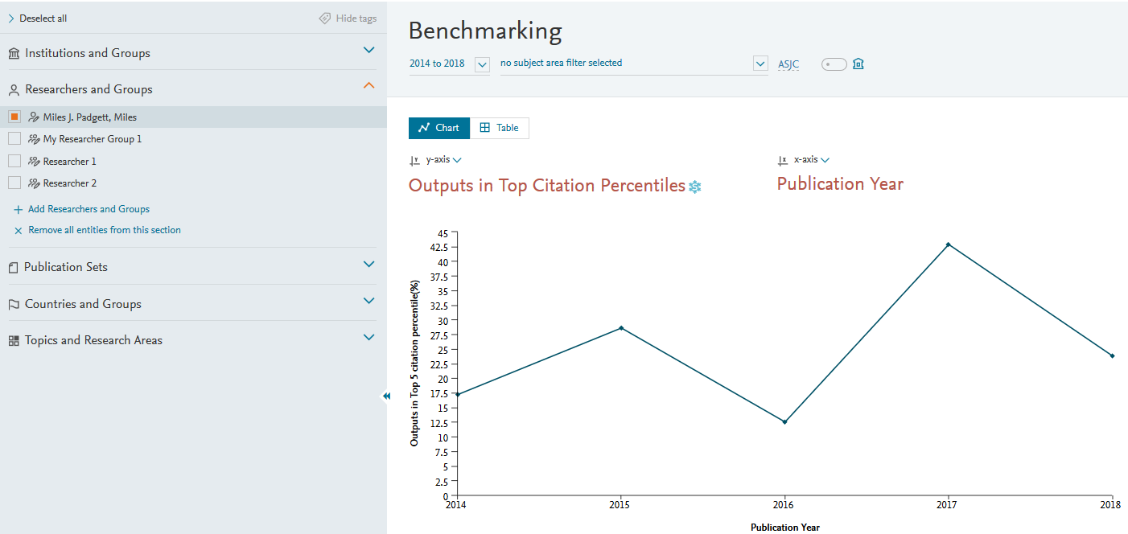
Benchmarking module: Compare yourself to others (1/3)
The Benchmarking module allows you to compare and benchmark yourself to other researchers and groups of researchers using a variety of metrics
Select yourself in the ‘Researchers and Groups’ section
Select up to 3 metrics. There are many to choose from: more information can be found here
In this example, Metric 1 is ‘Outputs in Top Citation Percentiles’ and Metric 2 is ‘Publication Year’.
In Metric 1, note the options. Here we have selected Outputs in the top 5% most highly cited. It will default to show as ‘Percentage’; it is more useful to display the results as ‘Total value’.
Change the year range to the desired interval (records start in 1996)
Data are available as a chart or table
5.
6.
1.
3.
2.
4.

Slide 11
Benchmarking module: Compare yourself to others (2/3)
Clicking on any value in the table allows you access the list of underlying publications
You can export this list to Excel
6.
7.

Slide 12
Benchmarking module: Compare yourself to others (3/3)
Use the steps described in slides 5–7 to add additional researchers to whom you wish to compare yourself
Use the steps described in slides 10–12 to compare yourself to these researchers across any of the SciVal metrics
8.

Slide 13
Further details on bibliometric indicators can be found on the MyGlasgow Research web pages
For further help with using SciVal, including queries on using the Collaboration module, please contact your College Librarian
Researchers are encouraged to read the University’s ‘Statement on the Use of Quantitative Indicators in the Assessment of Research Quality’ (2017) for guidance on the responsible use of metrics in research assessment
A copy of this Presentation can be found at https://edshare.gla.ac.uk/307

