Slide 1
Library
Guide to basic searches on key library databases in Medical, Veterinary and Life Sciences

Slide 2
This guide provides information on searching key library databases in Medical, Veterinary and Life Sciences.
The searches performed in the videos take you beyond simple textword (keyword) searching and introduce a level of rigour with the addition of subject headings to a search.
The processes illustrated are relevant to all types of literature review, although systematic-type searches will need to be a lot more exhaustive in the use of synonyms, acronyms and additionally searching and browsing for relevant subject headings.
Refer to the database help text for detailed search guidance for each database.
Guide contents
OvidSP (Medline and Embase)
EBSCOhost (CINAHL and PsycINFO)
Web of Science (BIOSIS Previews, Zoological Record and CAB Abstracts)
Cochrane Library
Truncation and wildcard crib sheet
Guide aims and contents

Slide 3
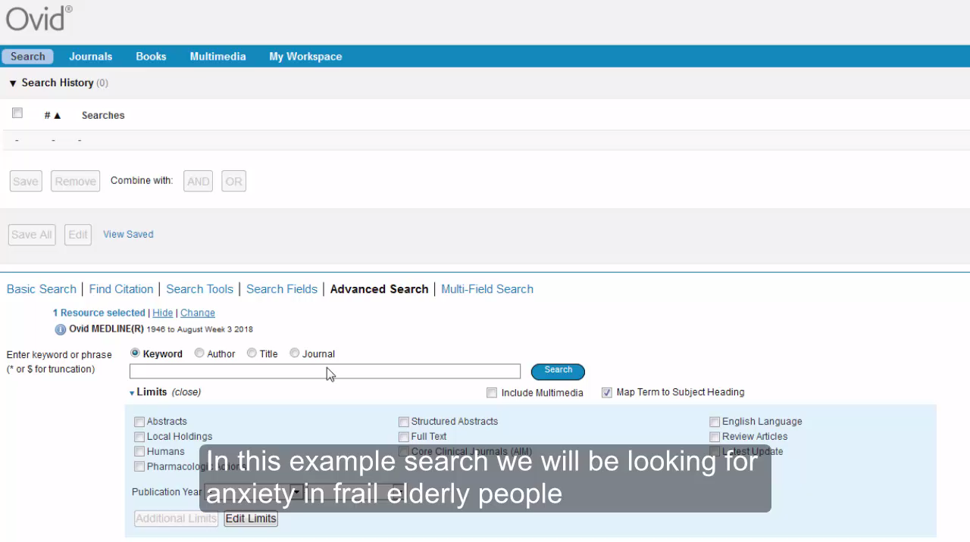
This video will illustrate a basic search conducted on the database Medline via the OvidSP interface. The same search process can be used for Embase.
The search focuses on anxiety in frail elderly people.
Click the image below to view the video. GUID and password required.
OvidSP (Medline and Embase)

Slide 4
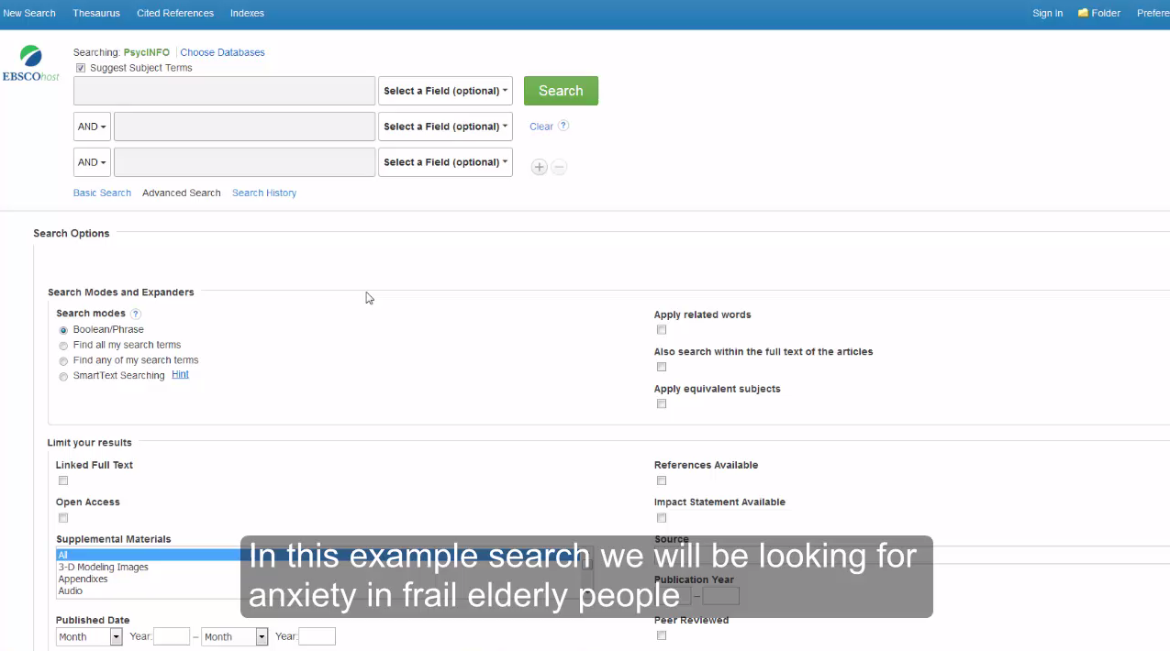
This video will illustrate a basic search conducted on the database PsycINFO via the EBSCOhost interface. The same search process can be used for CINAHL and other EBSCOhost databases.
The search focuses on anxiety in frail elderly people.
Click the image below to view the video. GUID and password required.
EBSCOhost (CINAHL and PsycINFO)

Slide 5
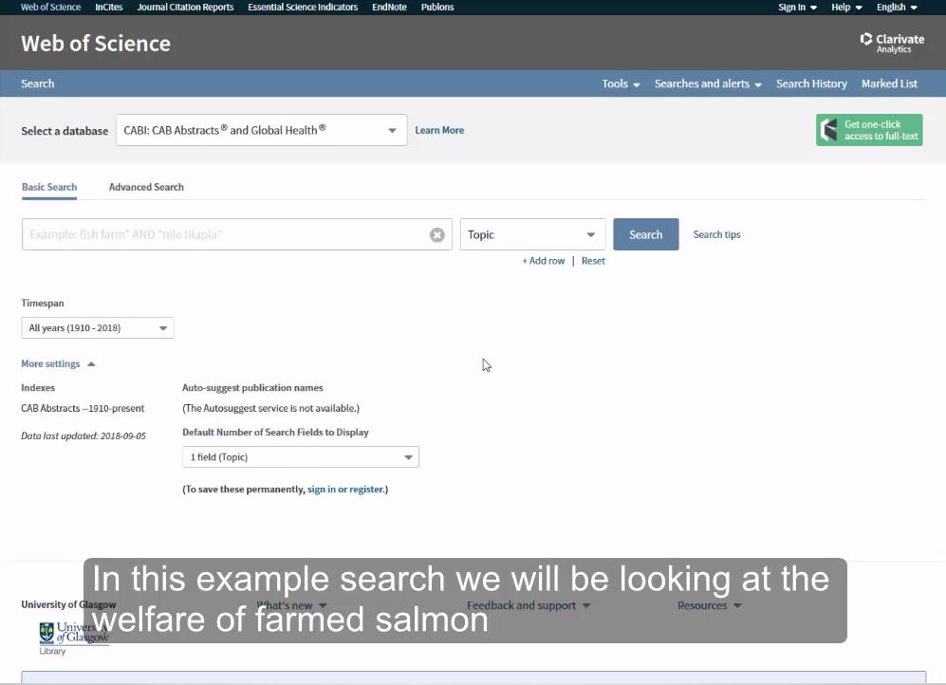
This video will illustrate a basic search conducted on the database CABI: Cab Abstracts and Global Health via the Web of Science interface. The same search process can be used for BIOSIS Previews and Zoological Record and other Web of Science databases. Note that the ‘standard/default’ Core Collection does not have the thesaurus options illustrated.
The search focuses on the welfare of farmed salmon.
Click the image below to view the video. GUID and password required.
Web of Science (BIOSIS Previews, Zoological Record and CAB Abstracts)

Slide 6
This video will illustrate a basic search conducted on the database Cochrane Library database via Wiley Interscience interface.
The search focuses on anxiety in frail elderly people.
Click the image below to view the video. GUID and password required.
Cochrane Library

Slide 7
Interface and database name(s) | Phrase searching | Truncation | Wildcard (mandatory one character) | Wildcard (zero or one character) | Proximity
OvidSP (Medline and Embase) | Automatic | * or $ | # | ? | adjX (where X can be from 1 to 99)
EBSCOhost (CINAHL and PsycINFO) | “Quotation marks around phrases” | * | ? | # | nX
Web of Science (BIOSIS Previews, Zoological Record and CAB Abstracts) | “Quotation marks around phrases” | * | ? | $ | near/X
Cochrane Library | “Quotation marks around phrases” | * | ? | * or ? depending of use | near/X
Always refer to the database help text for detailed search guidance for each database
Truncation and wildcard crib sheet

Slide 8
Library
Guide to basic searches on key library databases in Medical, Veterinary and Life Sciences by Paul Cannon is licensed under a Creative Commons Attribution 4.0 International License. Photo by Damian Zaleski on Unsplash.

