Slide 1
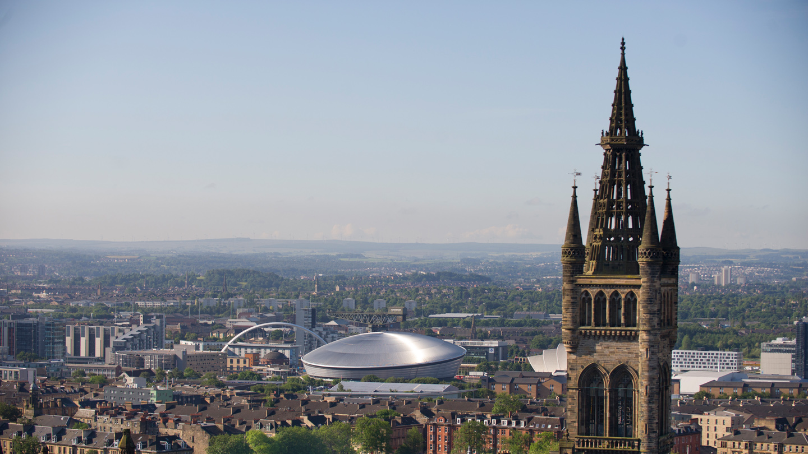


Lights, Camera, Deposit:
Using EMu and Sapphire to create a Digital Media Repository
@WilliamJNixon, Kirsty Menzies, Emma Yan
University of Glasgow Library, Information Services
#AxiellEU2018
24th May, 2018
Notes:
Good morning, I am delighted to be here at the UG to talk about a project which the library, archives and our comes office have worked on with EMu and Sapphire.
My name is William Nixon and I was the project sponsor and this morning’s designated speaker but this presentation and work belongs to Kirsty Menzies our project office and Emma Yan, the project manager. Much thanks to Kirsty in particular for her work in delivering this project and for this slidedeck!

Slide 2
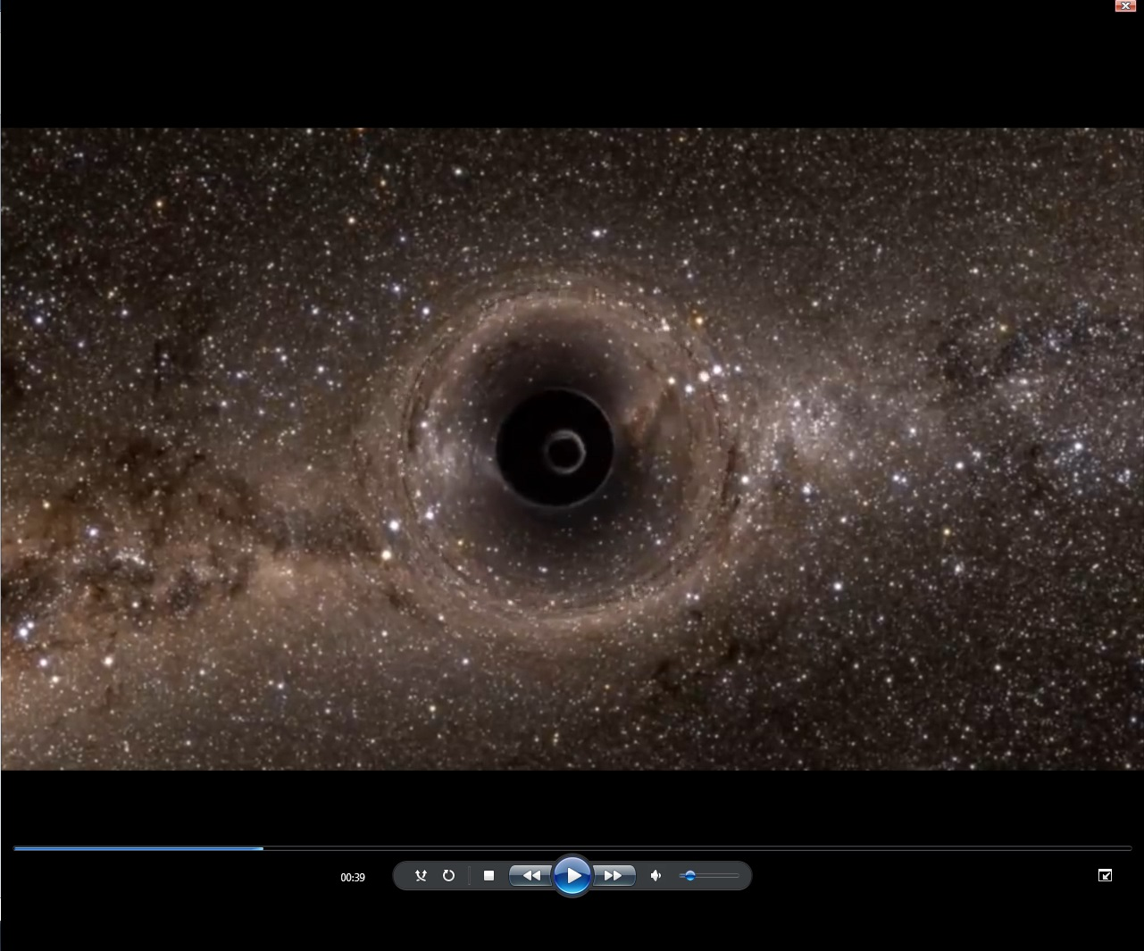
Background
Aim: To create a secure and searchable repository for the born-digital films created by the Comms & Public Affairs Office.
Stakeholders
Library & Archives
Comms & Public Affairs Office
Funding
US Innovation Fund
Notes:
So, why bother? Why this project?
Comms wanted a place where the films could be centrally stored, that would be searchable and easily found by staff. Films for reference and rushes that could be re-used in future film projects.​
Archive Services wanted a secure digital repository where the films can be kept safely as a record of life and work of the University and made available to researchers.​
The focus has been on simple tools for the upload, indexing and discovery will be created and the survival of this
information will be assured for future generations, in this case Sapphire.
​
​
This project will create a new secure digital repository to preserve the work of the Communications and Public Affairs Office as they engage society with the world changing work being
undertaken in Glasgow today. The repository will contain the multimedia items generated for
press releases including photographs and films. They will be indexed and made available to
the whole University to maximise the re-use potential in fundraising, public engagement and
marketing. This will enable press releases and films to be easily searchable and connected
with the Enlighten repository to enrich the auto-generation of material for staff webpages and
expert directories.
The project created new workflow, catalogue records and a data repository to capture and manage the
born digital output of the Communications and Public Affairs Office. The system will
empower them to efficiently store and share their output with the rest of the University.
This project will enable the University Archivists to test a new process for selecting and
capturing the University’s historical documents at point of creation. Many documents are in
current business systems ensuring their long term survival while that system is live. This
project will look at the materials that do not fall within such systems but which would be
designated essential to documenting our strategic priorities at any given moment in time.
Protecting priority digital materials at an early stage will ensure that our successors have the
information they might need to support future marketing and fundraising campaigns in the
same way we are using the story of building Gilmorehill to support and enhance campus
redevelopment on the Western site today.
Images: Gravitational Waves - Black Hole​

Slide 3
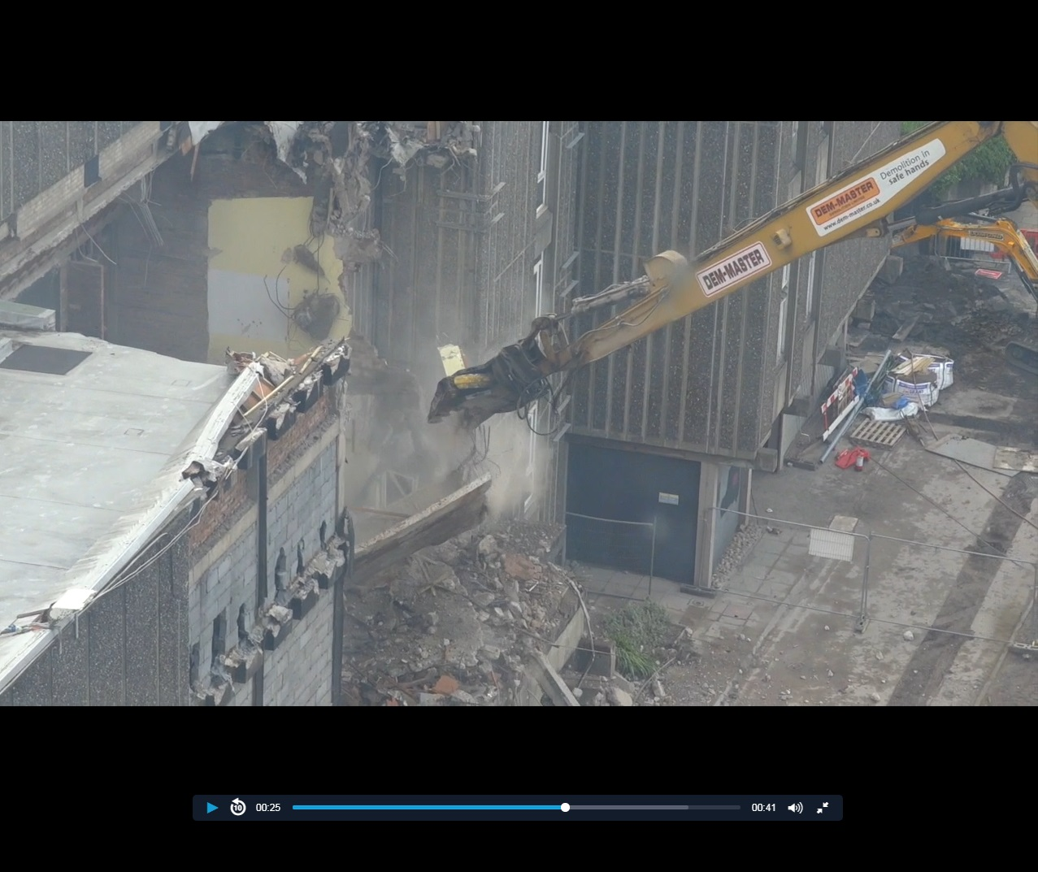
Wider Context
Explosion of Born Digital content
Digital Preservation
  Digital Preservation Policy
Extending use of EMu/Imu
Challenge of the Digital for Comms
Notes:
The working practices of the Communications and Public Affairs Office changed in August
2015. The making of short films about key stories has become routine and has been very
well received both by the University community and by the national and local media. The
relationship between the Communications Team and Archive Services has been
strengthened by the appetite of audiences for historical angles on current stories and the
strong imagery required in the film making process. Press releases and press cuttings are
an important resource in the University Archive and this project will ensure this continues to
the case by preserving them in a central data repository. These materials have a wide
potential appeal for enhancing webpages and for use at events. Creating the right storage
and access tools will be beneficial to current and future University Services staff
The University Archive has been the central place of deposit for the University’s records
since the appointment of the first archivist in 1955. Included are the records of previous
generations which are being used extensively for the Fundraising Campaign to engage
audiences

Slide 4
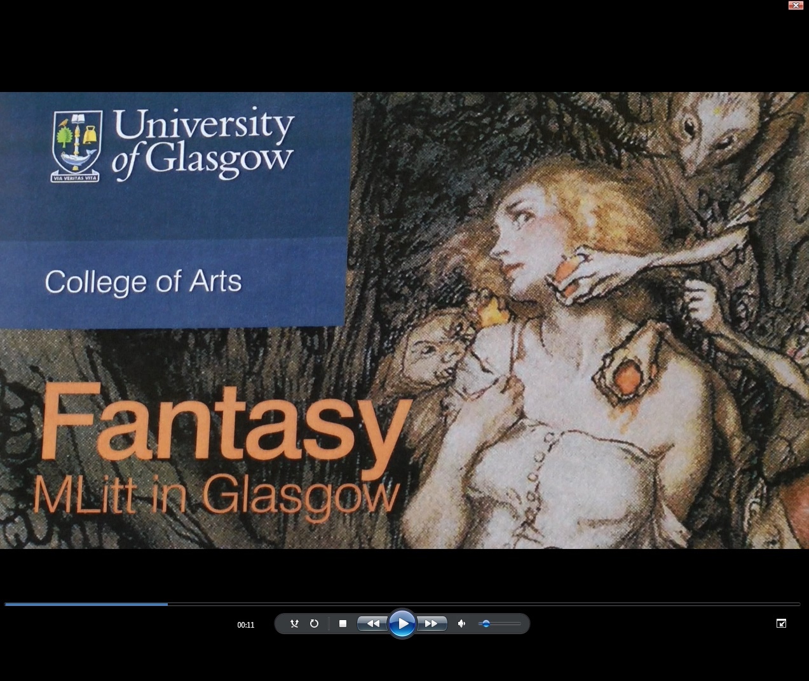
The Films
Films produced since 2015 for
UoG website
Facebook
Twitter
YouTube
Funding
Research & Learning
People, & Events
Buildings & Community
Notes:
Films – Capture different aspects of life and work of the University. News tends to be more serious items showcasing the high quality outputs, including; awards for staff; innovative and world-changing research; University rankings; major funding awards – all promoting the University as a world-class institution. Also updating people on what is happening on campus with events and building developments. Social media captures a more diverse picture of the University, from the ground-breaking stuff to the lighter-hearted side of student experience and university community. See from the images used in this presentation – all taken from Comms films.​
All the films were held on a couple of computers in the Comms office, filed in folders by name of who had produced them, no naming convention. Downloaded the films as mp4 files onto an external hard driver in order reflecting that of the computers they had been taken from and noting the date of the original film files. The files were taken back to archives for the next stage. The hard drive also provided a back-up until a secure management system was in place.

Slide 5
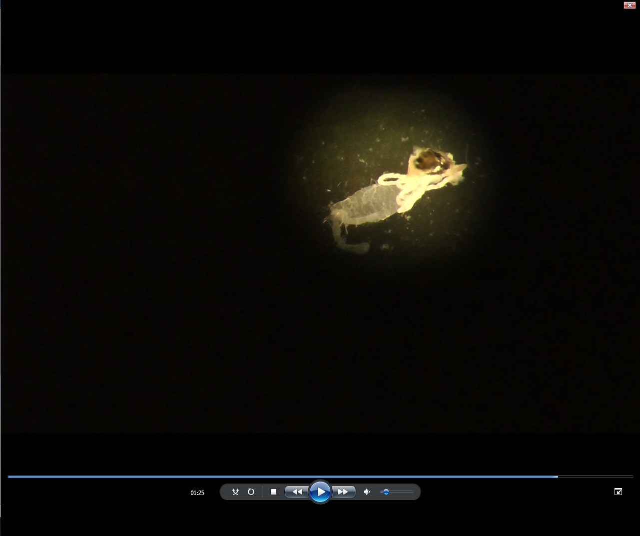
Why EMu & Sapphire?
ISAD (G) and EAD compliant
strong support base
tailored to our requirements
good global reputation
longevity
joined-up University collections
Notes:
EMu a collections management system offered by Axiell who also provide Calm and Adlib
Used by museums and archives across the world - support base from Axiell and the wide user- community, tailored to our needs, international reputation, longevity
Used by The Hunterian for its collections – joined up collections.
Image: Fly larvae in Zika Virus research.

Slide 6
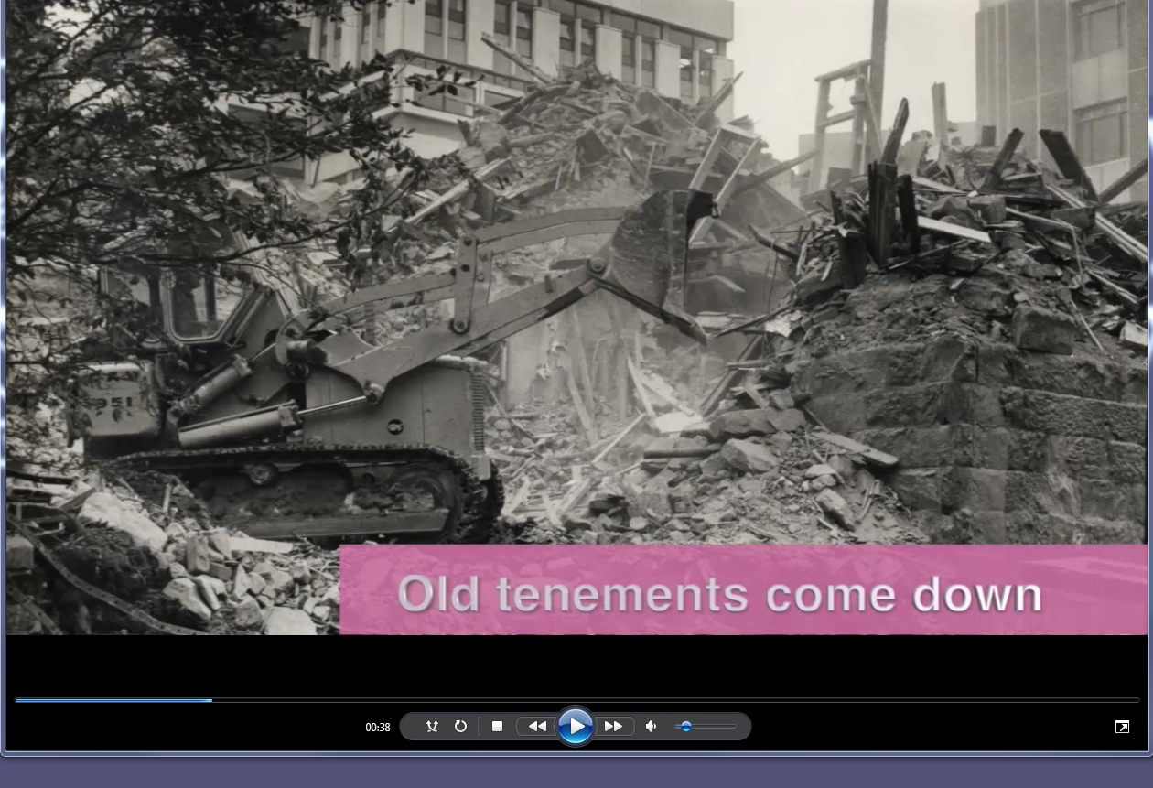
The Team
Staffing
William J Nixon (Sponsor)
Emma Yan (Project Manager)
  Managed project
Kirsty Menzies (Project Officer)
  Collected files
  Reviewed files
  Uploaded into EMu
Notes:
All the films were held on a couple of computers in the Comms office, filed in folders by name of who had produced them, no naming convention. Downloaded the films as mp4 files onto an external hard driver in order reflecting that of the computers they had been taken from and noting the date of the original film files. The files were taken back to archives for the next stage. The hard drive also provided a back-up until a secure management system was in place.
Work was still being done on the live EMu system so until it was ready I practised using the test system. Orla had been working on the project before me and left guidelines on the process. I listed all the films on a spreadsheet with file location, date, project, file name and reviewed each film writing a short description to include the subject matter, people in it and types of camera shots. Doing both these tasks got a feel for how EMu worked but also how the films could be catalogued and arranged within the system.
Now familiar with using EMu on the test system and having all the descriptions and films ready to upload meant that when the live EMu system was ready it would be a quick process to catalogue and upload the films – or so I thought.
Images: Maths & Stats building

Slide 7

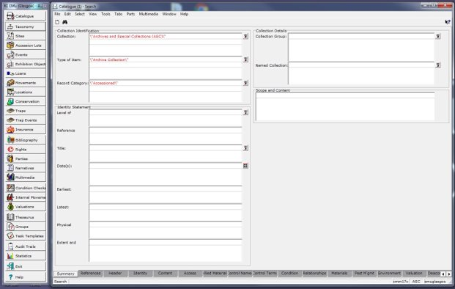
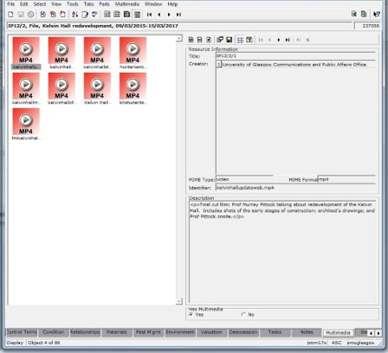
Overview
Upload
Catalogue/Accession
  Reference Numbers
  Names > Party Records
  Controlled Index Terms
  Topics
Discovery
IMu
  University of Glasgow

Slide 8

Overview
Notes:
Lightweight web interface for web users
Still have guidelines e.g. around date but will be done in consultation with the department
Description > Catalogue module (scope and content)
Multimedia > Multimedia module - just cut and paste
This has been shortened, did take 20 seconds can be up to 2 minutes
Save Successful only briefly appears -
Automatically tagged as Archive Collection and Archive upload in the background
Can now see everything which is in Archive Collection and Upload - this is a review file
Need to then do the controlled access term, date, parties, rights
Control Names > from Notes to party record (or create new one)
Control Terms

Slide 9
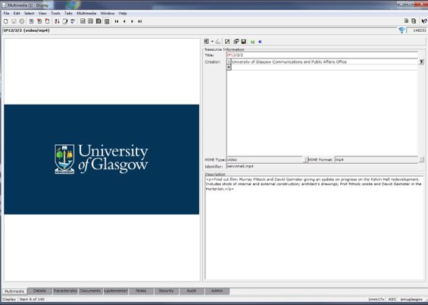
Key Challenges
File Sizes
Balancing Simplicity & Ease
of Use (and value)
Cataloguing the material
Wide Range of Formats
Notes:
Initially a 100MB limit on the upload – have tested upload up to 2 gig but focus here on future proofing
Number of fields for end user – balancing
Catloguing the material > still need to do the processing but need to capture what we cn

Slide 10
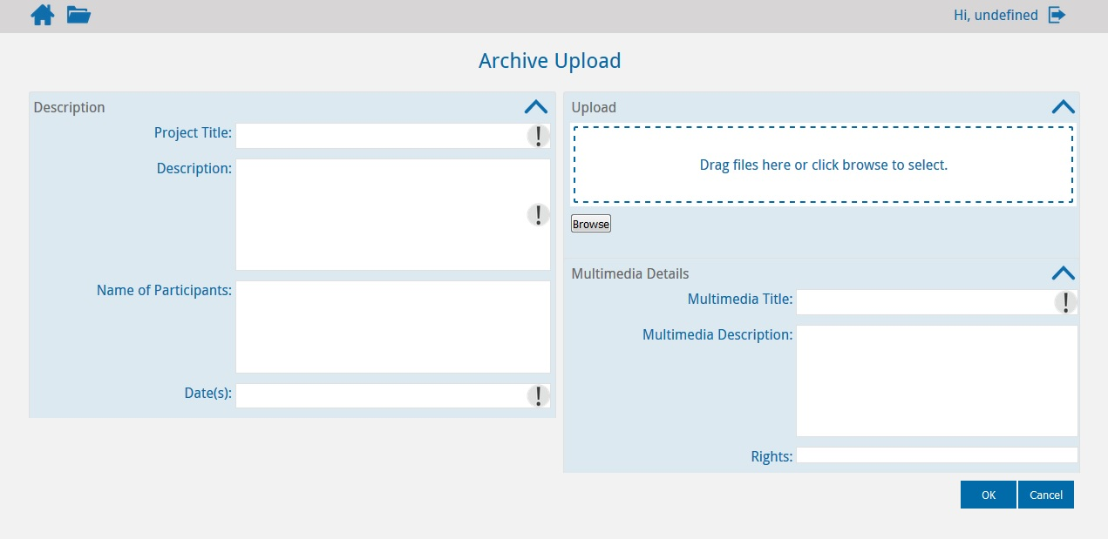
Sapphire
Capture essential information from the Comms Team including:
Project Title (Title)
Description (Description)
Name of Participants (Control Names)
Date(s)
Notes:
Looking ahead the next stage for the films project is to get Comms to describe and upload their content to EMu themselves. The cataloguing of the films will be done by archives but it makes sense for Comms to add the descriptions as they have a detailed knowledge of what the films are about and the information they will be searching on to retrieve films. Also it is a more efficient use of time for them to write descriptions than for an archives person to watch the films and then describe them.
Comms will not be adding films to EMu directly but via an upload system called Sapphire.
This is the Sapphire interface. Want something quick, easy to use, captures essential info.
Cataloguing from Comms data via Sapphire? File naming, descriptions, guidelines
Department or Unit Name(Creator) : Communications and Public Affairs Office
Project Title (Title): Title of the film Note not number at this stage but name
Description (Description): Description of content of the film
Name of Participants (Control Names): names of people in the films
Date(s) – same
Multimedia description needs to contain separate descriptions for each film if more than one uploaded.
Protocols needed – for Project Title so archives can identify new uploads on EMu.
Archivist will then allocate a reference code to the catalogue entry and individual multimedia files (Title), add physical description, add the names of participants in control names, add other control names and terms.
Different needs - Comms only keeping what they see as important stuff but archives want the daft stuff too as you want a memory of different aspects of the University – not just the serious research stuff and building redevelopment in the news website but the fun stuff in facebook Team UofG
Not using yet as there is a problem with upload size. Although uploading quickly directly into EMu the sapphire system is having problems loading anything over 100MB. The films range from 10-2,600 MB (2.6 GB) and most over 200 MB.

Slide 11
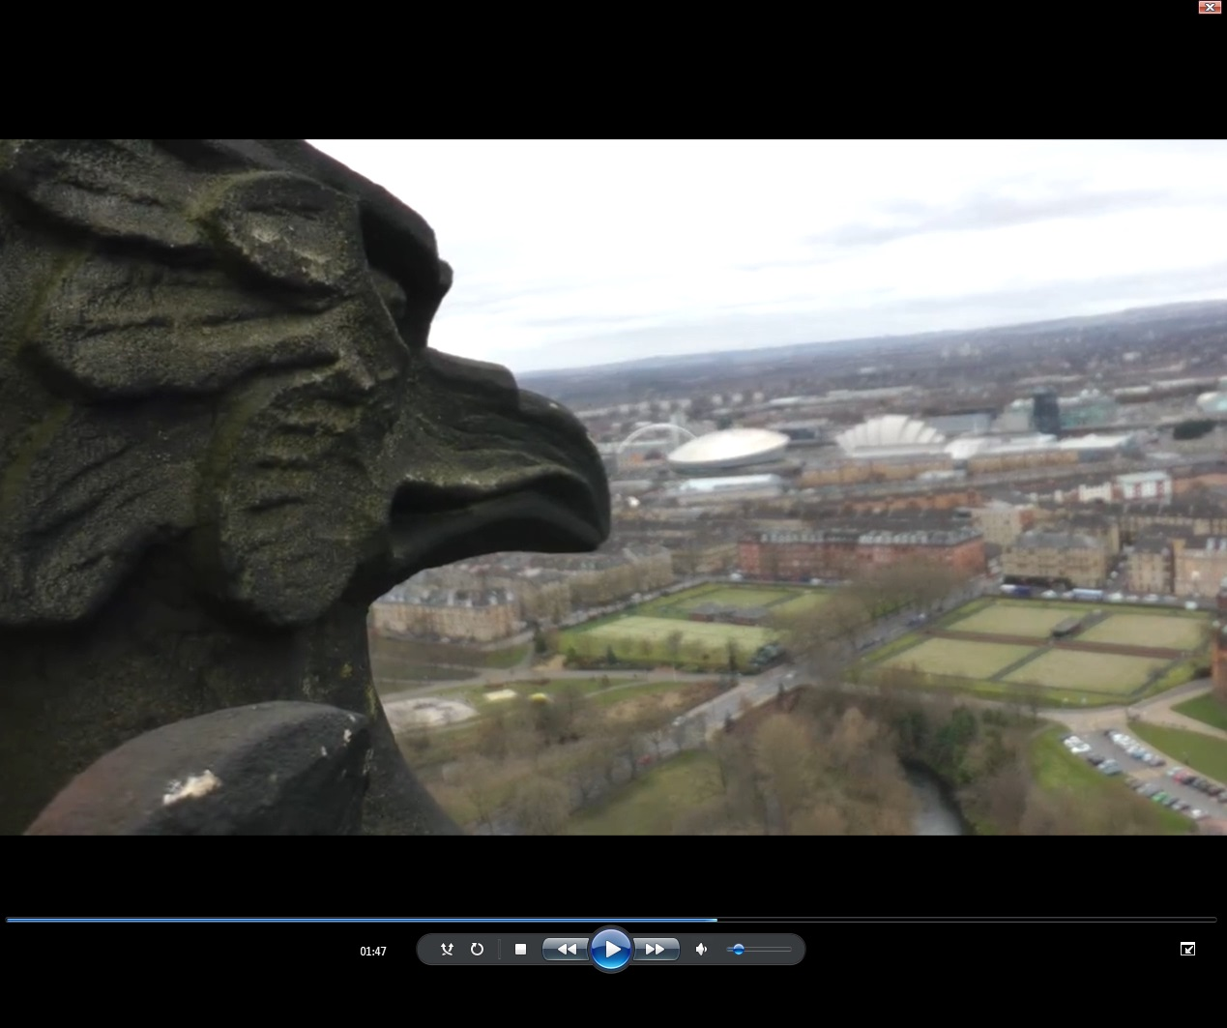
Next Steps
IMu
Embedded with Comms
Beyond Comms
Guidelines
Summer rollout
Other content
Digital Preservation
Notes:
Imu will be the public-facing online catalogue where people will be able to go in and search the content held in EMu. The Hunterian already have a system for searching their collections and it will be along those lines although tailored to be appropriate for archives and spec coll. From there users will be able to not only search for the films but be able to view them. Ultimately the ASC catalogues will be imported into EMu via magic devised by Mark where existing catalogues will have their fields mapped to those on EMu.
Future horizons:
Importing archives existing catalogues and listing new ones directly into EMu
Joined up searching between archives, spec coll and hunterian
Linking to Research data, Enlighten, e.g. Sheila Rowan, Nick Kamenos
Adding digitised analogue footage from the archives, which could also be used in born-digital material.
Capturing the web pages and linking to the films
Image: Tower

Slide 12
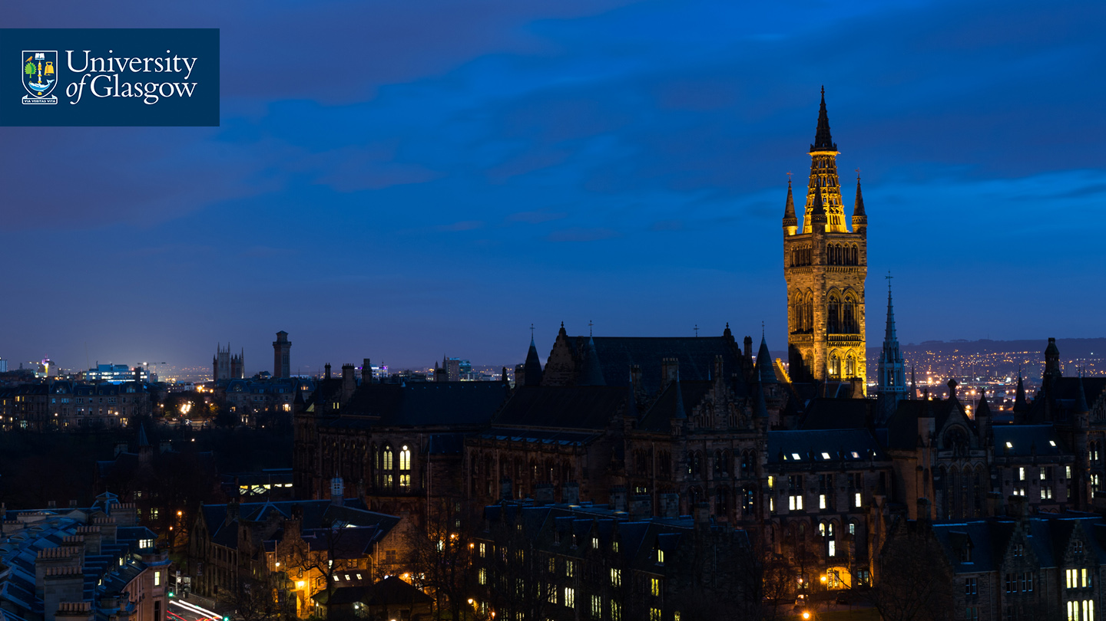



Thanks (and Questions)
Acknowledgements
Moira Rankin
Kirsty Menzies
Emma Yan
University Services Innovation Fund
#UofGWorldChangers
@UofGlasgow

