Slide 1
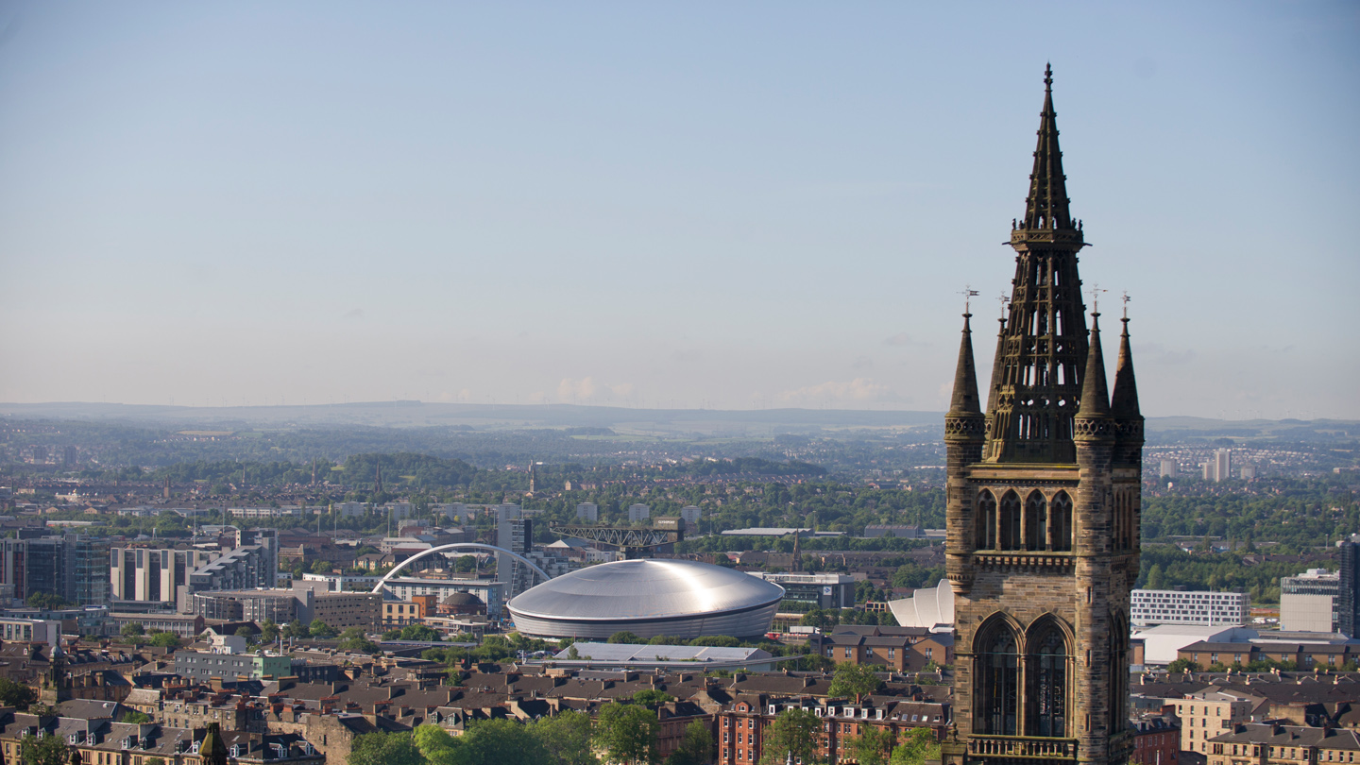


Lights, Camera, Deposit:
Using EMu and Sapphire to create a Digital Media Repository
@WilliamJNixon, Kirsty Menzies, Emma Yan
University of Glasgow Library, Information Services
#AxiellEU2018
24th May, 2018

Slide 2
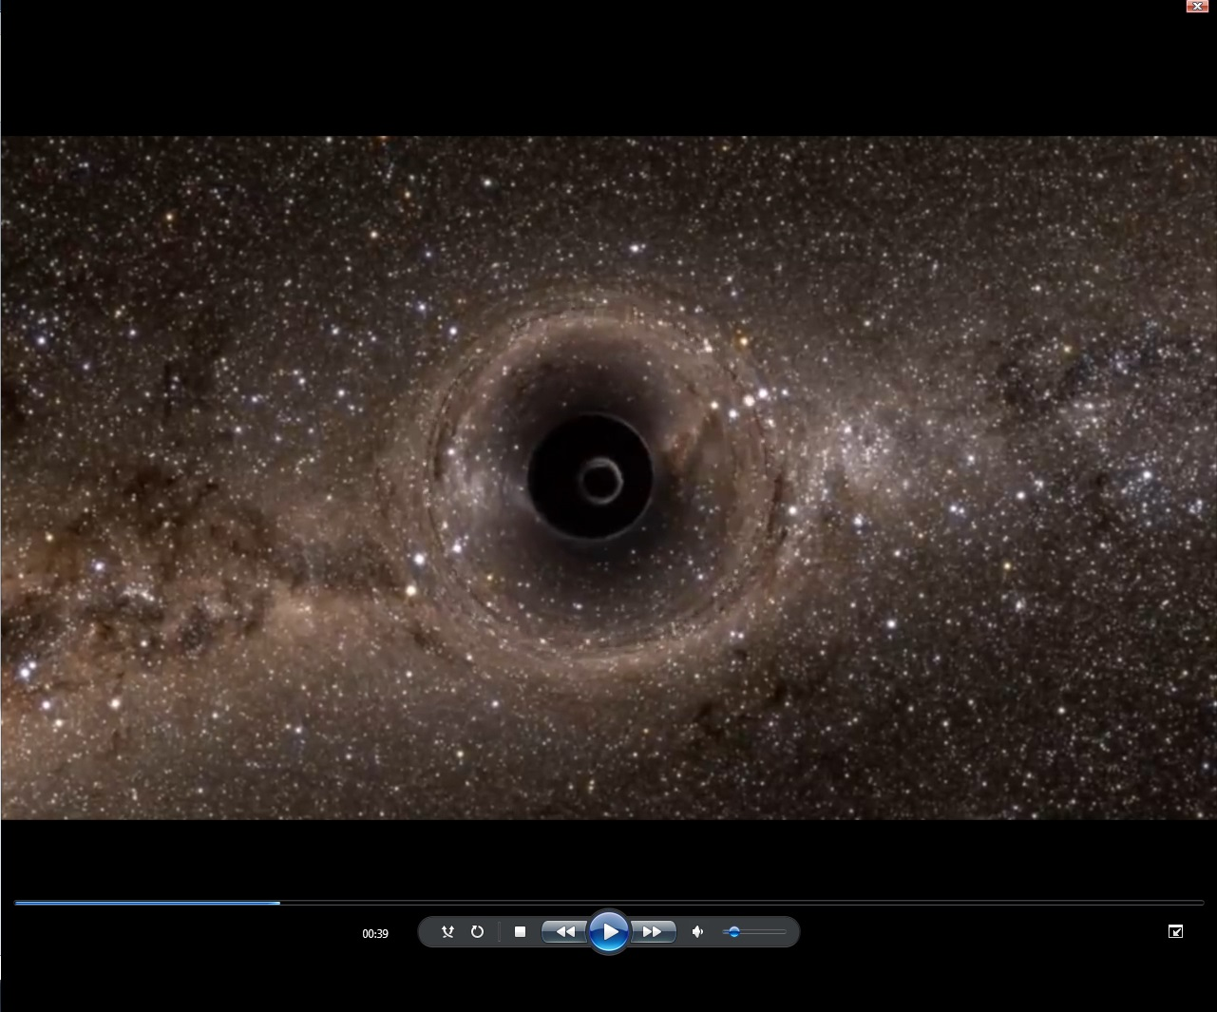
Background
Aim: To create a secure and searchable repository for the born-digital films created by the Comms & Public Affairs Office.
Stakeholders
Library & Archives
Comms & Public Affairs Office
Funding
US Innovation Fund

Slide 3
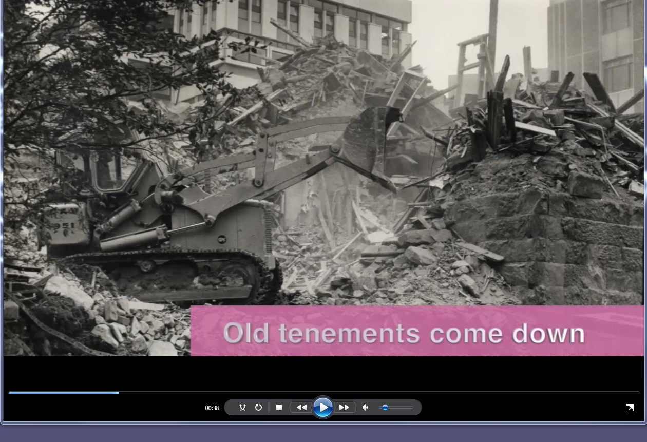
The Team
Staffing
William J Nixon (Sponsor)
Emma Yan (Project Manager)
  Managed project
Kirsty Menzies (Project Officer)
  Collected files
  Reviewed files
  Uploaded into EMu

Slide 4
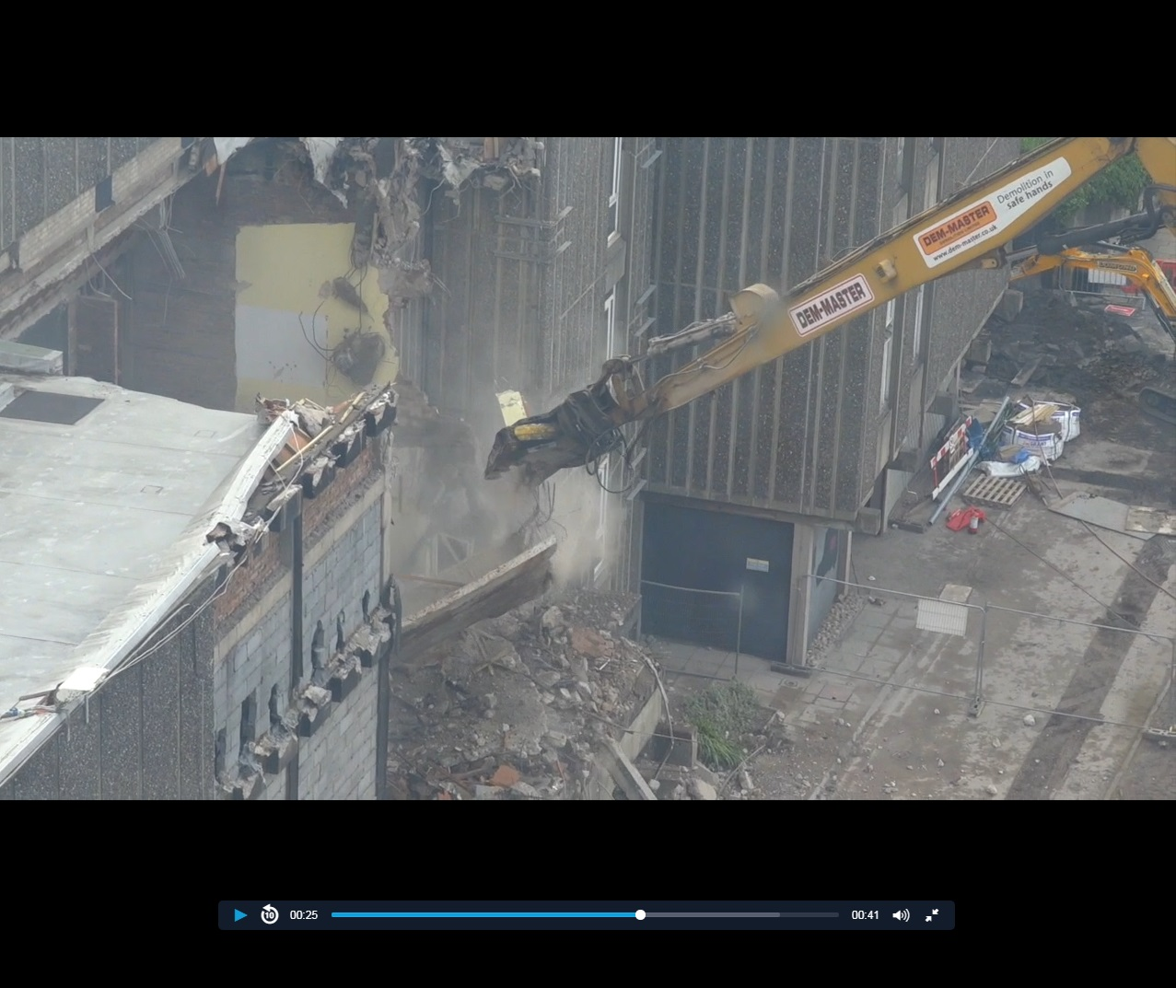
Wider Context
Explosion of Born Digital content
Digital Preservation
  Digital Preservation Policy
Extending use of EMu/Imu
Challenge of the Digital for Comms

Slide 5
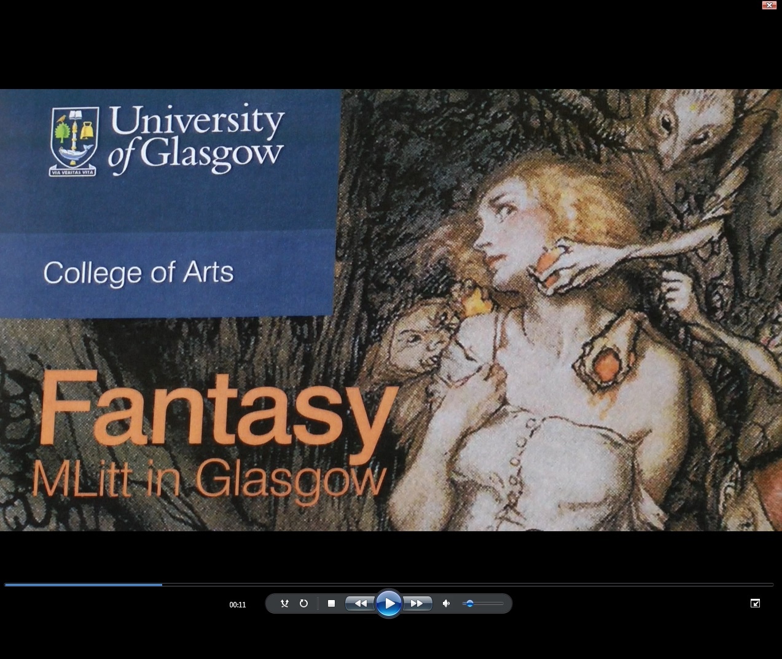
The Films
Films produced since 2015 for
UoG website
Facebook
Twitter
YouTube
Funding
Research & Learning
People, & Events
Buildings & Community

Slide 6
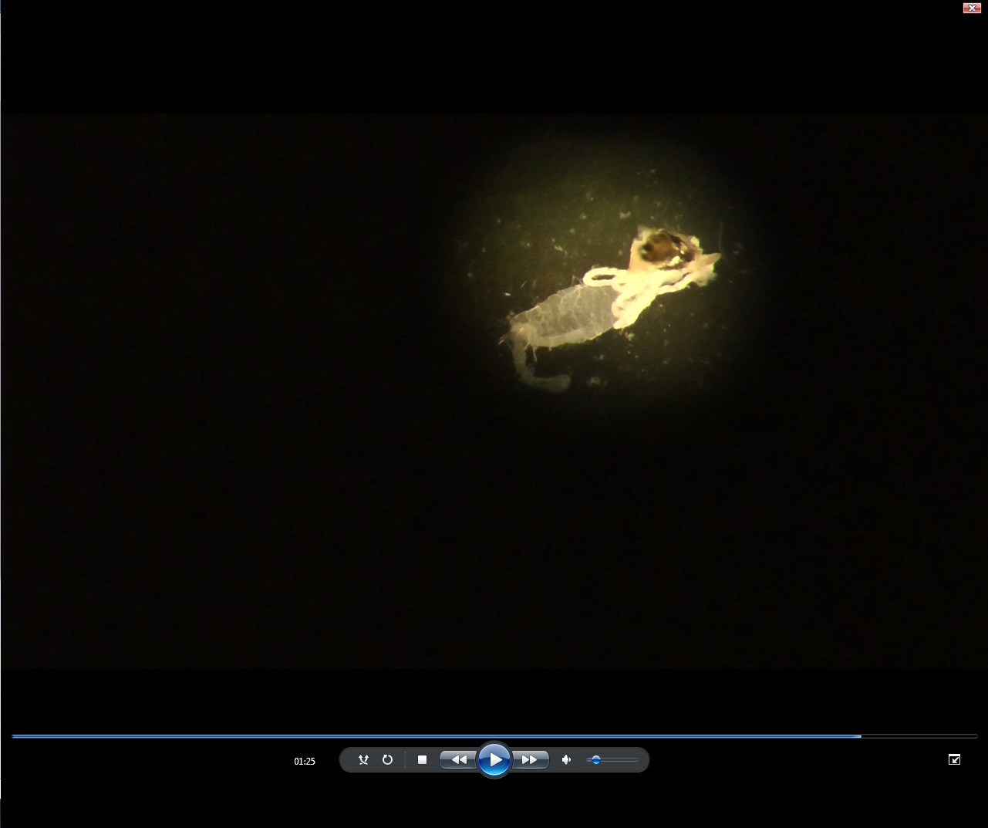
Why EMu & Sapphire?
ISAD (G) and EAD compliant
strong support base
tailored to our requirements
good global reputation
longevity
joined-up University collections

Slide 7

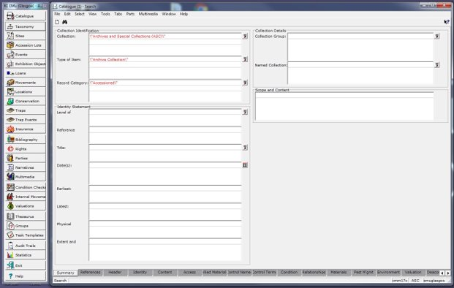
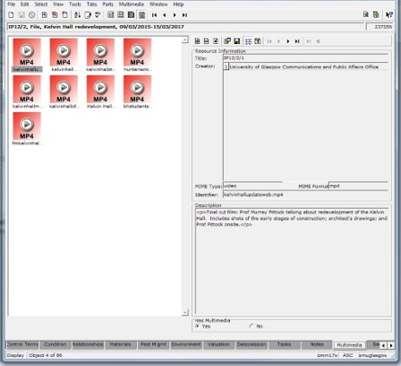
Overview
Upload
Catalogue/Accession
  Reference Numbers
  Names > Party Records
  Controlled Index Terms
  Topics
Discovery
IMu
  University of Glasgow

Slide 8
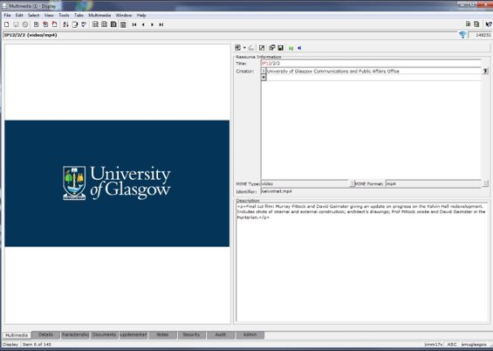
Key Challenges
File Sizes
Balancing Simplicity & Ease
of Use (and value)
Cataloguing the material
Wide Range of Formats

Slide 9
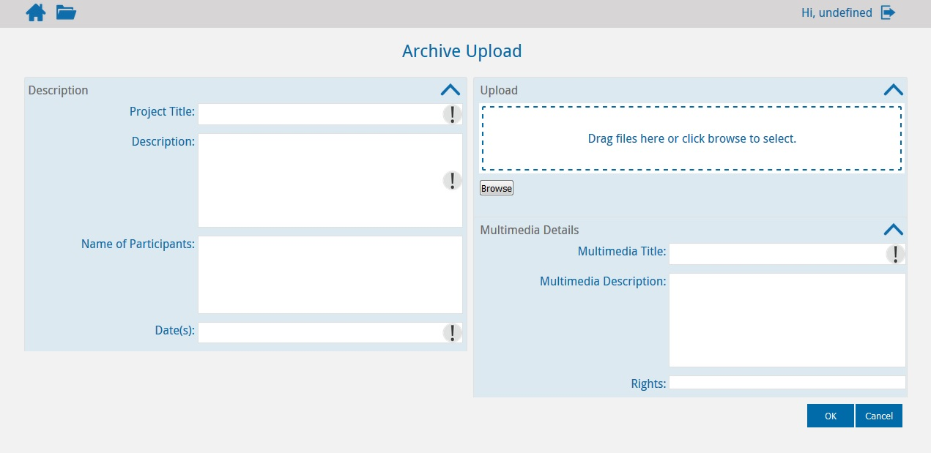
Sapphire
Capture essential information from the Comms Team including:
Project Title (Title)
Description (Description)
Name of Participants (Control Names)
Date(s)

Slide 10
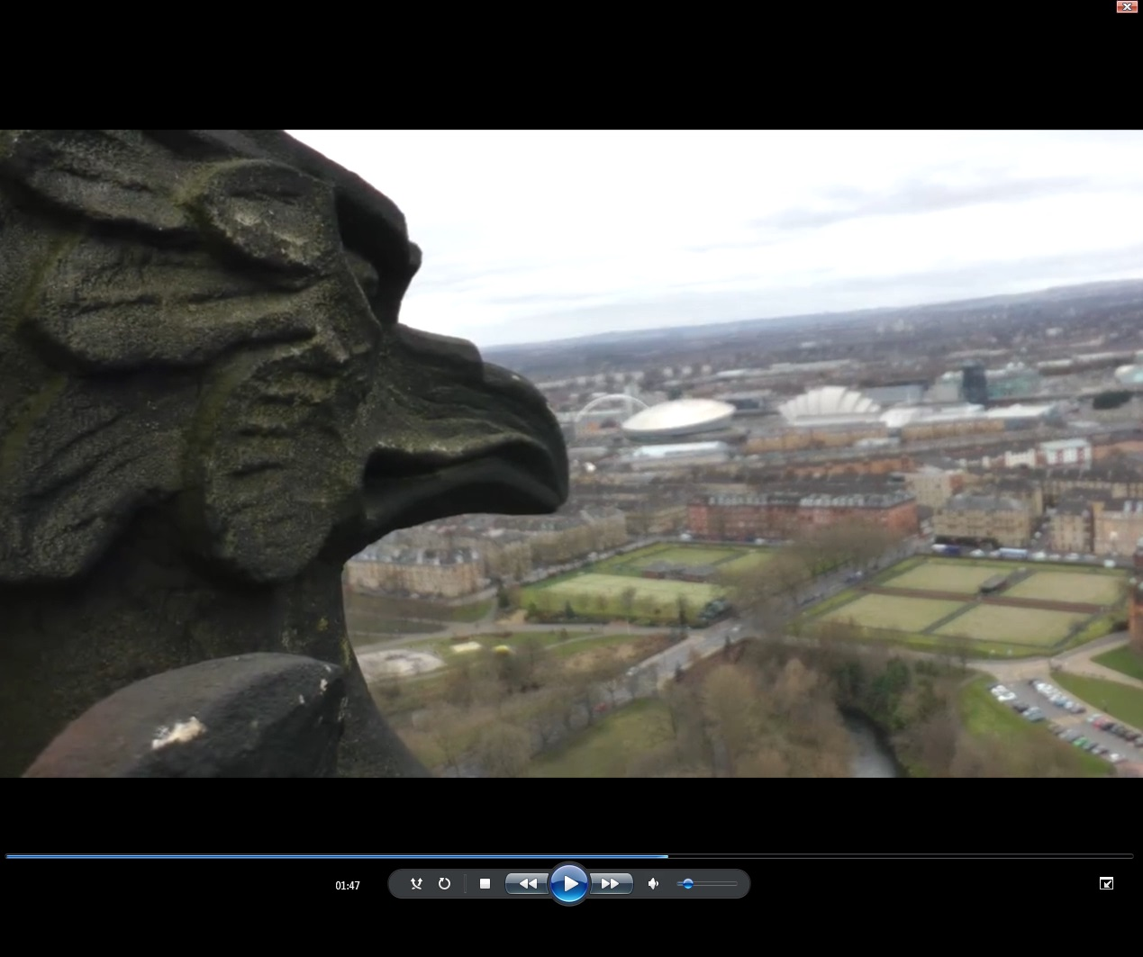
Next Steps
IMu
Embedded with Comms
Beyond Comms
Guidelines
Summer rollout
Other content
Digital Preservation

Slide 11
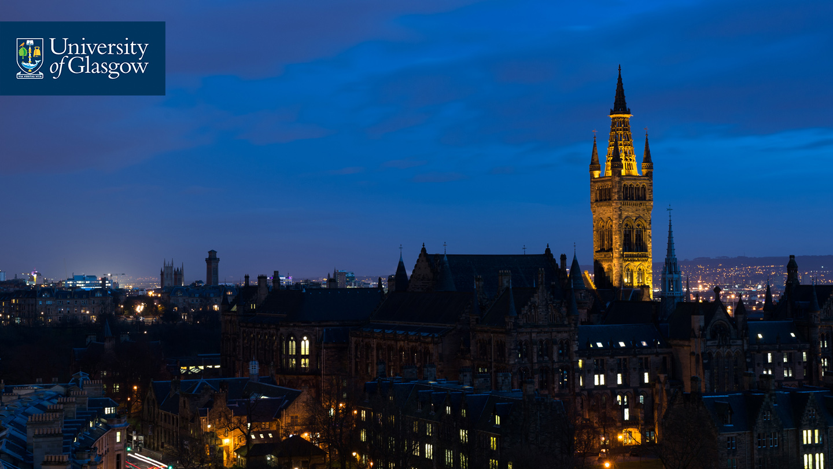



Thanks (and Questions)
Acknowledgements
Moira Rankin
Kirsty Menzies
Emma Yan
University Services Innovation Fund
#UofGWorldChangers
@UofGlasgow

