Slide 1
Introduction
to systematic
reviews
Paul Cannon
College Librarian Medical, Veterinary & Life Sciences
paul.cannon@glasgow.ac.uk
@pcann_LIS
http://orcid.org/0000-0001-8721-1481
This work is licensed under a Creative Commons Attribution 4.0 International License

Slide 2
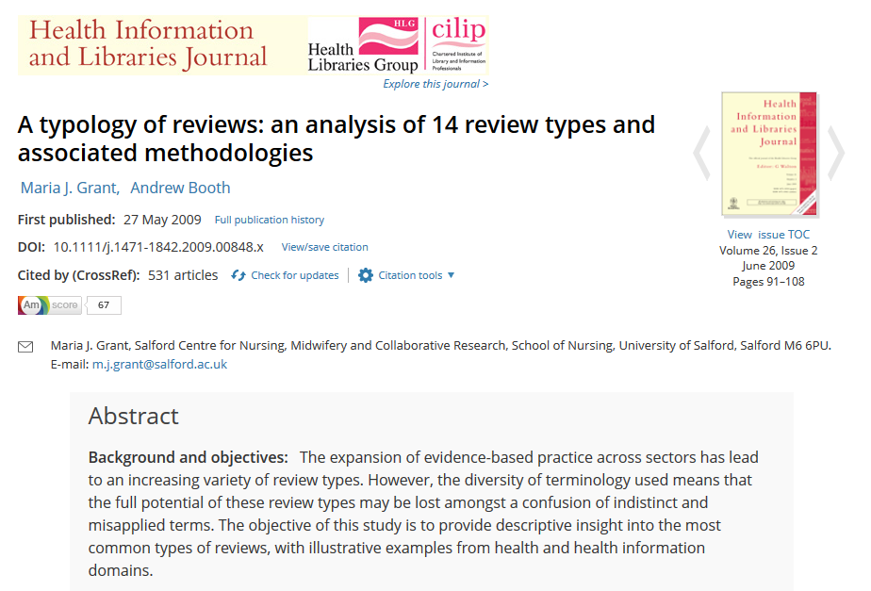
Systematic reviews compared to other types of review
https://doi.org/10.1111/j.1471-1842.2009.00848.x
How are systematic reviews defined?

Slide 3
How are systematic reviews defined?
Description:
Systematic search, appraisal and synthesis, following set guidelines
Transparent reporting of its methods
Perceived strengths:
Collation of all knowledge as defined by the protocol
Wide range of study methodologies
Perceived weaknesses:
Limitations in search breadth and scope
Adapted from: Grant, M. J. and Booth, A. (2009), A typology of reviews: an analysis of 14 review types and associated methodologies. Health Information & Libraries Journal, 26: 91-108. doi:10.1111/j.1471-1842.2009.00848.x
How are systematic reviews defined?

Slide 4
Finding systematic reviews
Clinical medicine
PROSPERO
Cochrane Library
Joanna Briggs Library
Turning Research Into Practice (TRIP)
PubMed Health
Public health and social sciences
Health Evidence
EPPI-Centre
Campbell Collaboration
Finding systematic reviews

Slide 5
Defining the review question, scoping searches and the review protocol
Review questions will come from the existing literature
Your own clinical practice and experiences to date
Conversations with supervisors and peers
The review question will be refined by your scoping searches
Scoping searches help define your systematic review protocol
Review question, scoping and protocol

Slide 6
Creating a search strategy
PICO Used for: Evidence-based medicine http://dx.doi.org/10.7326/ACPJC-1995-123-3-A12 | SPICE Used for: Evaluating projects or interventions http://dx.doi.org/10.1108/07378830610692127 | SPIDER Used for: Qualitative or mixed methods http://dx.doi.org/10.1177/1049732312452938 | ECLIPSE Used for: Evaluating services http://dx.doi.org/10.1046/j.1471-1842.2002.00378.x
Population / patient | Setting | Sample | Expectation
Intervention / indicator | Perspective / population | Phenomenon of Interest | Client group
Comparator / control | Intervention | Design | Location
Outcome | Comparison | Evaluation | Impact
 | Evaluation | Research methodology / method | Professionals
 |  |  | SErvice
See Supplementary Material 1 of Booth A, Noyes J, Flemming K, et al. Formulating questions to explore complex interventions within qualitative evidence synthesis. BMJ Global Health 2019;4:e001107: http://dx.doi.org/10.1136/bmjgh-2018-001107 for an exhaustive list of question formulation frameworks.
If a template doesn’t fit your research question, don’t worry. The main aim is to identify the key components of your search and the various synonyms and acronyms used to describe them.
Search strategies

Slide 7
A worked PICO(-ish) example…
“For children and adolescents with attention deficit hyperactivity disorder (ADHD), what is the comparative efficacy and safety of pharmacological and non-pharmacological treatments?” [Looking only for meta-analyses and systematic reviews].
Children and adolescents with ADHD
Population / patient
Intervention / indicator
Comparator / control
Outcome
Pharmacological treatments
Non-pharmacological treatments
Efficacy and safety
Study type | Meta-analyses and systematic reviews
Research question taken from: Catala-Lopez, F et al. The treatment of attention deficit hyperactivity disorder in children and adolescents: protocol for a systematic review and network meta-analysis of randomized controlled trials. Available at: http://www.crd.york.ac.uk/PROSPERO/display_record.php?ID=CRD42014015008
Search strategies

Slide 8
Illustrating a PROSPERO search strategy
Adapted from search strategy in: Catala-Lopez, F et al. The treatment of attention deficit hyperactivity disorder in children and adolescents: protocol for a systematic review and network meta-analysis of randomized controlled trials. Available at: http://www.crd.york.ac.uk/PROSPERO/display_record.php?ID=CRD42014015008
INTERVENTION
CONDITION
STUDY TYPE
POPULATION
INTERVENTION
Retrieved literature
Intervention
A
B
F
OR
C
POPULATION
Paed-iatric
CONDITION
Hyper-kinetic
E
D
Adole-scent
OR
Child
AND
Attention deficit disorder
OR
ADHD
Meta-analysis
STUDY TYPE
OR
SRs
Search strategies

Slide 9
What would a librarian do?
By Bill Branson (Photographer) [Public domain], via Wikimedia Commons
A librarian at the National Library of Medicine (NLM) is using an IBM computer to access PDQ. The Physicians Data Query was designed by the National Cancer Institute to help physicians obtain information about the most up-to-date protocols, physicians, and clinics treating cancer patients.

Slide 10
Remove the intervention…
The most systematic method of retrieving all literature on children with ADHD, but will retrieve lots of irrelevant results that are not intervention-led.
POPULATION
CONDITION
STUDY TYPE
Search strategies

Slide 11
Focus on (a) particular intervention(s)…
If a specific intervention is chosen, naturally the number of results retrieved will be smaller. That may make the review more feasible with respect to time and resource limits, but may reduce the impact of the review.
POPULATION
INTERVENTION
CONDITION
STUDY TYPE
Search strategies

Slide 12
Meta-analysis
Similar to the original search strategy, but with the addition of no intervention or placebo.
POPULATION +
CONDITION +
PHARMALOGICAL INTERVENTION
POPULATION +
CONDITION +
NON-PHARMALOGICAL INTERVENTION
POPULATION +
CONDITION +
NO INTERVENTION OR PLACEBO
Search strategies

Slide 13
The importance of the scoping search
These various methods of designing a search illustrate the importance of a scoping search. A scoping search will help you define the field, find gaps in the literature and guide how you will structure a search and analyse the results.
Photo by Olloweb Solutions on Unsplash

Slide 14
Advanced search techniques
Boolean searching
OR: increases sensitivity
use for different synonyms, spelling variants and acronyms, i.e. diet or eat or feed…
AND: increases specificity
use to group different concepts that must be mentioned with the search results, i.e. GP and CEA and abdominal pain
NOT: exclude unwanted terms
in most circumstances, never use NOT; you may lose important references
Advanced search techniques

Slide 15
Advanced search techniques
Search syntax
Proximity: more sensitive than phrase searching
use to find words near each other, i.e. “mental health” adj3 (personnel or professional or staff…)
NOTE: the proximity syntax varies in each database, and is not supported in others
Truncation: different word endings (or sometime beginnings)
use for singular, plural and adjectives, i.e. toxic* will retrieve toxic, toxicity, toxicology…
Wildcards: spelling variations
use for British and American spelling amongst other uses, i.e. colo?r will retrieve color and colour
NOTE: the wildcard syntax varies in each database, and is not supported in others
Advanced search techniques

Slide 16
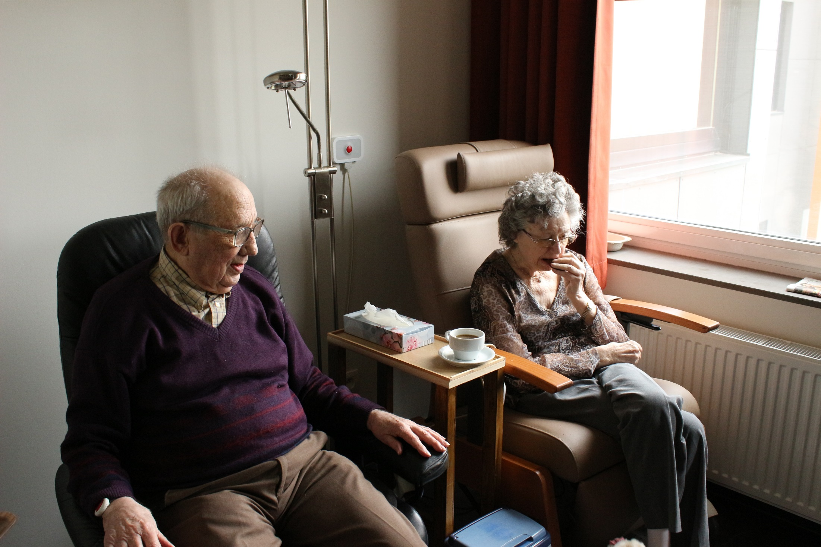
How would you describe the age of these people?
Photo by Elien Dumon on Unsplash

Slide 17
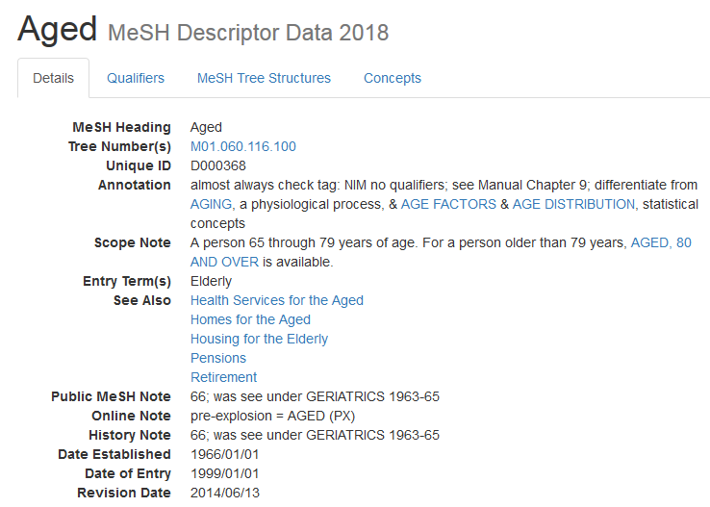
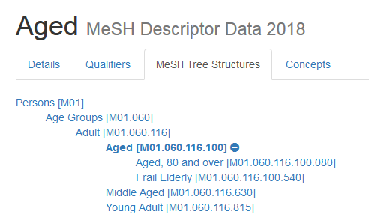
https://meshb.nlm.nih.gov/record/ui?ui=D000368
Subject headings
Notes:
Subject headings are not just for systematic reviews, they go some way to ensuring that relevant papers are not missed. Arguably, they may also reduce geographical bias by retrieving articles with different spelling variations or articles from non-English language publications.
Subject headings
Controlled vocabulary
Often hierarchical
Increase the sensitivity of a search
Are database-specific
Some databases include sub-headings of the subject headings

Slide 18
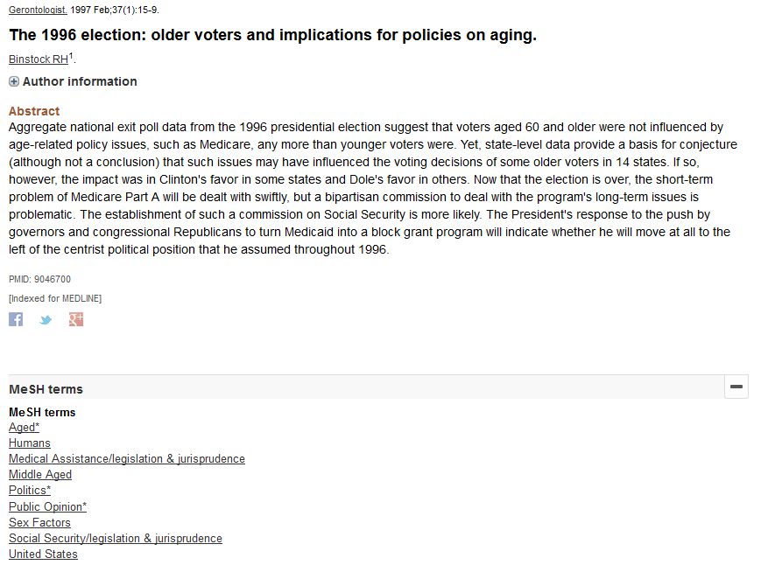
https://www.ncbi.nlm.nih.gov/pubmed/9046700
Subject headings
Notes:
Subject headings are not just for systematic reviews, they go some way to ensuring that relevant papers are not missed. Arguably, they may also reduce geographical bias by retrieving articles with different spelling variations or articles from non-English language publications.

Slide 19
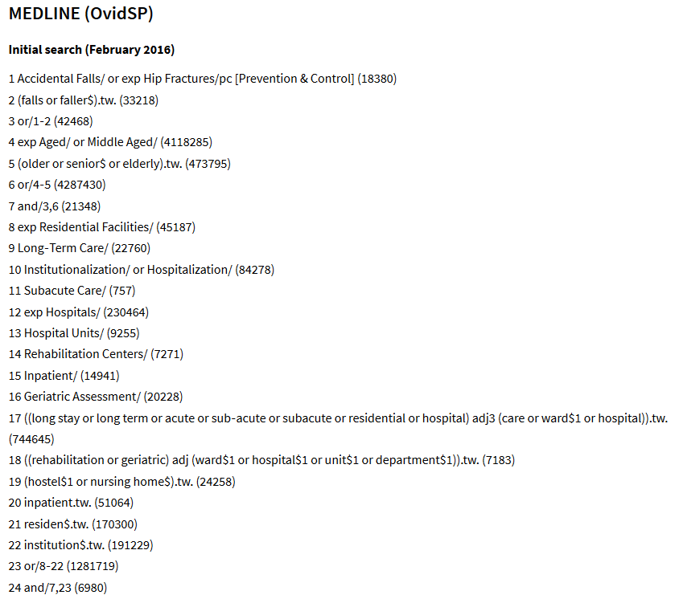
Cameron, ID, Dyer, SM, Panagoda, CE, et al. (2018) Interventions for preventing falls in older people in care facilities and hospitals. Cochrane Database of Systematic Reviews: https://www.cochranelibrary.com/cdsr/doi/10.1002/14651858.CD005465.pub4
Advanced search techniques

Slide 20
How do you find the right words?
Previously identified literature
Language used in titles and abstracts
How literature is indexed [with subject headings] in databases
These articles also act as signals for your search strategy – not retrieving them and your search might be too precise, you might not be using the right words or subject headings, or simply looking in the wrong place
Text mining
PubMed PubReMiner: text mines PubMed
MeSH on Demand: identifies MeSH headings & articles from PubMed
The National Centre for Text Mining
The right words and subject headings

Slide 21
As an illustration, here is an annotated Ovid Medline search from Elsner B, Kugler J, Pohl M, Mehrholz J. Transcranial direct current stimulation (tDCS) for improving aphasia in patients with aphasia after stroke. Cochrane Database of Systematic Reviews 2015, Issue 5. Art. No.: CD009760. DOI: 10.1002/14651858.CD009760.pub3.
exp aphasia/
language disorders/ or speech disorders/ or anomia/
speech-language pathology/ or exp "rehabilitation of speech and language disorders"/
(aphasi$ or dysphasi$ or anomia or anomic).tw.
((speech or language or linguistic) adj5 (disorder$ or impair$ or problem$ or dysfunction)).tw.
((speech or language or linguistic) adj5 (therap$ or train$ or rehabilitat$ or treat$ or remediat$ or intervention$ or pathol$)).tw.
or/1-6
Electric Stimulation Therapy/
Electric Stimulation/
Electrodes/
(transcranial adj5 direct current adj5 stimulation).tw.
(transcranial adj5 DC adj5 stimulation).tw.
(transcranial adj5 electric$ adj5 stimulation).tw.
(tDCS or A-tDCS or C-tDCS or S-tDCS or electrode$ or anode or anodes or anodal or cathode or cathodes or cathodal).tw.
or/8-14
7 and 15
exp animals/ not humans.sh.
16 not 17
Subject headings for Population concepts
Keywords for Population concepts
Population group
Subject headings for Intervention concepts
Keywords for Intervention concepts
Intervention group
Combined Population and Intervention groups
Animal/Human subject heading filter
Combined Population and Intervention groups limited to human studies
Annotated search

Slide 22
Grey literature
Conference proceedings and abstracts
Covered in Scopus, Web of Science and PapersFirst and ProceedingsFirst
Official publications
Government, NGOs, charities, professional bodies, etc.
Sources
Open Grey (EU)
National Technical Information Service (US)
NICE Evidence Search
Don’t underestimate grey literature. It is important to look beyond academic publications and to the professional use of information and knowledge.
Grey literature

Slide 23
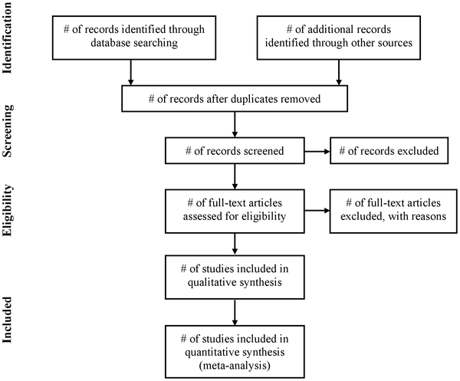
Reporting of systematic reviews
Moher D, Liberati A, Tetzlaff J, Altman DG, The PRISMA Group (2009) Preferred Reporting Items for Systematic Reviews and Meta-Analyses: The PRISMA Statement. PLOS Medicine 6(7): e1000097. https://doi.org/10.1371/journal.pmed.1000097
See also http://prisma-statement.org
Search methodologies

Slide 24
Feeling a bit like this?
Photo by Mishal Ibrahim on Unsplash

Slide 25
Resources and further guidance
Plenty of print and electronic books on SRs in the Library
Cochrane Handbook for Systematic Reviews of Interventions
Systematic Reviews: CRD’s guidance for undertaking reviews in health care
Joanna Briggs Institute Reviewer’s Manual
Searching for Studies: a Guide to Information Retrieval for Campbell systematic reviews
Preferred Reporting Items for Systematic Reviews and Meta-Analyses (PRISMA)
Managing and Coding References for Systematic Reviews and Scoping Reviews in EndNote
Systematic Review Toolbox
Resources and further guidance

Slide 26
Self-help resources
ArticleReach: https://bit.ly/2yqI20Y
Literature search and review in MVLS: https://edshare.gla.ac.uk/78/
Formulating a research question and structuring a literature search: https://edshare.gla.ac.uk/38
Developing literature search strategies: https://edshare.gla.ac.uk/76
Searching library databases: https://edshare.gla.ac.uk/278
Book an appointment to see me at: http://bit.ly/2lIaTGI
only after reviewing the self-help material, please!
Contact me
paul.cannon@glasgow.ac.uk
0141 330 6532
Self-help resources

Slide 27
http://www.gla.ac.uk/myglasgow/library/
Paul Cannon
College Librarian Medical, Veterinary & Life Sciences
paul.cannon@glasgow.ac.uk
@pcann_LIS
http://orcid.org/0000-0001-8721-1481
This work is licensed under a Creative Commons Attribution 4.0 International License

