Slide 1
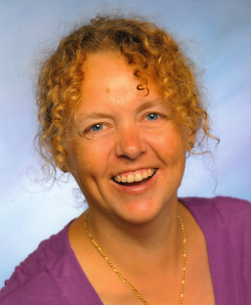
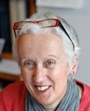
Preventing Plagiarism and the Role of Honour Codes
Nicole Brown
nicole.brown@ucl.ac.uk
@ncjbrown
www.nicole-brown.co.uk
Rosalind Janssen
r.janssen@ioe.ac.uk

Slide 2
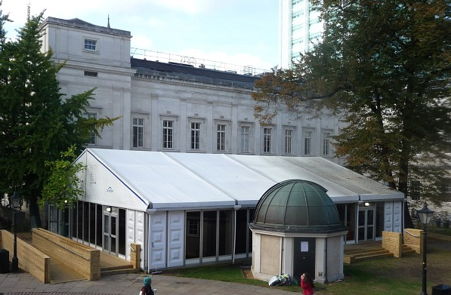
Session Outline
Introduction
What is plagiarism? – sorting activity
What is the impact of plagiarism? – real cases
How can I prevent plagiarism? – synthesising
How can I check for plagiarism? – turnitin practice
Integrity code
What do I know now? – summary sheet
Evaluation
Source: https://www.ucl.ac.uk/transforming-ucl/transitional-projects/managing-our-transition-and-activities-at-UCL/pavilion-front-quad

Slide 3
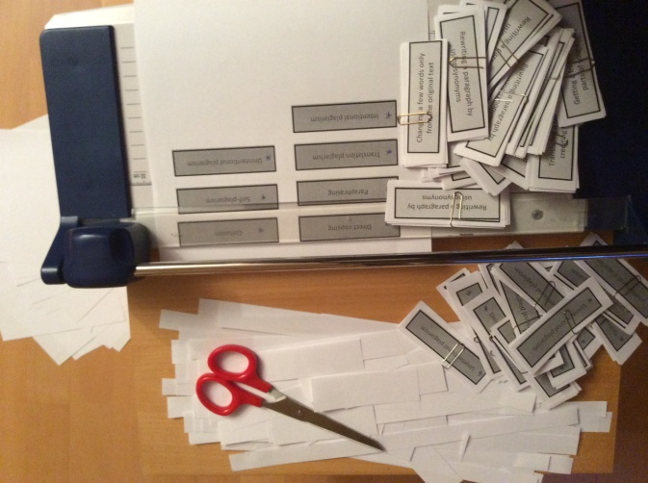
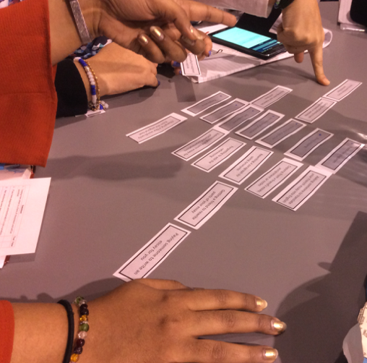
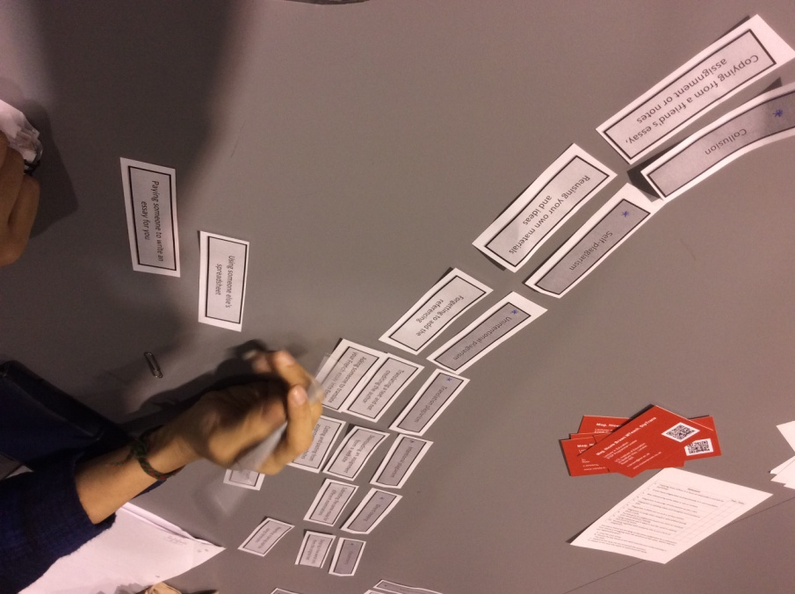
What is Plagiarism?

Slide 4
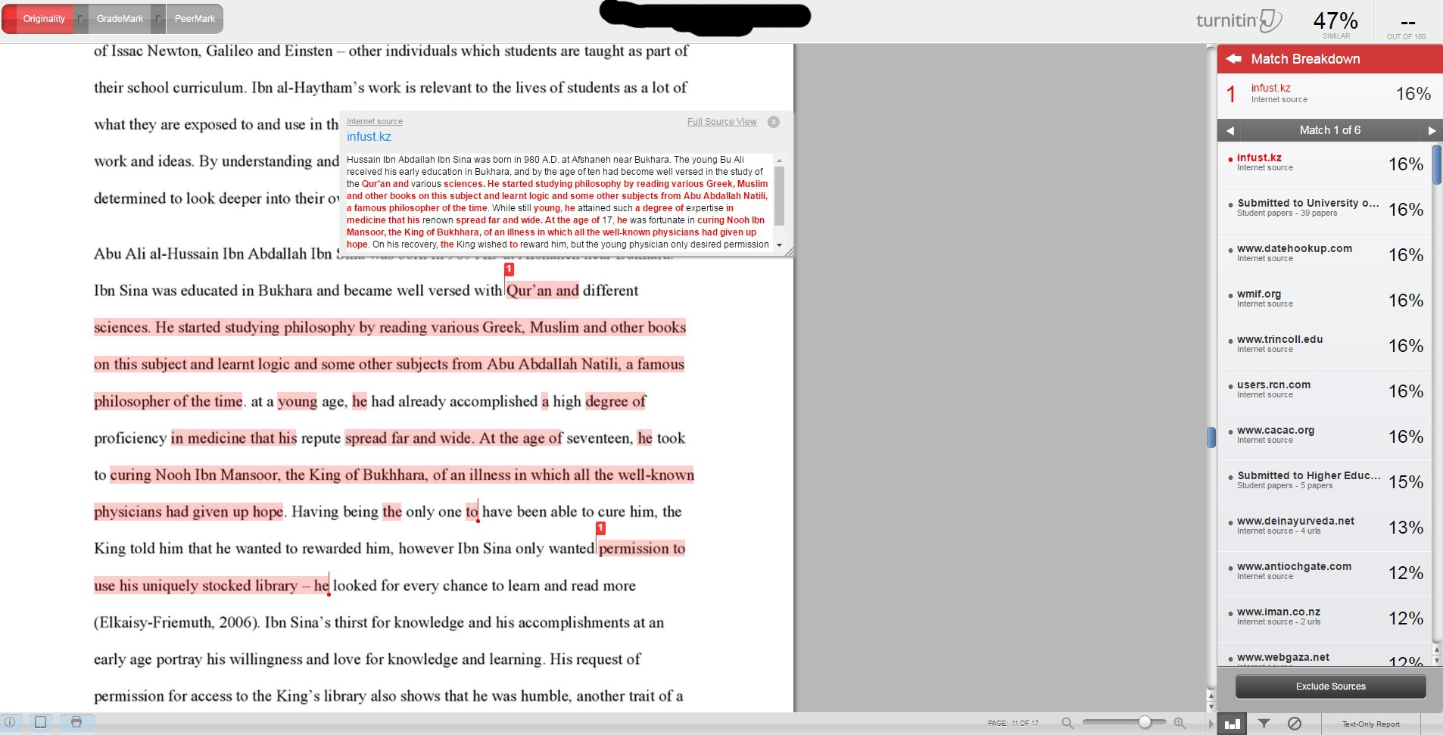
Case A

Slide 5
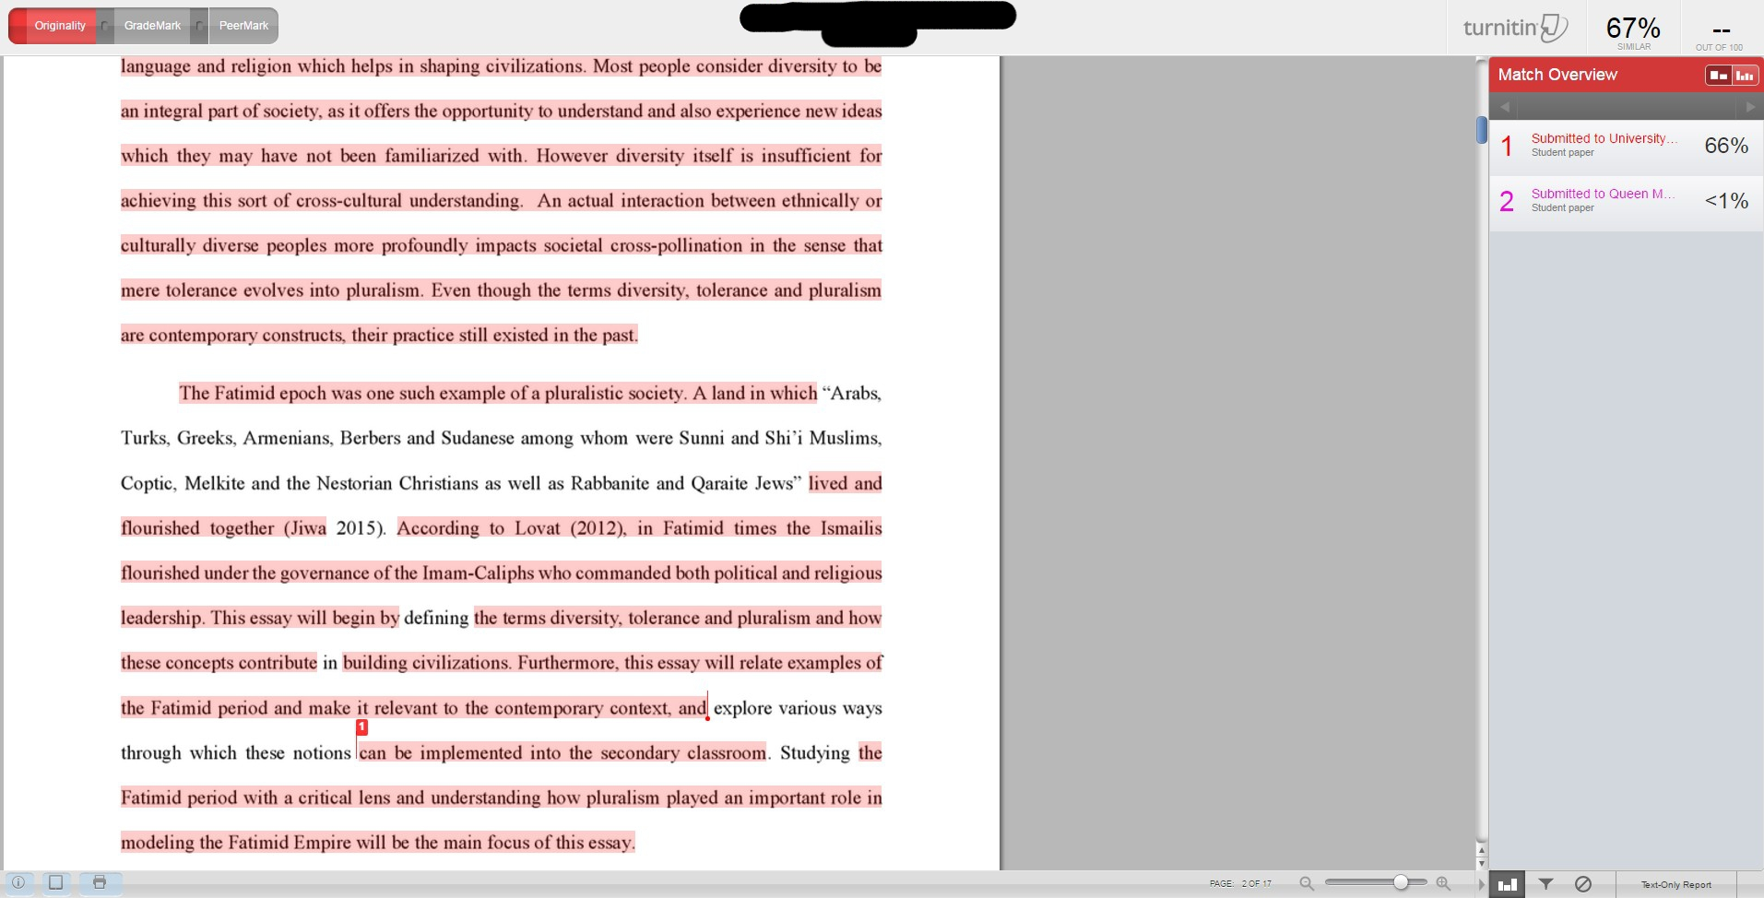
Case B

Slide 6
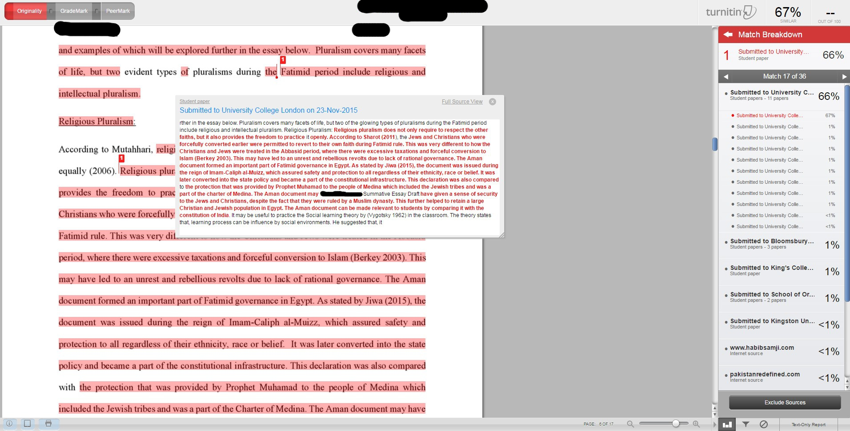
Case C

Slide 7
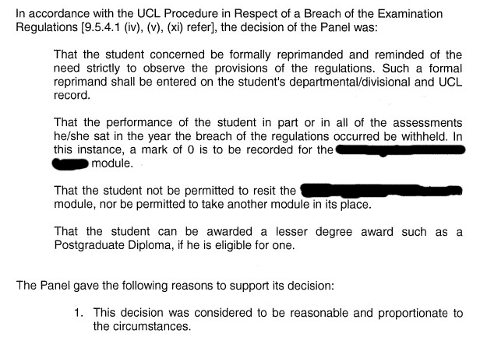
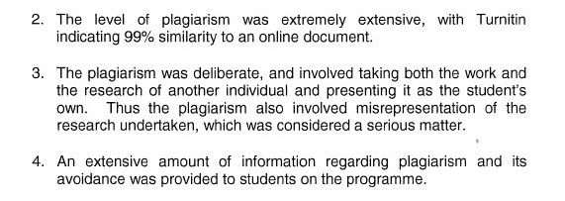
Case D

Slide 8
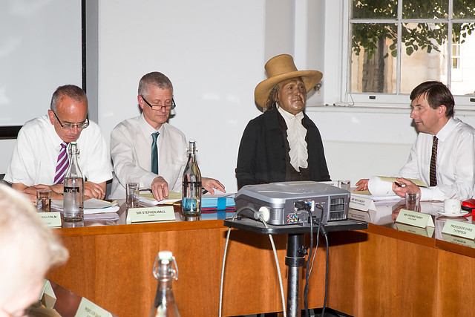
How can I prevent Plagiarism?
Jeremy Bentham
Jeremy Bentham was a philosopher and jurist whose doctrine of Utilitarianism has inspired many great thinkers. When he died in 1832 he left his body to be publicly dissected by his friend, Dr Thomas Southwood Smith, and asked that it be preserved as an ‘auto-icon’.
Sources: https://www.ucl.ac.uk/museums/jeremy-bentham
http://pimediaonline.co.uk/wp-content/uploads/2015/09/JB_CollegeCouncil_0164_c6ac1.jpg

Slide 9
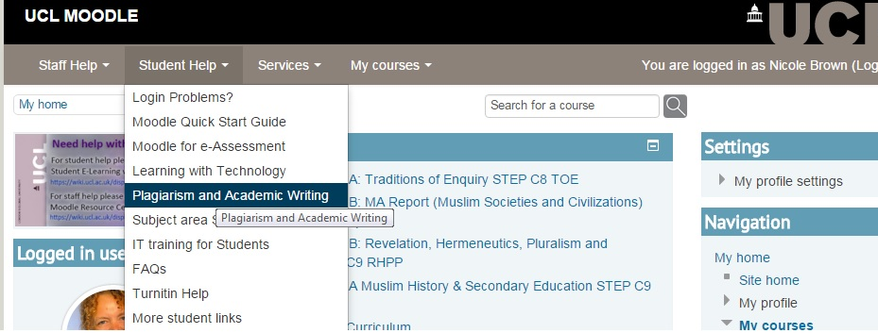
How can I Check for plagiarism?
Source: https://moodle.ucl.ac.uk/my/

Slide 10
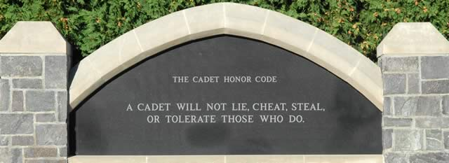
Integrity Code
Source: http://www.usma.edu/scpme/sitepages/honor.aspx

Slide 11
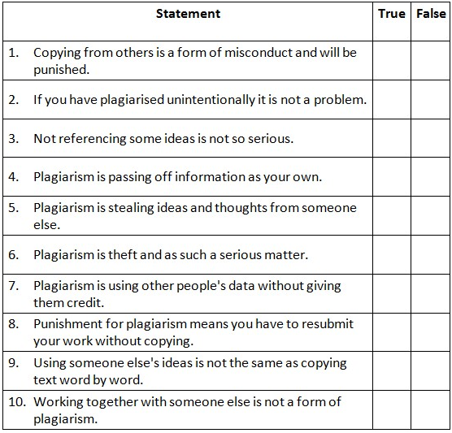
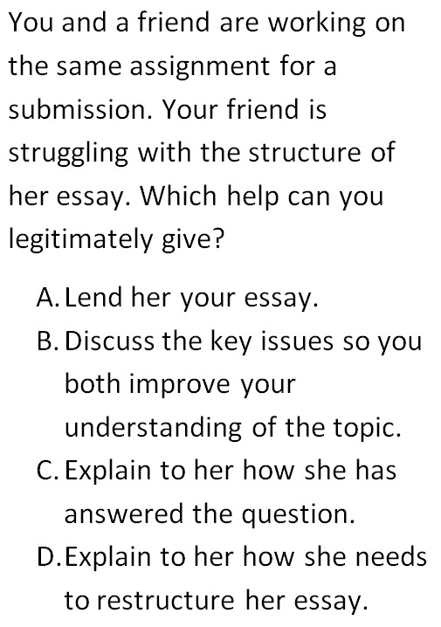
What do I know now?

Slide 12
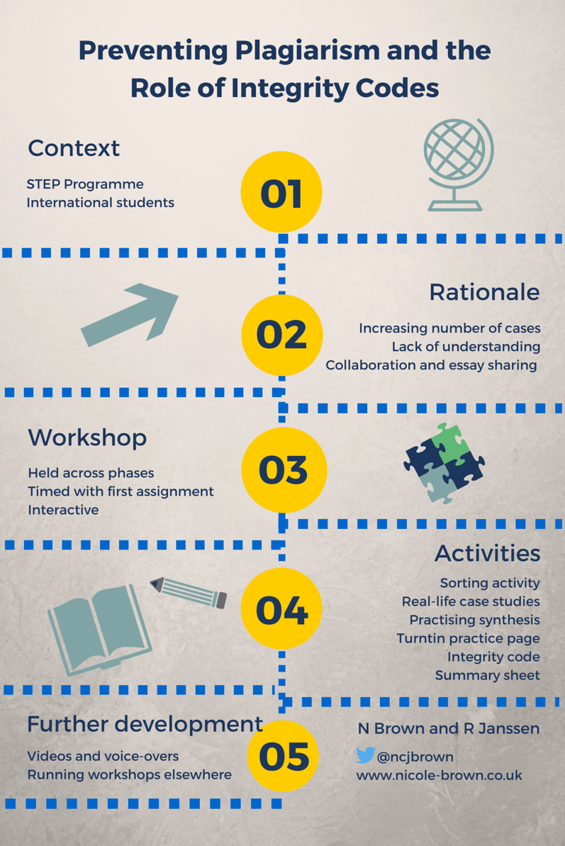
Evaluation
Impact
Further development

