Slide 1
Open.Ed
Supporting Open Education
at the
University of Edinburgh
Anima Celtica, The Evergreen Spring, 1895, ©University of Edinburgh, CC BY, Europeana / images.is.ed.ac.uk

Slide 2
University of Edinburgh Mission
Provide the highest quality learning and teaching environment for the greater wellbeing of our students
Make a significant, sustainable and socially responsible contribution to Scotland, the UK and the world, promoting health and economic and cultural wellbeing.
CC BY-NC-ND 2.0, kaysgeog, https://flic.kr/p/ZpbuTZ
Notes:
Open education can encompass many different things. These are just some of the aspects of open education

Slide 3
University of Edinburgh OER Vision
The history of the Edinburgh Settlement.
Excellent education and research collections.
Traditions of the Enlightenment and civic mission.
CC BY-NC-SA 2.0, Centre for Research Collections, https://flic.kr/p/snkn7o
Notes:
Open education can encompass many different things. These are just some of the aspects of open education

Slide 4
University of Edinburgh OER Policy
http://open.ed.ac.uk/about/
Approved by Learning and Teaching Committee in January 2016.
Informative and permissive.
Encourages staff and students to use, create and publish OERs to enhance the quality of the student experience.
Helps colleagues make informed decisions about creating and using OER.
CC BY-NC-SA 2.0, Centre for Research Collections, https://flic.kr/p/fcwNdT
Notes:
Open education can encompass many different things. These are just some of the aspects of open education

Slide 5
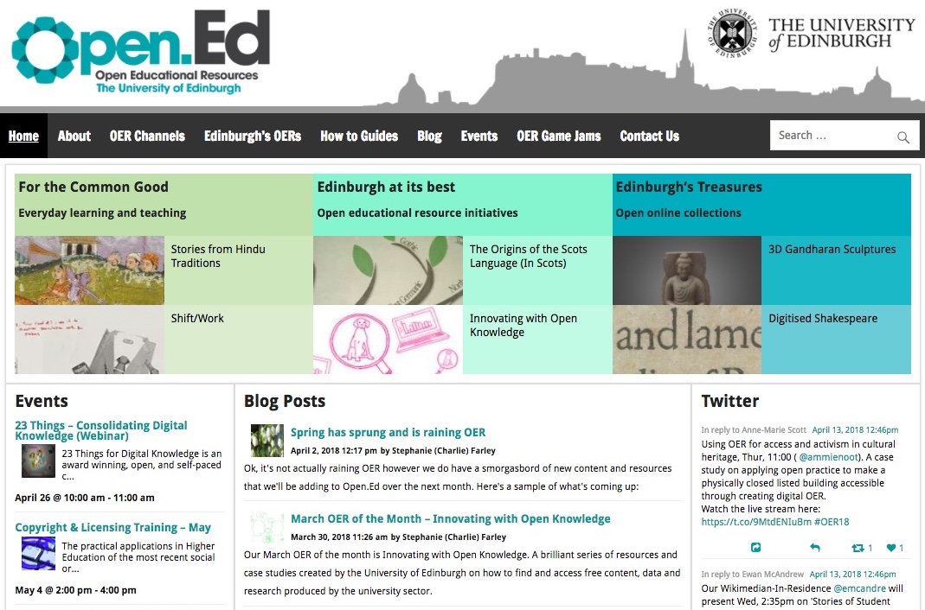
Open.Ed, https://open.ed.ac.uk/

Slide 6
Run workshops and digital skills development events.
Provide support to Schools and Colleges.
Provide advice and guidance on copyright and open licensing.
Run regular Copyright & Licensing training events with the Copyright Enquiries Service.

Slide 7
Support for strategic technology initiatives

Slide 8
Media Hopper Replay Training, https://www.ed.ac.uk/information-services/learning-technology/media-hopper-replay/training/preparing

Slide 9
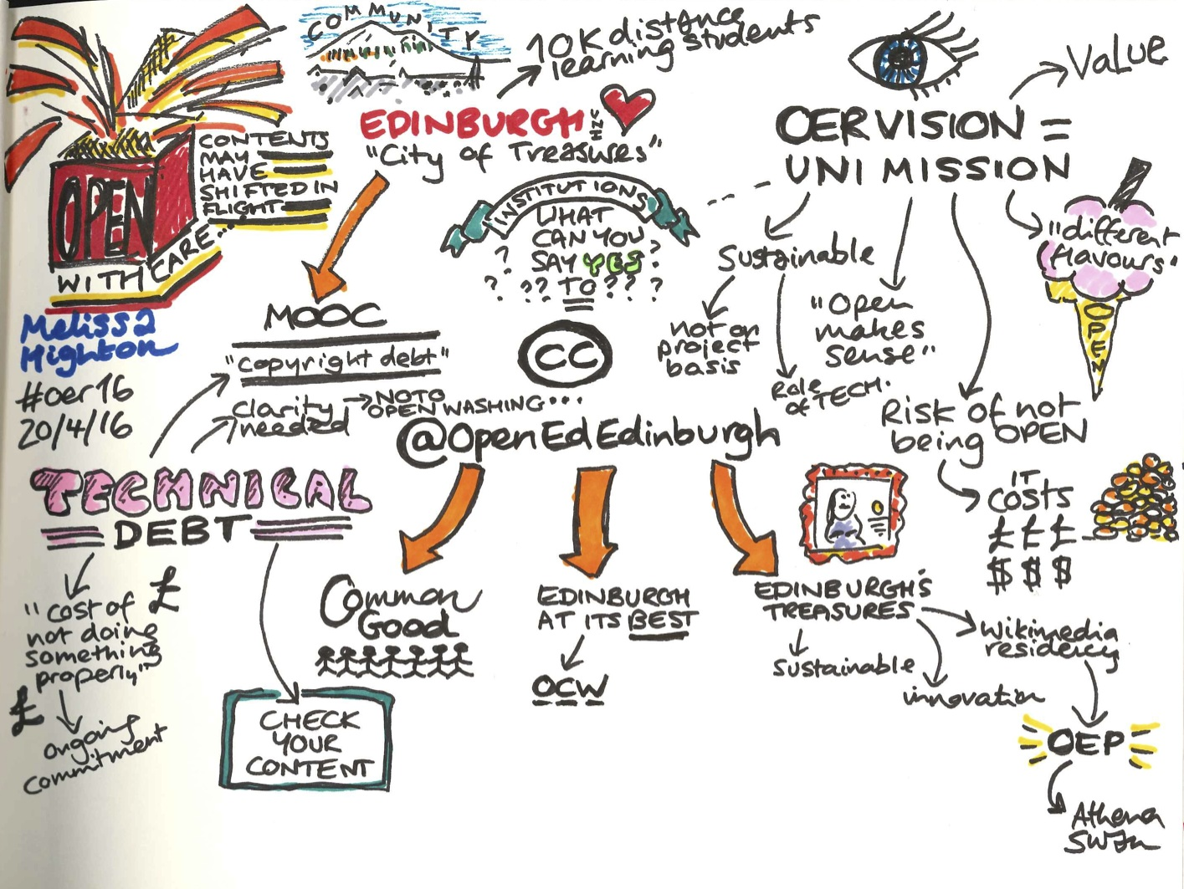
Open With Care, Melissa Highton, OER16 Keynote. CC BY 4.0, Beck Pitt

Slide 10
Academic Blogging

Slide 11
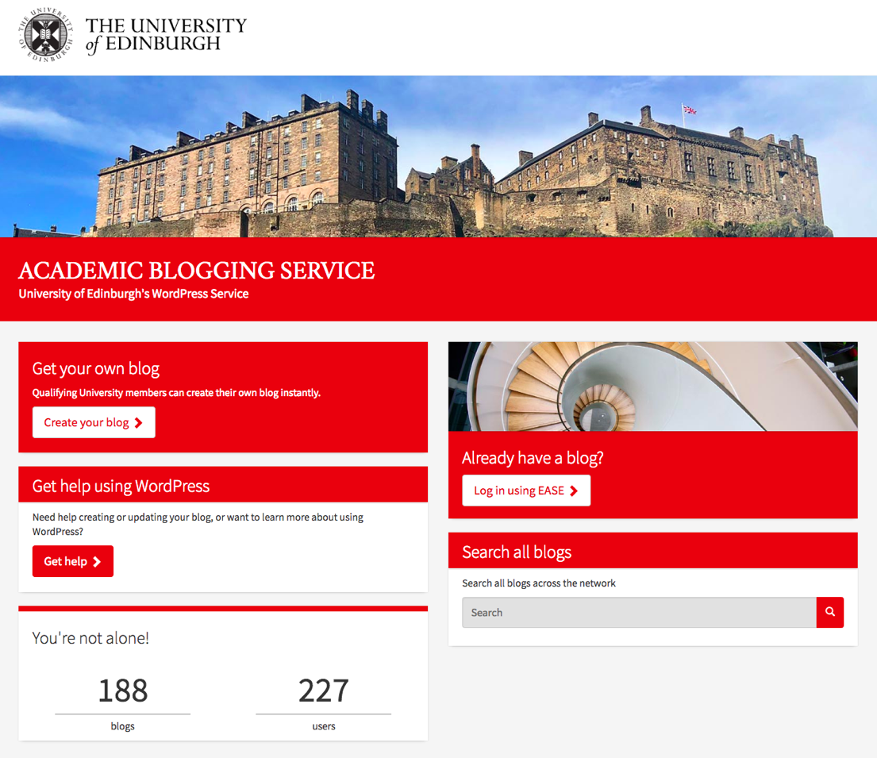
Academic Blogging Service, https://blogs.ed.ac.uk/

Slide 12
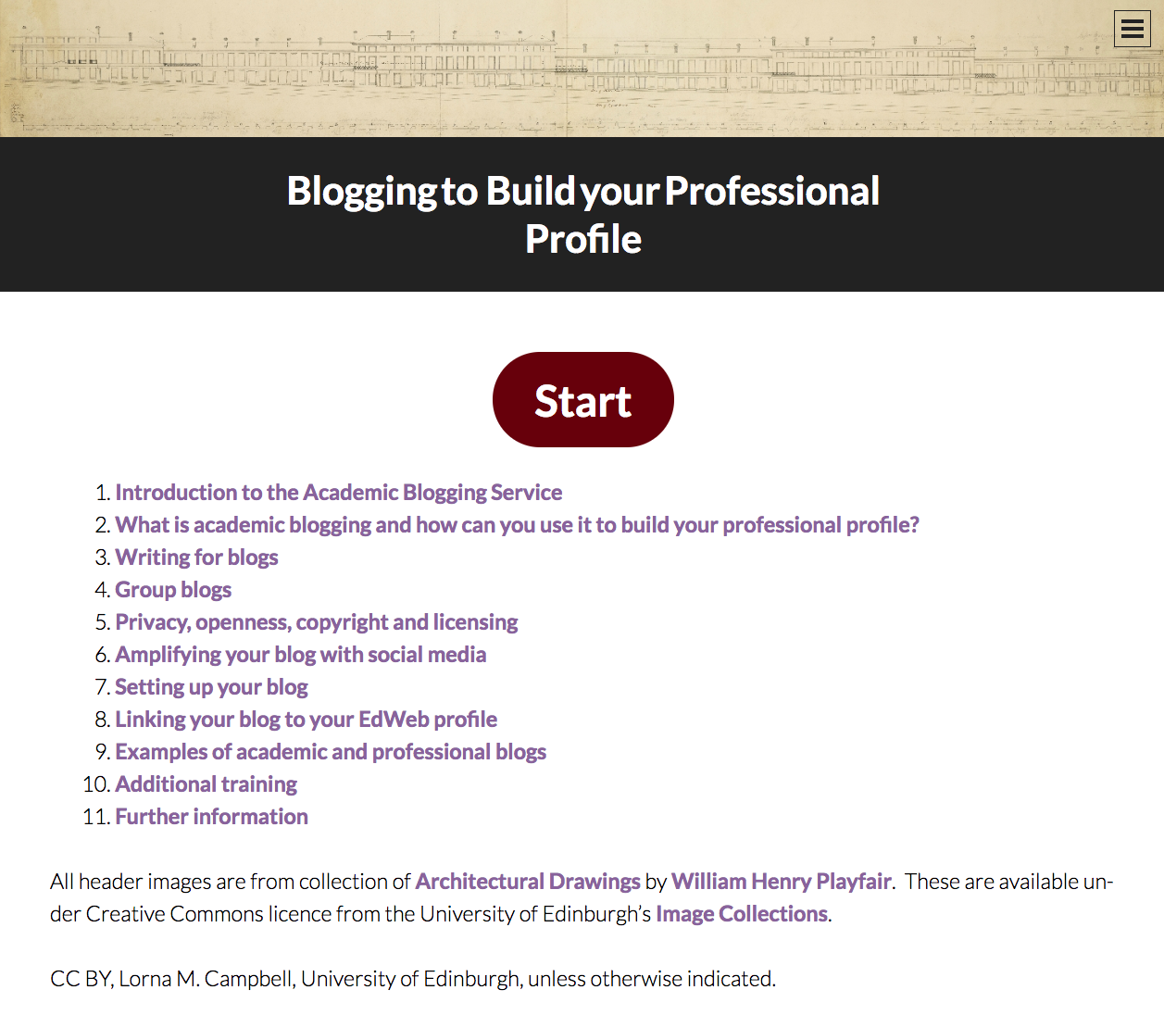
Blogging to Build your Professional Profle, https://thinking.is.ed.ac.uk/professional-blogging/

Slide 13
23 Things
for
Digital Knowledge

Slide 14
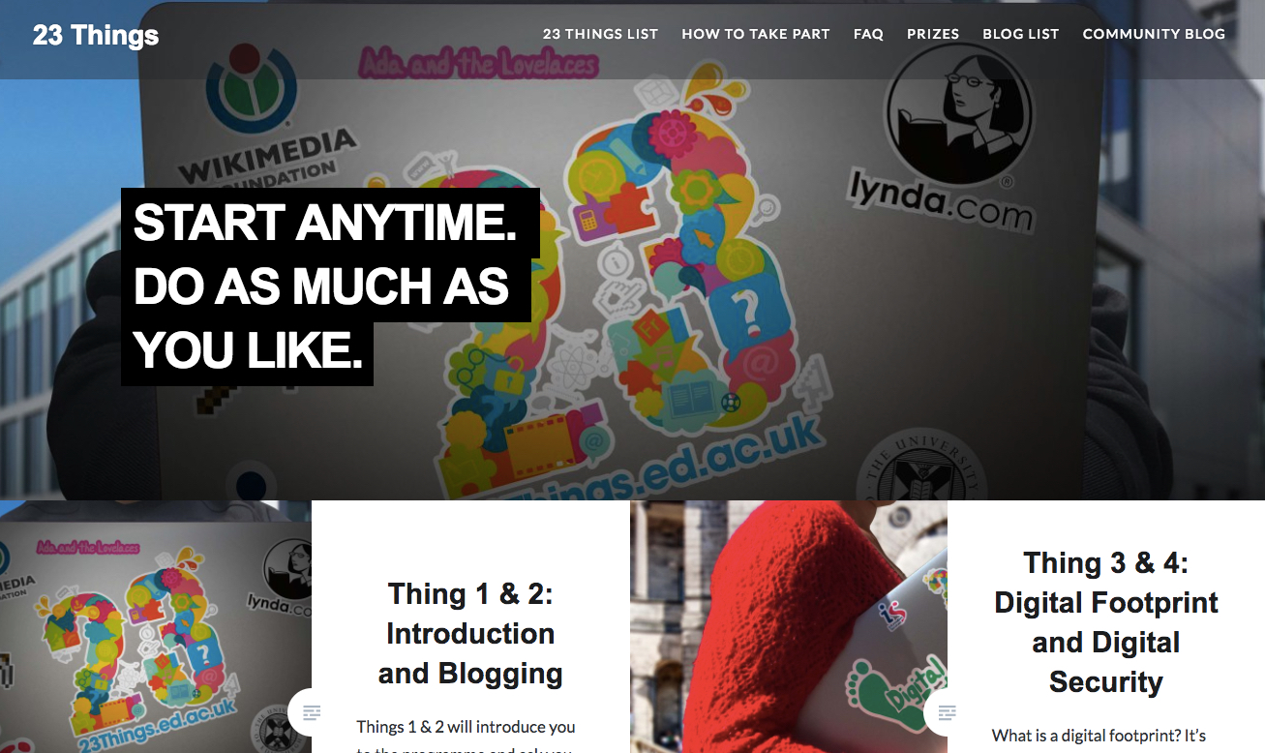
23 Things for Digital Knowledge, https://www.23things.ed.ac.uk/

Slide 15
Playful Engagement

Slide 16
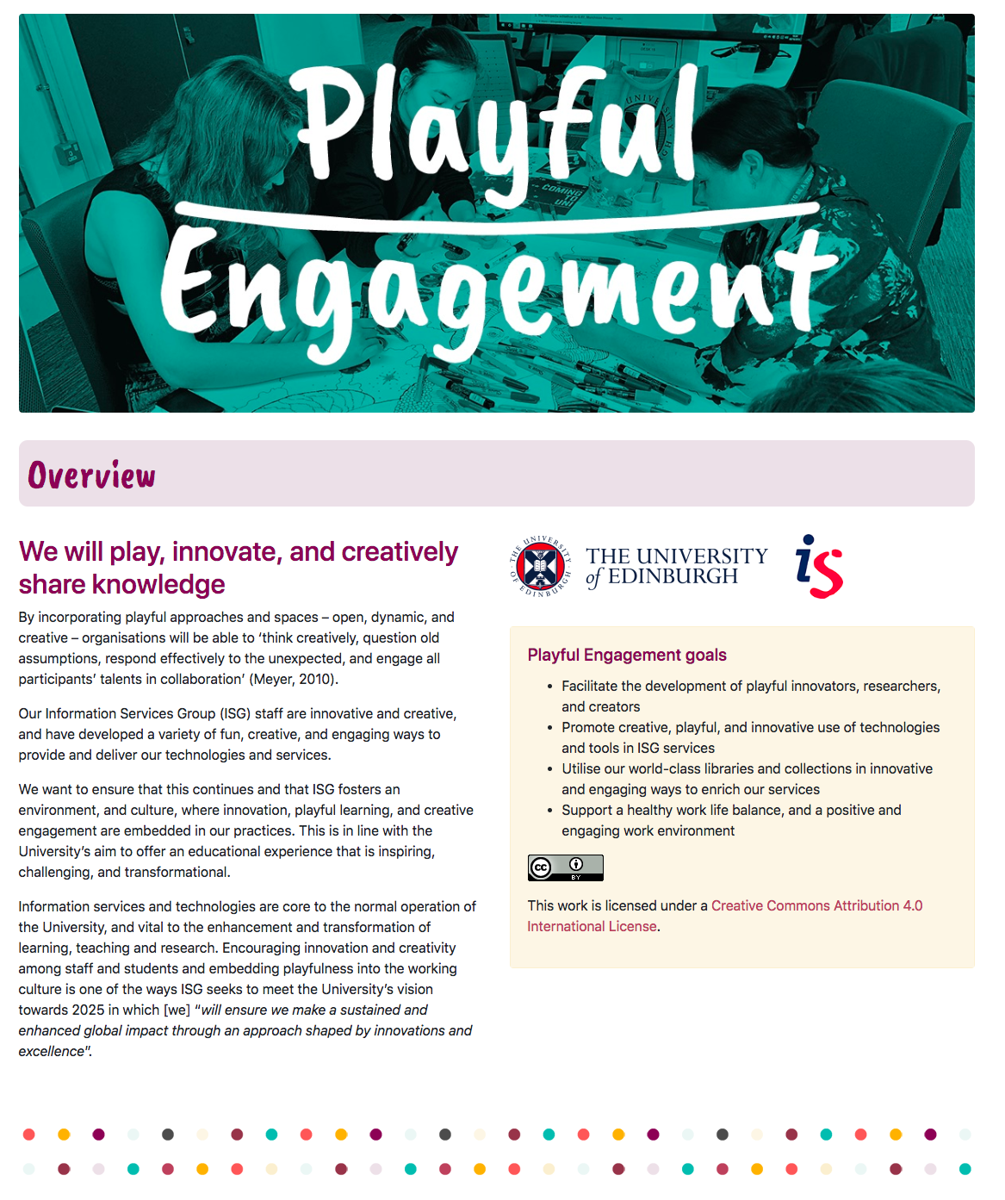
Playful Engagement,
https://thinking.is.ed.ac.uk/playful-engagement/

Slide 17
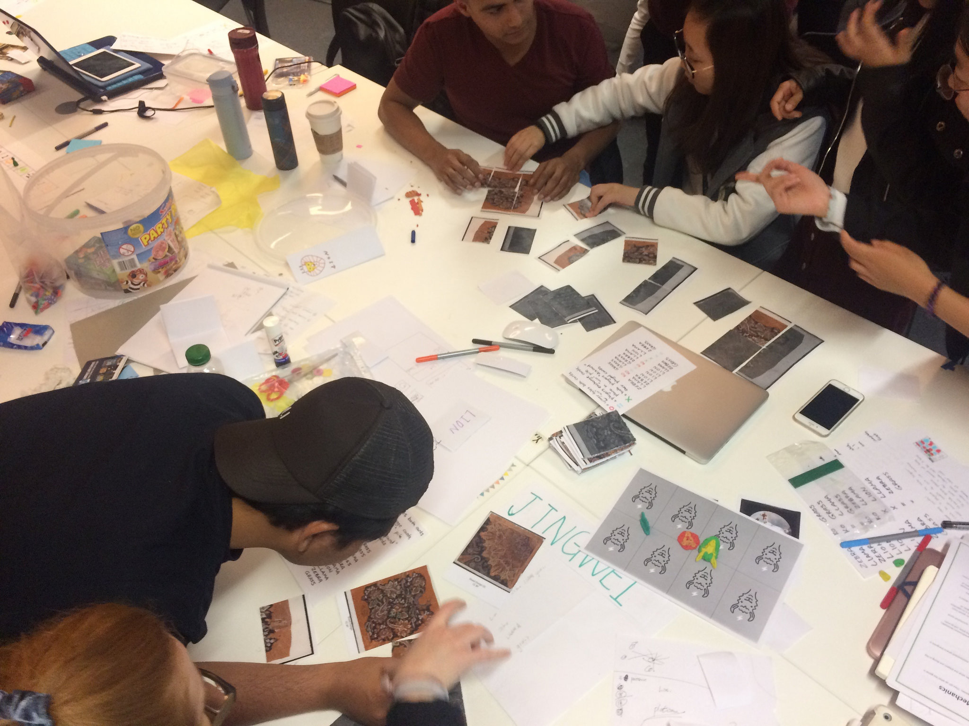
Board Game Jam, CC BY 2.0, Open.Ed, http://open.ed.ac.uk/run-your-own-board-game-jam/

Slide 18
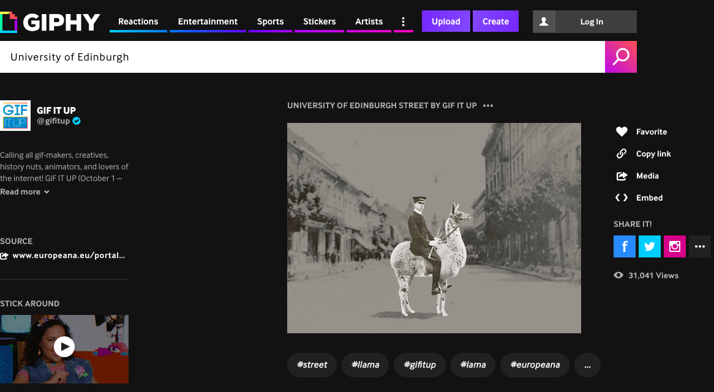
Gif It Up!, Open.Ed, http://open.ed.ac.uk/event/gif-it-up-introduction-to-gif-making-5/

Slide 19
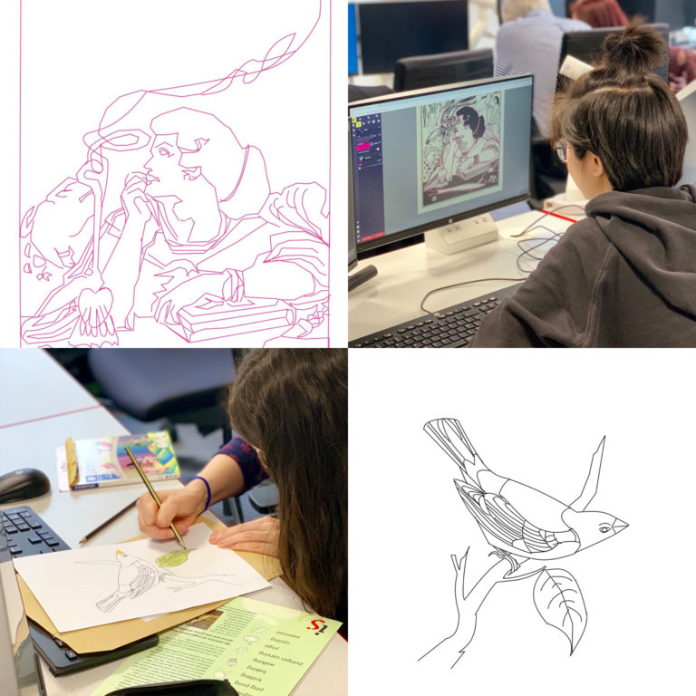
Adult Colouring Book Workshop,
https://blogs.ed.ac.uk/dlam/2019/02/27/reflections-on-our-adult-colouring-book-workshops/

Slide 20
OER Showcase

Slide 21
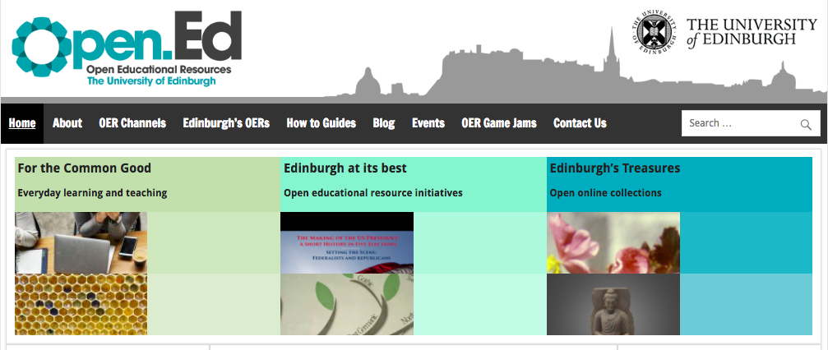
Open.Ed, http://open.ed.ac.uk/edinburghs-oers/

Slide 22
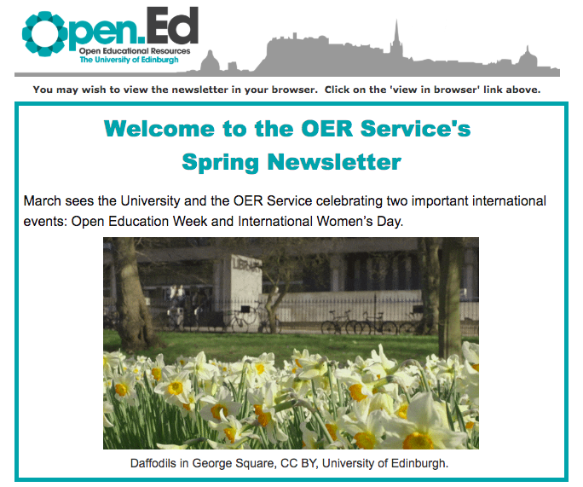
Open.Ed Newsletter, http://open.ed.ac.uk/newsletter/

Slide 23
MOOCs

Slide 24
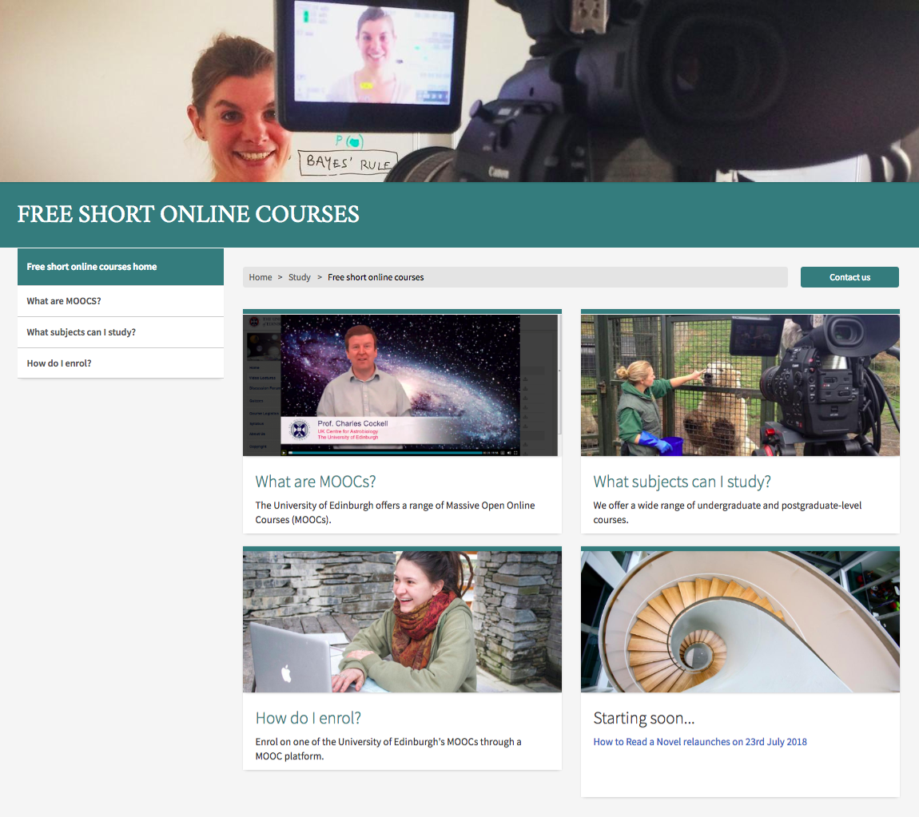
Edinburgh MOOCs, https://www.ed.ac.uk/studying/free-short-online-courses

Slide 25
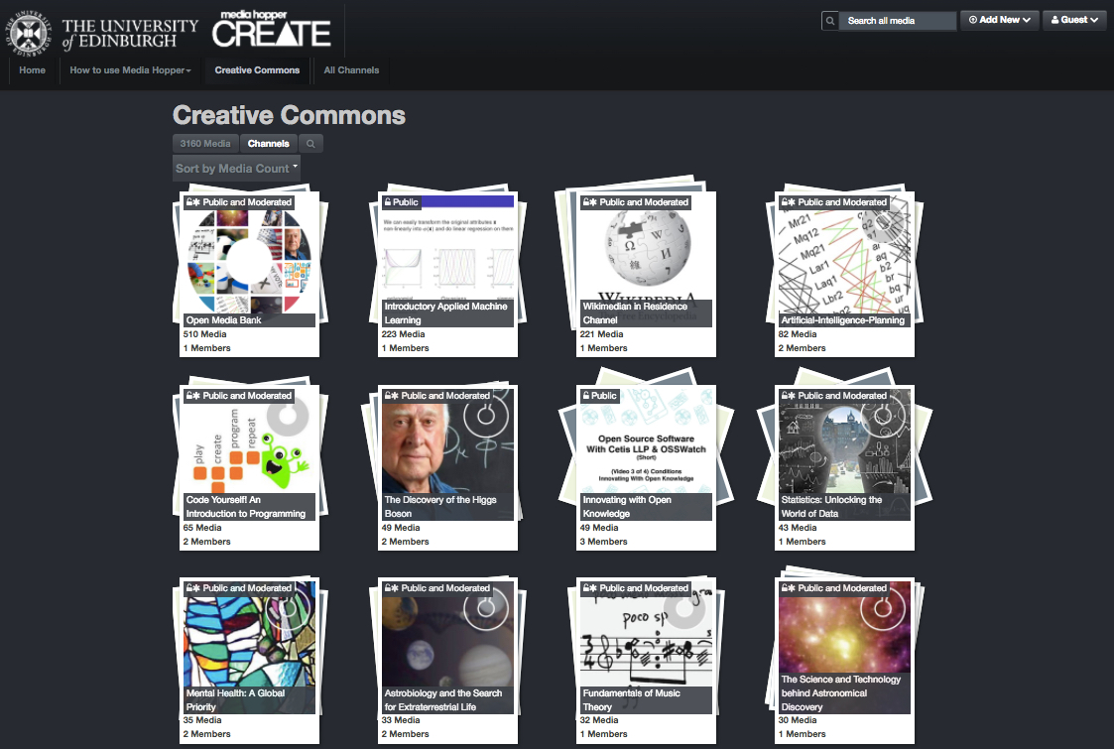
Media Hopper Create, https://media.ed.ac.uk/

Slide 26
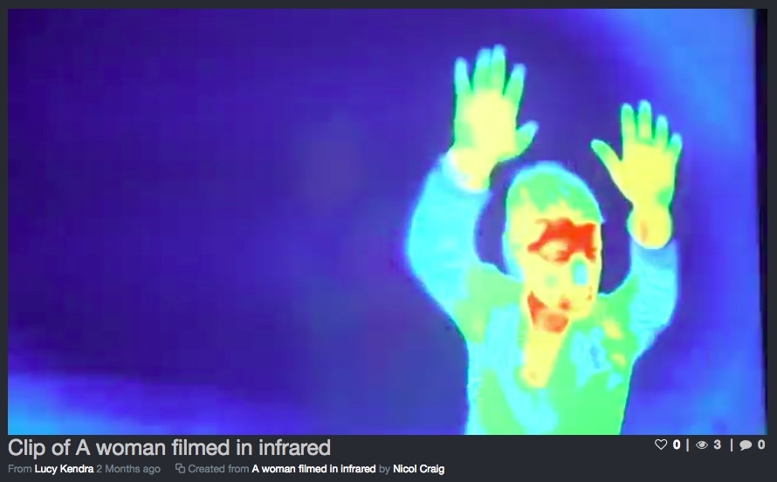
CC BY, University of Edinburgh, https://media.ed.ac.uk/media/Clip+of+A+woman+filmed+in+infrared/1_0z30cojk

Slide 27
Open Content Curation Interns

Slide 28
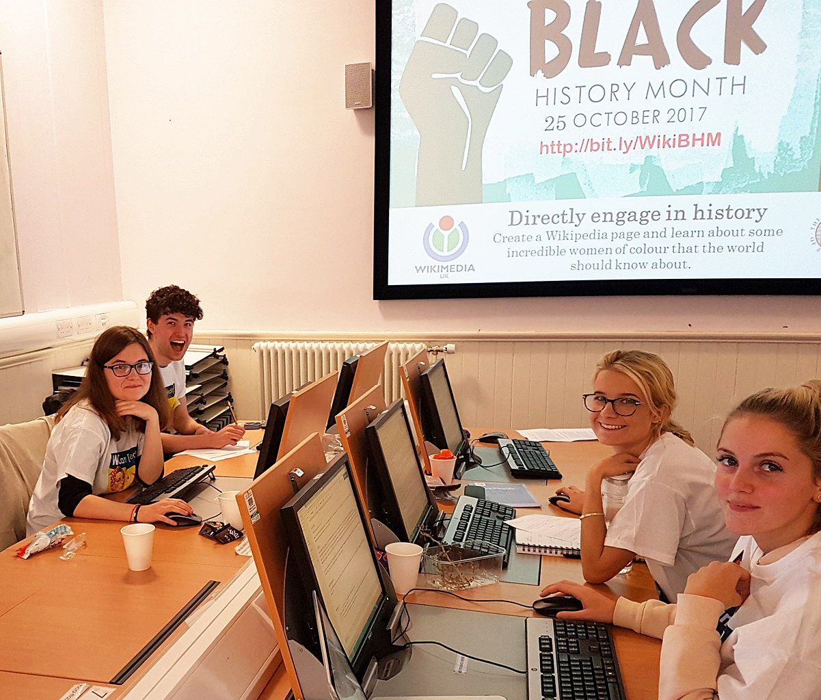
Open Content
Curation
Student Interns
Tomas Sanders, Open Content Curation Intern, CC BY, Lorna M. Campbell
Black History Month Wikipedia editathon, CC BY-SA 4.0, Stinglehammer,
Wikimedia Commons

Slide 29
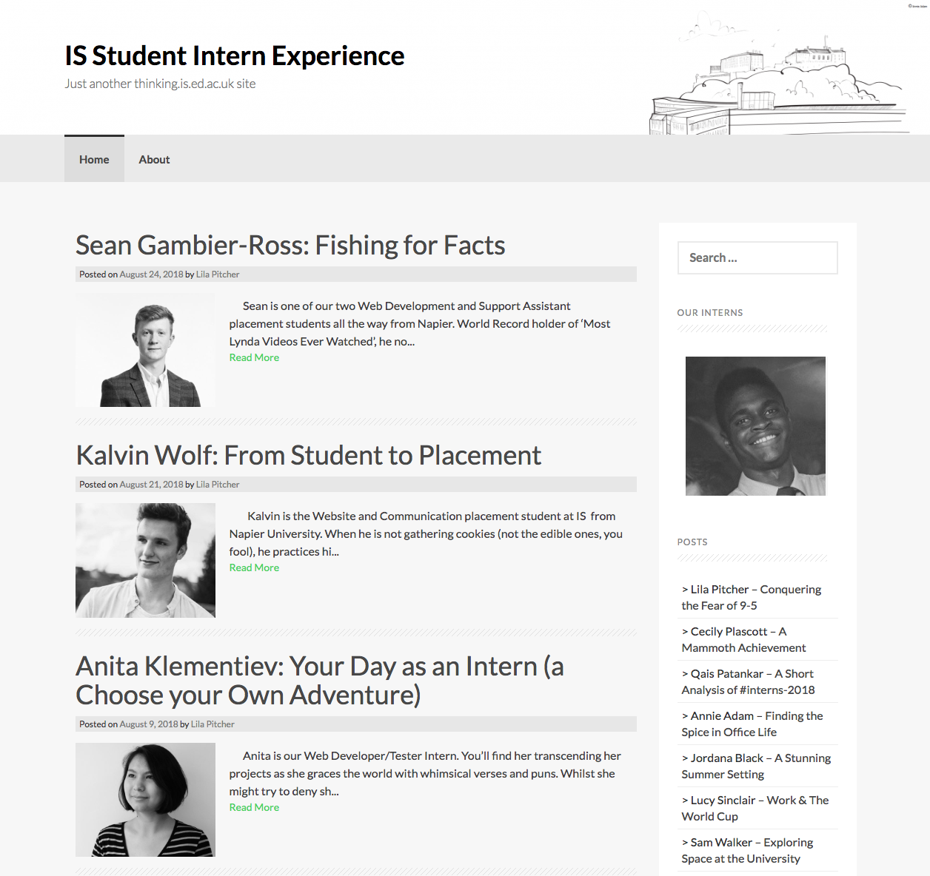
IS Student Intern Experience Blog, https://thinking.is.ed.ac.uk/intern/

Slide 30
Wikimedian
in
Residence
Notes:
Open education can encompass many different things. These are just some of the aspects of open education

Slide 31
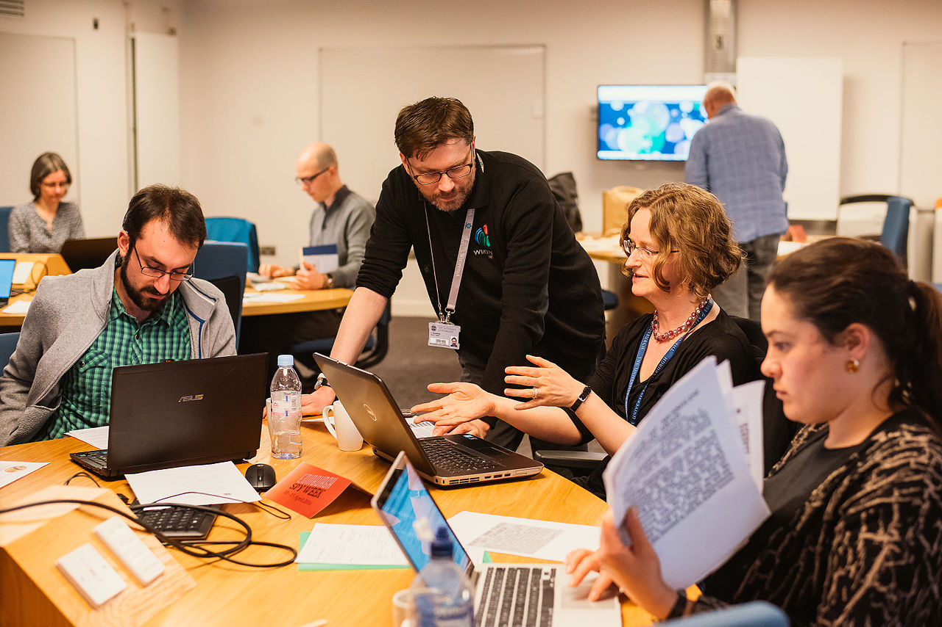
University of Edinburgh Wikipedia Editathon, CC BY-SA 4.0, Mihaela Bodlovic, https://commons.wikimedia.org/wiki/File:University_of_Edinburgh_Spy_Week_Wikipedia_edit-a-thon_02.jpg

Slide 32
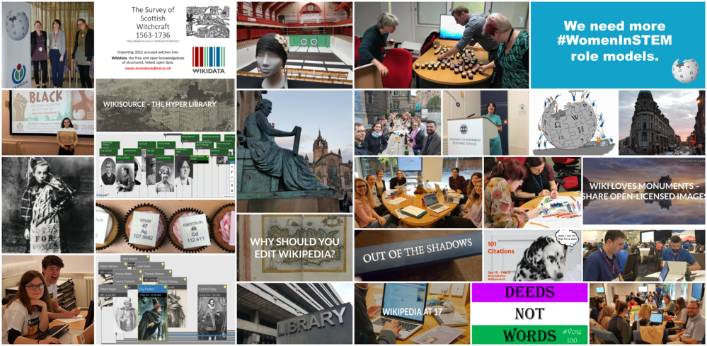
Wikimedian in Residence, https://en.wikipedia.org/wiki/Wikipedia:University_of_Edinburgh

Slide 33
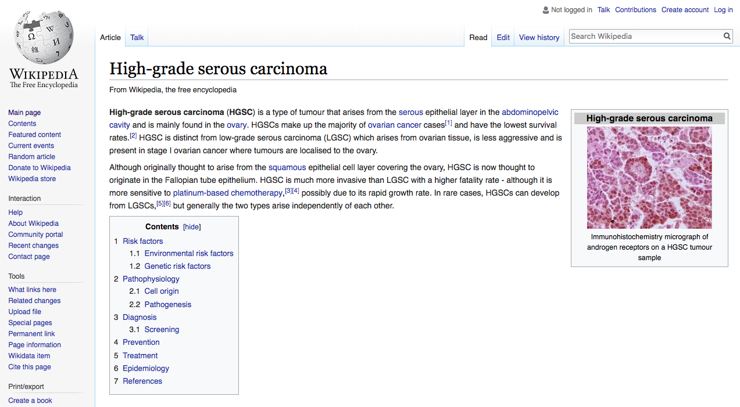
High-grade serous carcinoma, https://en.wikipedia.org/wiki/High-grade_serous_carcinoma

Slide 34
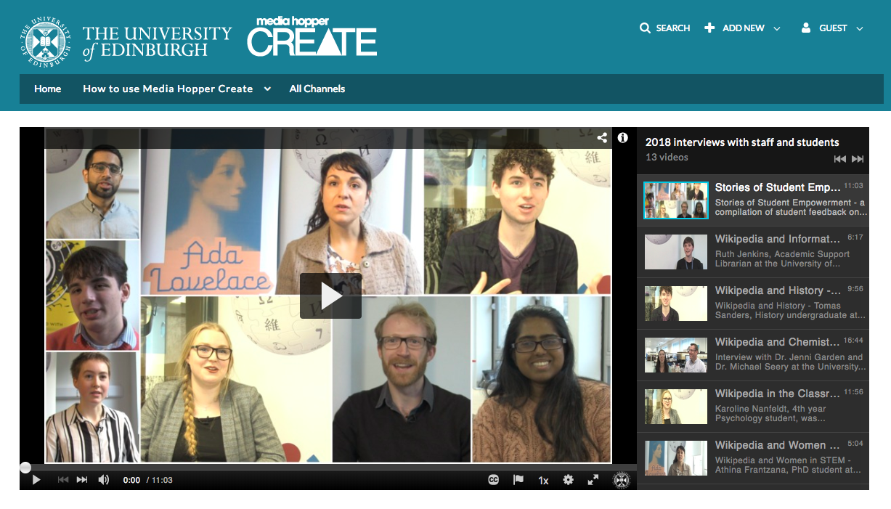
Stories of Student Empowerment: Student feedback on the Wikimedia Residency https://media.ed.ac.uk/playlist/dedicated/51020161/1_5ikxjzq6/1_prhg9j4t

Slide 35
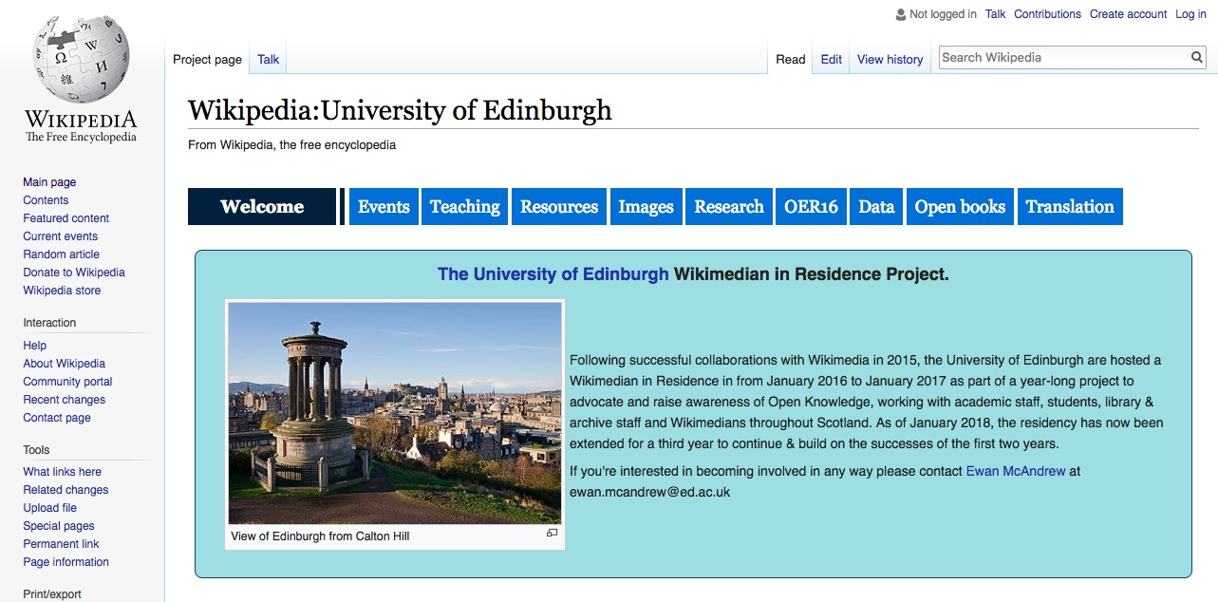
Wikimedia Residency, University of Edinburgh, https://en.wikipedia.org/wiki/Wikipedia:University_of_Edinburgh

Slide 36
Benefits of OER
Diversifies the curriculum.
Improves digital skills.
Engages students in co-creation.
Promotes the outputs of open research.
Foster creativity and playful learning.
Contributes to the development of open knowledge.
Enhances engagement with content and collections.
CC BY-NC-SA 2.0, Centre for Research Collections, https://flic.kr/p/ob6imX
Notes:
Open education can encompass many different things. These are just some of the aspects of open education

Slide 37
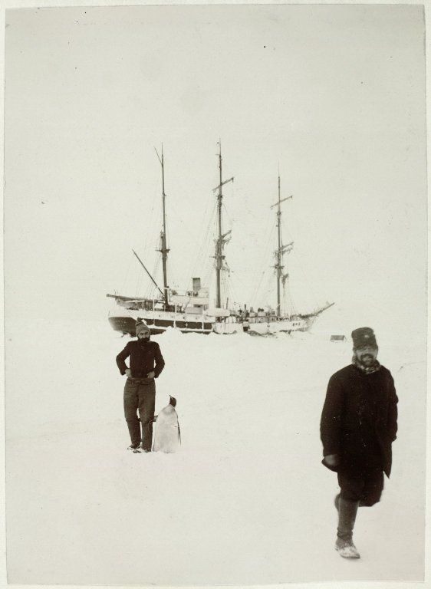
Contact
Lorna M. Campbell
lorna.m.campbell@ed.ac.uk
@LornaMCampbell
Open.Ed
open.ed@ed.ac.uk
http://open.ed.ac.uk/
@OpenEdEdinburgh
Charlie Farley
stephanie.farley@ed.ac.uk
@SFarley_Charlie
CC BY Lorna M. Campbell, University of Edinburgh, unless otherwise indicated.
CC BY-NC-SA 2.0, Centre for Research Collections, https://flic.kr/p/fcwCzM

