Slide 1

Open Education as part of the Open Science agenda
Dr Paul Ayris
Pro-Vice-Provost (UCL Library Services)
Co-Chair, LERU community of Chief Information Officers (League of European Research Universities)
Chair, Jisc Content Strategy Group
e-mail: p.ayris@ucl.ac.uk

Slide 2
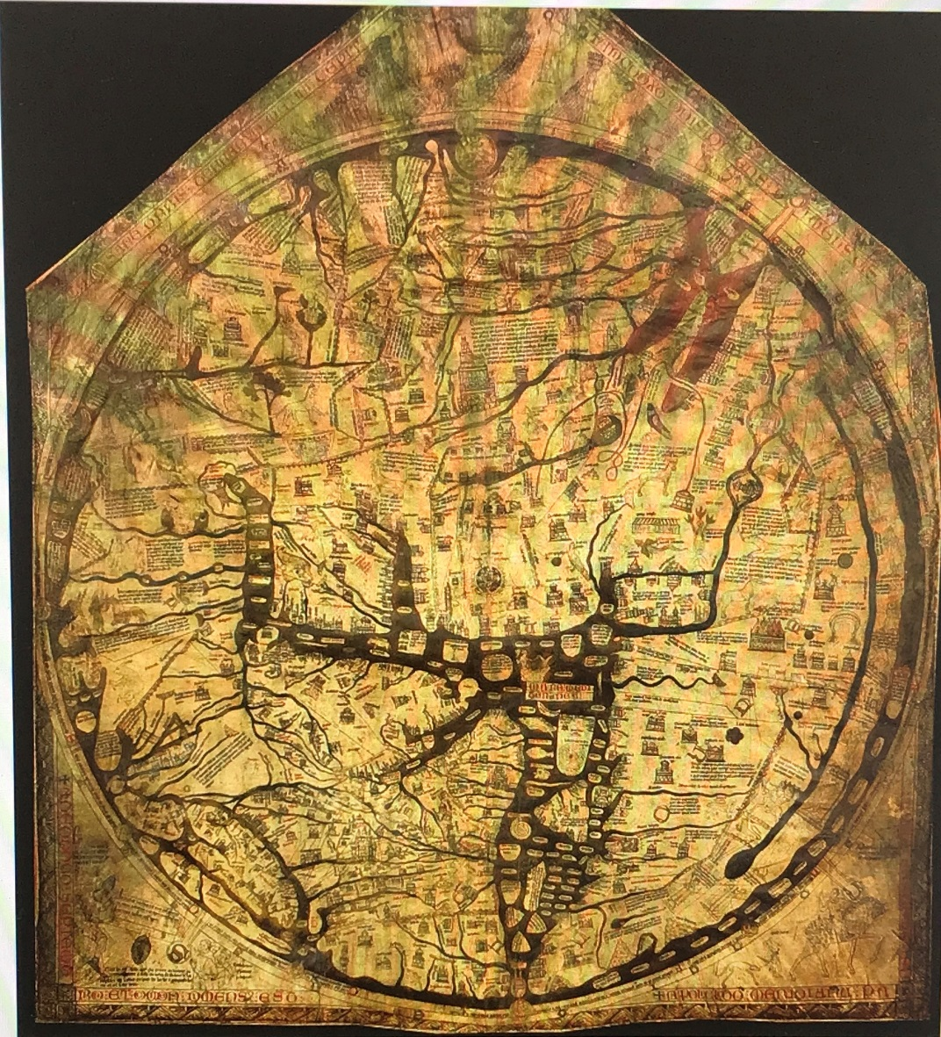
A pan-European Roadmap for Open Science?
Hereford ‘Mappa Mundi’
Largest surviving medieval map
A theological statement
Drawn in Lincoln c. 1300
But Africa is called Europe and vice versa…
England

Slide 3
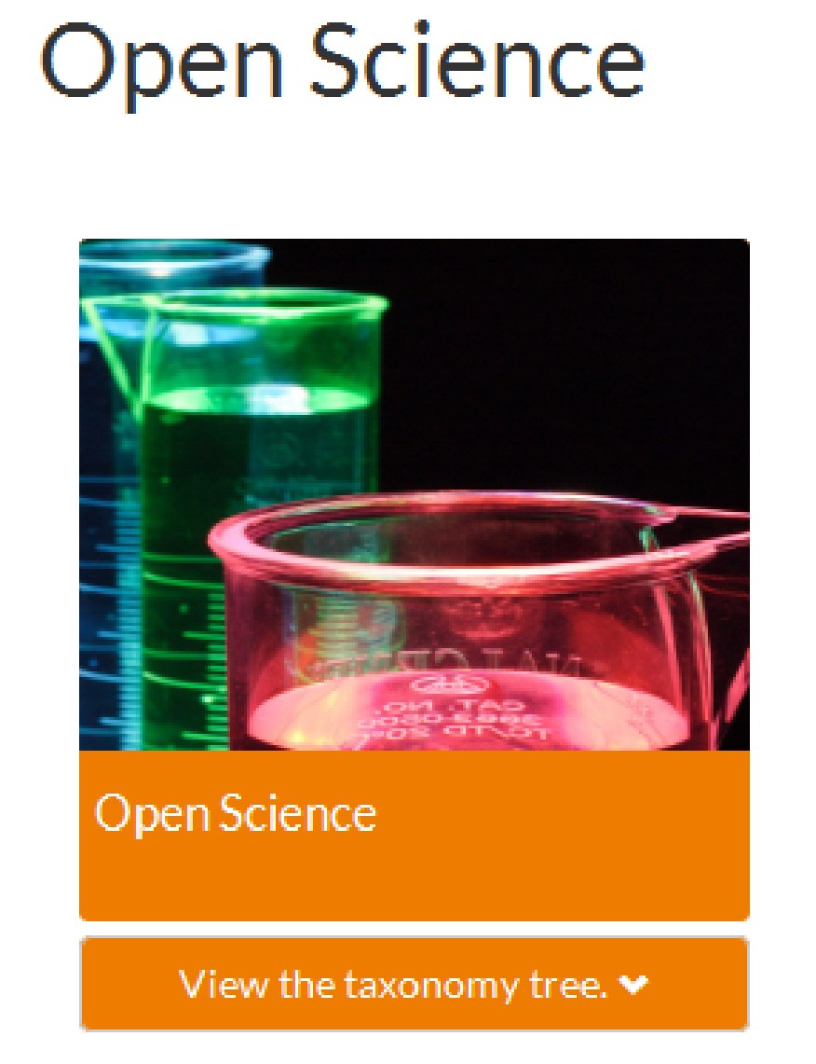
A Statement which offers a pan-European Roadmap?
Hereford ‘Mappa Mundi’
Largest surviving medieval map
A theological statement
Drawn in Lincoln c. 1300
But Africa is called Europe and vice versa…

Slide 4
The pillars of Open Science
Future of Scholarly Communication
EOSC (European Open Science Cloud)
FAIR Data
Skills
Research Integrity
Rewards
Altmetrics
Citizen Science

Slide 5
The pillars of Open Science
Future of Scholarly Communication
EOSC (European Open Science Cloud)
FAIR Data
Education and Skills
Research Integrity
Rewards
Altmetrics
Citizen Science

Slide 6
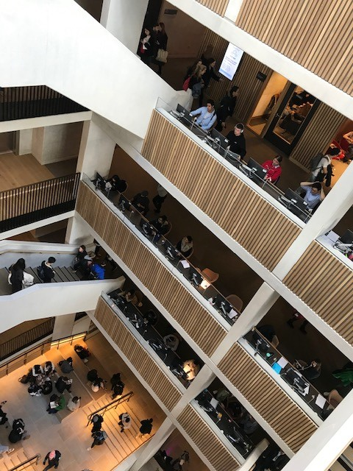
Education as a pillar of Open Science
Education and Skills development are core parts of Open Science
Openness is good for educational practice as it facilitates reproducibility and the validation of assertions/results
Users can access materials any time, any place, anywhere
UCL Student Centre, opened 18/2/19

Slide 7
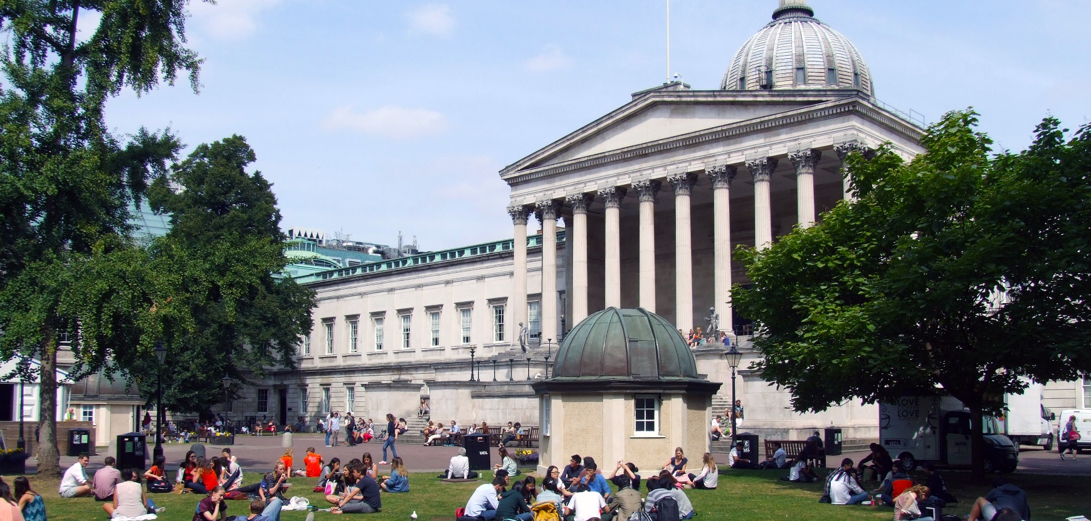
So, let’s hear more from our speakers

