Slide 1

Search, share, reuse, collaborate!
Repositories and metadata for open educational resources
Leo Havemann
Digital Education Advisor
UCL ISD
@leohavemann
#Learnhack 5.0
5 November 2018
Notes:
Troubling concepts: binary logics in educational technology and openness

Slide 2

Metadata?
Yes I am going to talk about metadata for OER as advertised, but before I launch straight into that, first, a story.
A story that takes us back to the 1990s … about Learning Objects!
And Standardised Metadata, e.g. Dublin Core!

Slide 3
OER vs Learning Objects
OER can be ‘big’ (e.g. textbook) or ‘little’ (e.g. photo, sound file, slides), and any kind of format
No particular specialist knowledge is needed for OER creation
OER should be freely available (online) with an open license (allowing use and adaptation)

Slide 4
Why Open Educational Resources?
At the heart of the movement toward Open Educational Resources is the simple and powerful idea that the world's knowledge is a public good and that technology in general and the Worldwide Web in particular provide an extraordinary opportunity for everyone to share, use, and reuse it.
Smith & Casserly, 2006

Slide 5
Why upload resources into repositories?
The purpose of Repositories for OER is to support educators in searching for content, sharing their own resources, reusing and evaluating materials, and adapting materials made by or in collaboration with other members of the community.
Search, share, reuse, collaborate.

Slide 6
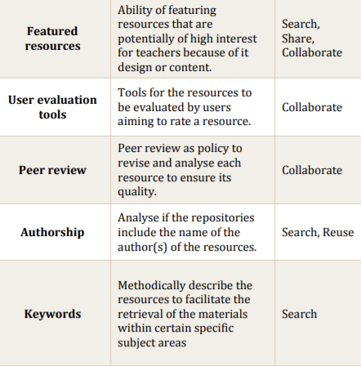
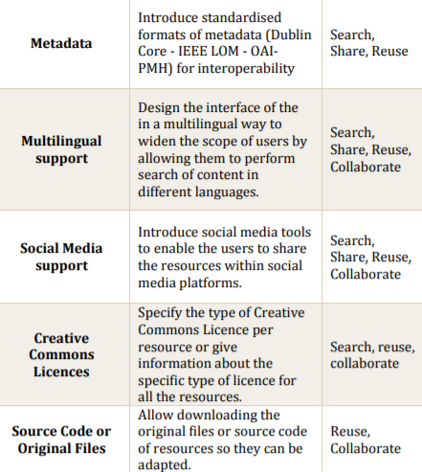
Quality indicators for repositories - how many kinds of metadata?

Slide 7
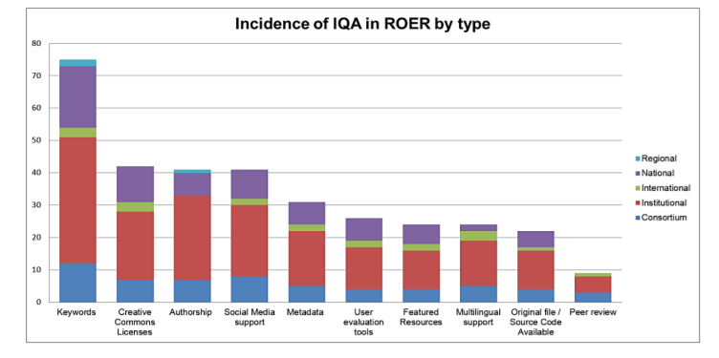
Current repositories: work in progress

Slide 8
Why have metadata - of whatever kind?
This should help people to find a resource but also, to understand the context or purpose a resource was created for, in order to help them use, repurpose, and remix it in new ways.

